Slide 1
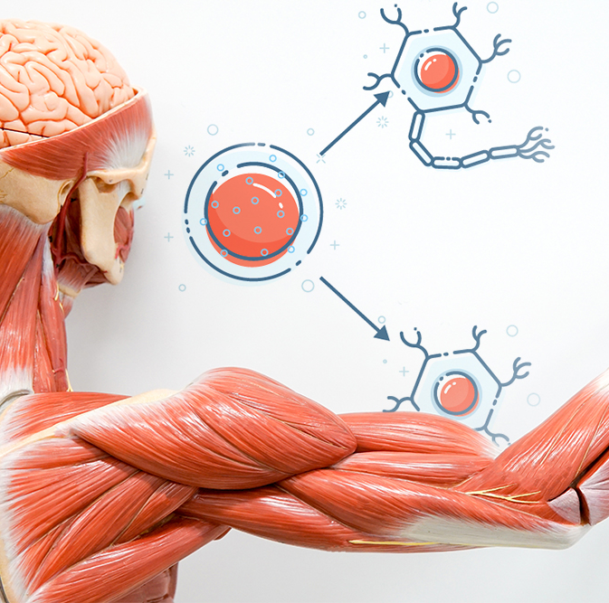

The Musculoskeletal System
Prepared by: Klaudia Gogół
Physiotherapy JMS
2023/2024
University of Rzeszów
Faculty of Medicine
https://www.wibroterapia.pro/badania-i-raporty/ruch/wibroterapia-w-leczeniu-zaburzen-ukladu-miesniowo-szkieletowego-przeglad-badan-in-vitro-i-in-vivo/

Slide 2
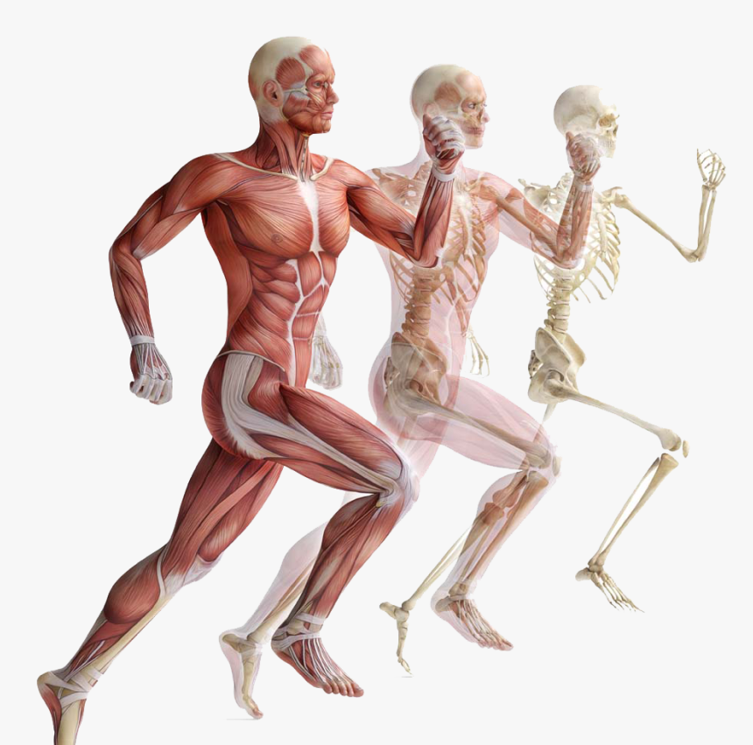
What is the musculoskeletal system?
It is a human body system.
It is subdivided into two broad systems:
1. Muscular system, which includes all types of muscles in the body.
There are more than 600 muscles in the human body.
2. Skeletal system, whose main component is the bone.
https://www.kindpng.com/imgv/womwbi_muscle-anatomy-png-muscular-system-png-transparent-png/

Slide 3
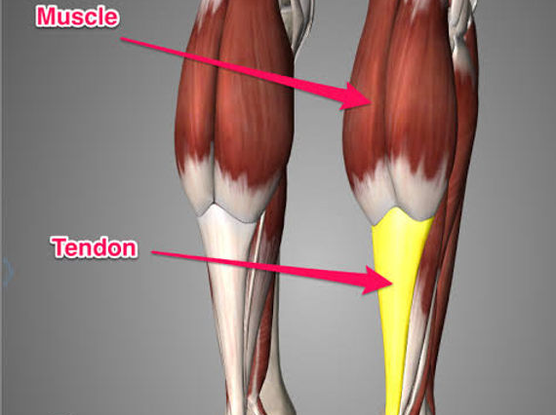
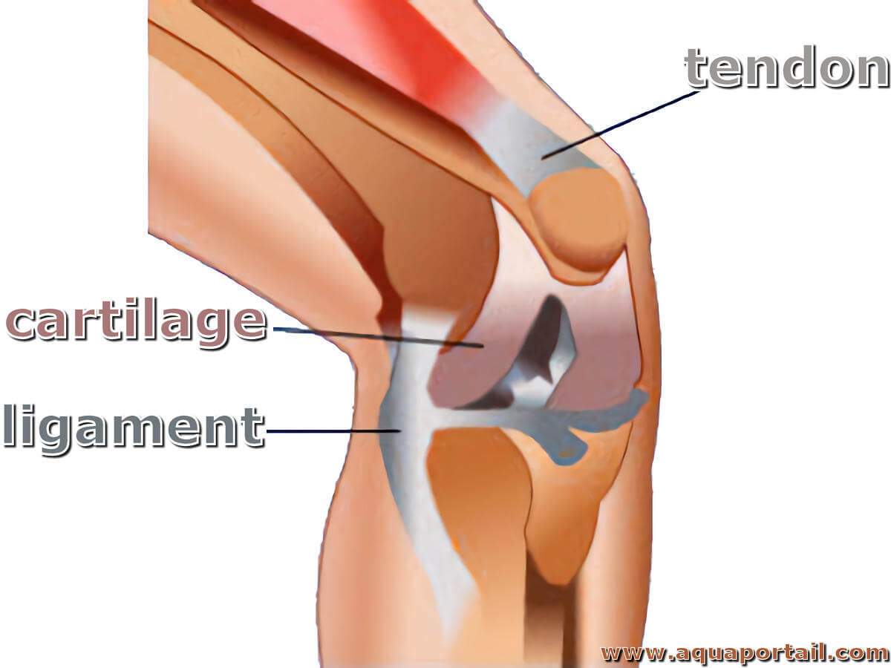
The parts of the musculoskeletal system
Bones
Cartilage
Joints
Muscles
Ligaments
Tendons
https://www.nepeanphysioclinic.com.au/post/muscle-tendon-injury
https://www.aquaportail.com/dictionnaire/definition/3630/ligament

Slide 4
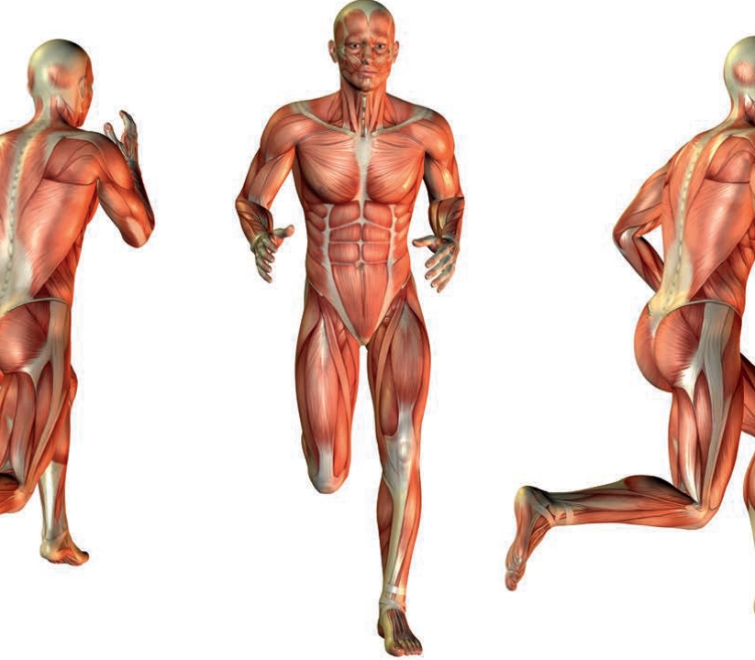
Functions of the locomotor system
Locomotion
Stablility of joints
Maintaining posture
Heat production
Protection of internal organs
Metabolic functions
https://redro.pl/plakaty/temat/anatomia-miesnie/

Slide 5
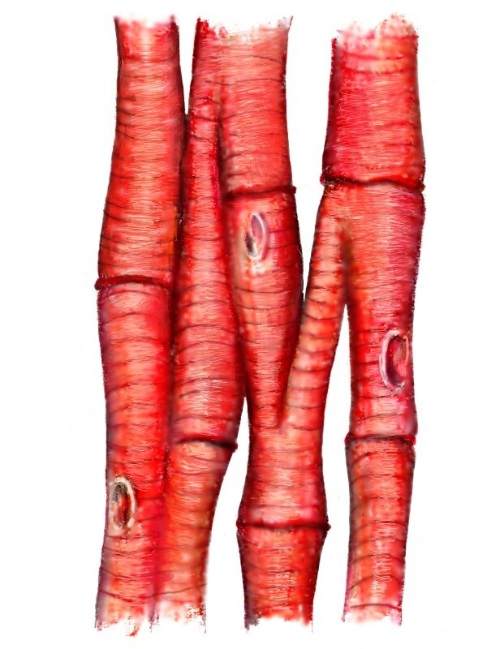
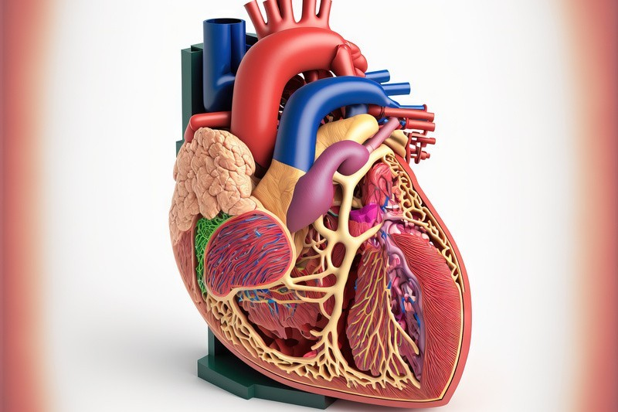

Types of muscle cells
Cardiac Muscle Cells
https://zpe.gov.pl/a/tkanka-miesniowa-poprzecznie-prazkowana/Da99CDljp

Slide 6
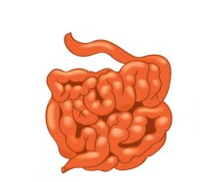
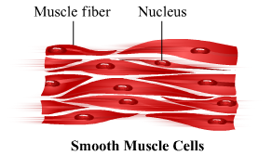
Types of muscle cells
https://myloview.pl/fototapeta-realistyczne-narzady-ludzkie-tworza-anatomie-nr-5CE5836

Slide 7
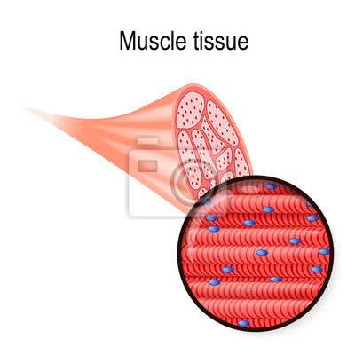
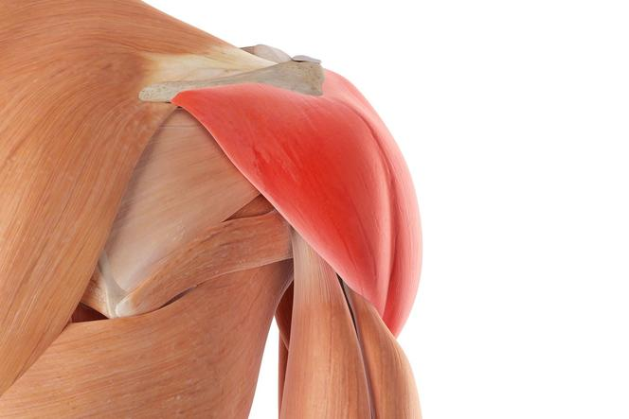
Types of muscle cells
Skeletal Muscle Cells

Slide 8
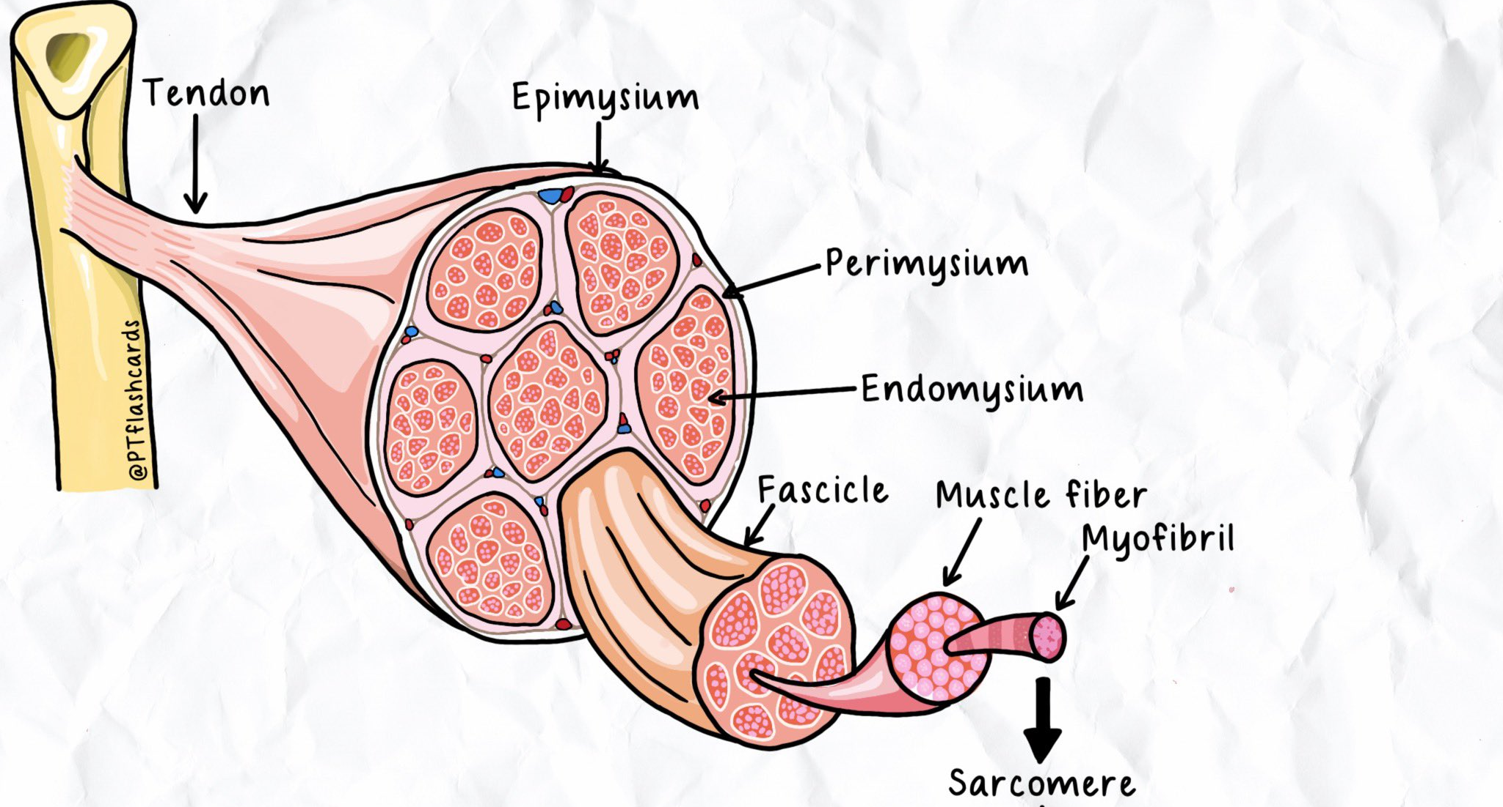
Structure of skeletal muscle
https://twitter.com/PTFlashcards/status/1638012755700764672
Myocytes
Sarcolemma
Sarcoplasm
Sarcomeres
Endomysium
Perymisium

Slide 9
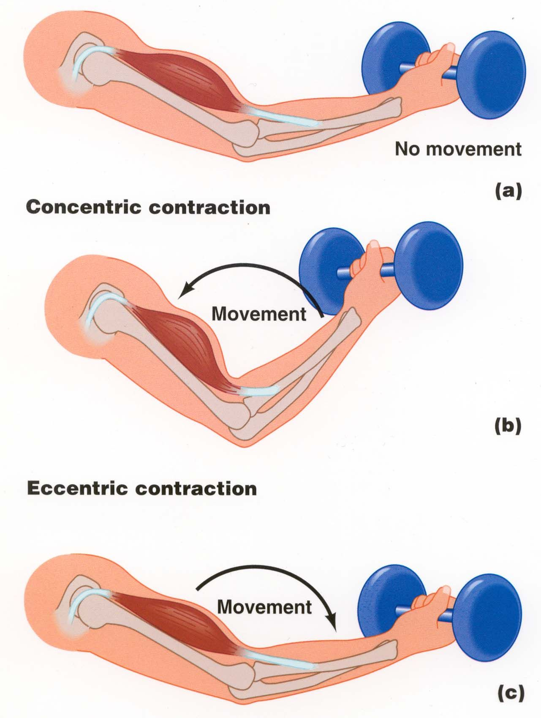
Muscle contraction
Concentric contraction
the type of muscle contraction in which the muscles shorten while generating force
Eccentric contraction
the motion of an active muscle while it is lengthening under load
https://vickphysiotherapy.wordpress.com/2018/11/06/isometric-concentric-and-eccentric-muscle-contractions-whats-the-difference/

Slide 10
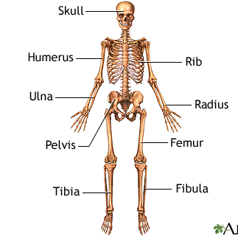
Skeletal system
Axial skeleton:
vertebral column
bones of the head
bones of the thoracic cage
Appendicular skeleton:
the bones of the shoulder and pelvic girdle,
the bones of the upper and lower extremities
The adult human skeleton is composed of 206 bones.
https://medlineplus.gov/ency/imagepages/9065.htm

Slide 11
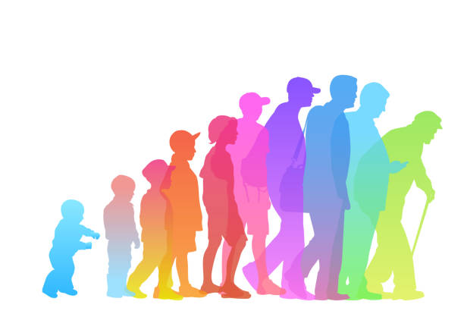
Effects of Aging on the Musculoskeletal System
The joints become stiffer.
The cartilage inside a joint becomes thinner.
Sarcopenia.
Reduction in bone density.
Muscular imbalances and reduced flexibility.
https://kobieta.onet.pl/zdrowie/24-oznaki-ze-zaczynasz-sie-starzec-zauwazasz-je-u-siebie/7gn8lvt

Slide 12

How can I keep my musculoskeletal system healthy?
Exercise regularly.
Get plenty of sleep.
Maintain a healthy weight.
Make healthy food choices.
Quit smoking and avoid tobacco.
Have regular checkups and age-appropriate health screenings.
https://www.freepik.com/premium-vector/health-fitness-cartoon_3285557.htm

Slide 13

Quiz
How many bones is the human skeletal system made of?
200
198
206
289
2. In which muscles is contraction dependent on our willpower?
pulmonary
skeletal
cardiac
smooth
3. Where do smooth muscles occur?
In the walls of blood vessels
in the skull
in the heart
In the skeletal system

Slide 14

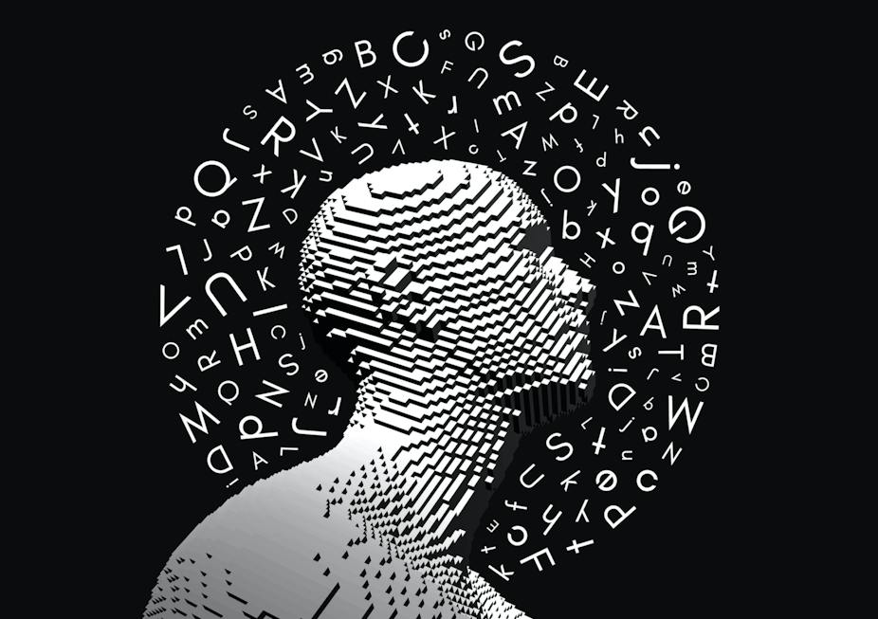
Dictionary
Subdivided- podzielony
Component- składnik
Cartilage- chrząstka
Joints- stawy
Ligamnts- więzadła
Tendons- ścięgna
Maintaining- utrzymanie
Internal organs- narządy wewnętrzne
Cardiac muscle- mięsień sercowy
Smooth muscle- mięśnie gładkie
Skeletal muscle- mięśnie szkieletowe
Myocytes- miocyty
Sarcolemma- sarkolemma
Sarcoplasm- sarkoplazma
Sarcomeres- sarkomery
Contraction-skurcz
Concetric- koncentryczny
Eccentric- ekscentryczny
Axial- osiowy
Appendicular skeleton- szkielet kończyn
Stiffer- sztywniejszy

Slide 15

Bibliography
Sally R, Pauline C, Aneka S, Claire M, Jan H D ,Jérôme G, James R E; ,, Ageing in the musculoskeletal system’’; 2016 Dec; 87(Suppl 363): 15–25; 2016 Dec; 87(Suppl 363): 15–25
Andrew C. Murphy , Sarah F. Muldoon, David Baker, Adam Lastówka ,Brittany Bennett , Muzhi Yang , Danielle S. B; Structure, function, and control of the human musculoskeletal network; 2018 Jan; 16(1): e2002811; doi: 10.1371/journal.pbio.2002811
Paweł P, Mariusz K, Przemysław D, Tomasz D, Mariusz G, Elżbieta S; Comparison of concentric and eccentric resistance training in terms of changes in the muscle contractile properties; Volume 73, December 2023, 102824; https://doi.org/10.1016/j.jelekin.2023.102824
https://www.wibroterapia.pro/badania-i-raporty/ruch/wibroterapia-w-leczeniu-zaburzen-ukladu-miesniowo-szkieletowego-przeglad-badan-in-vitro-i-in-vivo
https://www.kindpng.com/imgv/womwbi_muscle-anatomy-png-muscular-system-png-transparent-png/
https://www.nepeanphysioclinic.com.au/post/muscle-tendon-injury
https://www.aquaportail.com/dictionnaire/definition/3630/ligament
https://zpe.gov.pl/a/tkanka-miesniowa-poprzecznie-prazkowana/Da99CDljp
https://myloview.pl/fototapeta-realistyczne-narzady-ludzkie-tworza-anatomie-nr-5CE5836
https://twitter.com/PTFlashcards/status/1638012755700764672
https://vickphysiotherapy.wordpress.com/2018/11/06/isometric-concentric-and-eccentric-muscle-contractions-whats-the-difference/
https://www.freepik.com/premium-vector/health-fitness-cartoon_3285557.htm

Slide 16
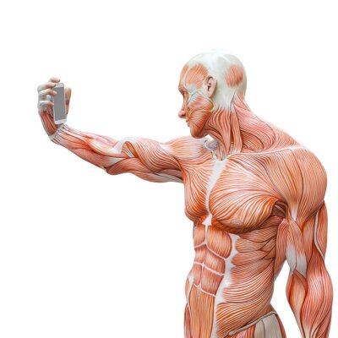
Thank you for your atttention
https://redro.pl/obraz-z-przodu-iz-tylu-miesni-czlowieka,568015

