Slide 1
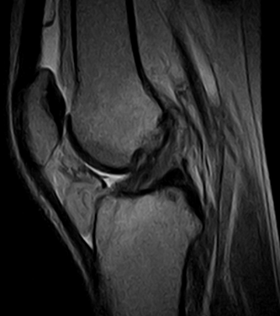

Physiotherapy in knee joint injuries
Aleksandra Gliwa
Język angielski- III Rok Fizjoterapia stacjonarne studia jednolite magisterskie
20.11.2023

Slide 2
Dictionary
hinge joint- staw zawiasowy
gait training- trening chodu
slide exercises sideways- ćwiczenia ślizgowe na boki
sideway lurges- wypady na boki
active-passive exercises- ćwiczenia czynno-bierne
closed kinematic chain- łańcuch zamknięty
one legged leg press- wyciskanie jednonóż
running pattern- wzorzec biegu
resistance exercises- ćwiczenia oporowe
contracture- przykurcz
accelerate bone fusion- przyspieszony zrost kości
blood suply- dopływ krwi
blood flow- przepływ krwi
vasodilation of blood vessels- rozszerzenie naczyń krwionośnych

Slide 3
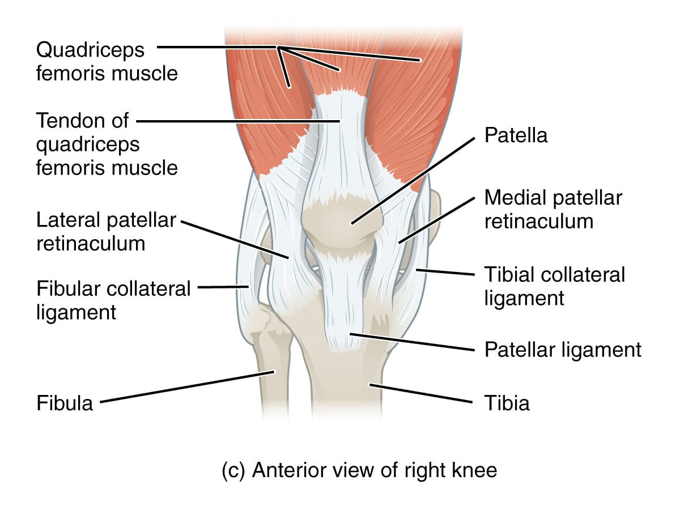
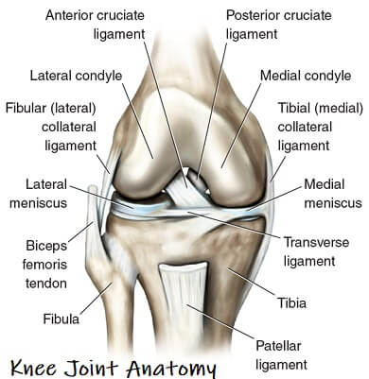
What is the knee joint?
The knee joint is a complex, hinge joint. It includes anatomical structures such as bony parts and join surfaces.
Sources: https://milescallahan.com.au/conditions/knee/anatomy-knee
https://www.knee-pain-explained.com/knee-joint-anatomy.html

Slide 4
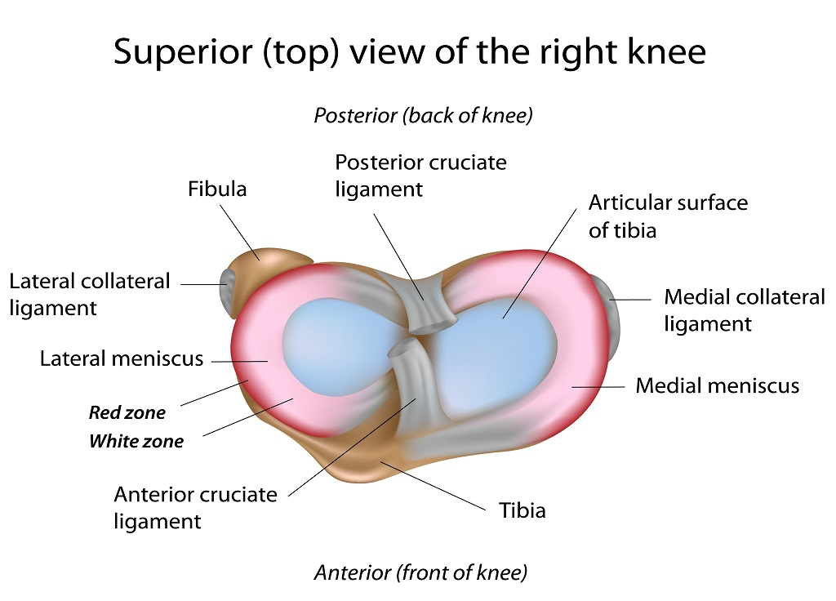
Meniscus, what is it?
Meniscus is a functionally significant structure in human body. It play a vital role in shock absorption, stabilization, proprioception and nutrition. In high contact sports and sports that involve rotating movements, meniscus injuries are really often.
Sources: https://www.orthozentrum-freiburg.de/en/kniegelenk/meniskusverletzung/

Slide 5
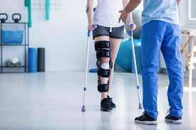
Physiotherapy in meniscus injury
In this injury can use neuromuscular and strengthening exercises. Additionally in this patients are using gait training.
Sources: https://www.mpowermd.com/blog/physical-therapy-after-acl-surgery

Slide 6
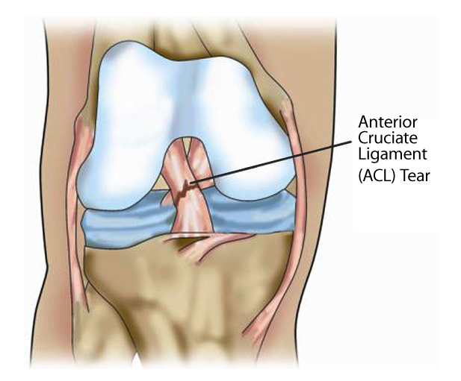
Anterior cruciate ligament
Anterior cruciate ligament- ACL is a central ligament in knee joint. The important role of the ACL is to provide stability.
Sources: https://www.drchienwenliew.com.au/knee-conditions/acl-rupture/

Slide 7
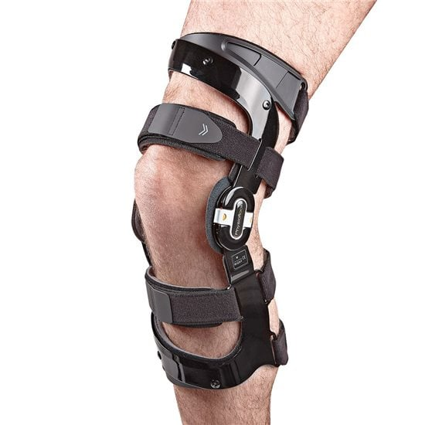
Physiotherapy after anterior cruciate ligament reconstruction
After reconstruction patients must use brace in extension and crutches. From the beginning after surgery patient starts different exercises.
Sources: https://www.physioroom.com/info/best-knee-braces-recovering-acl-injury/

Slide 8
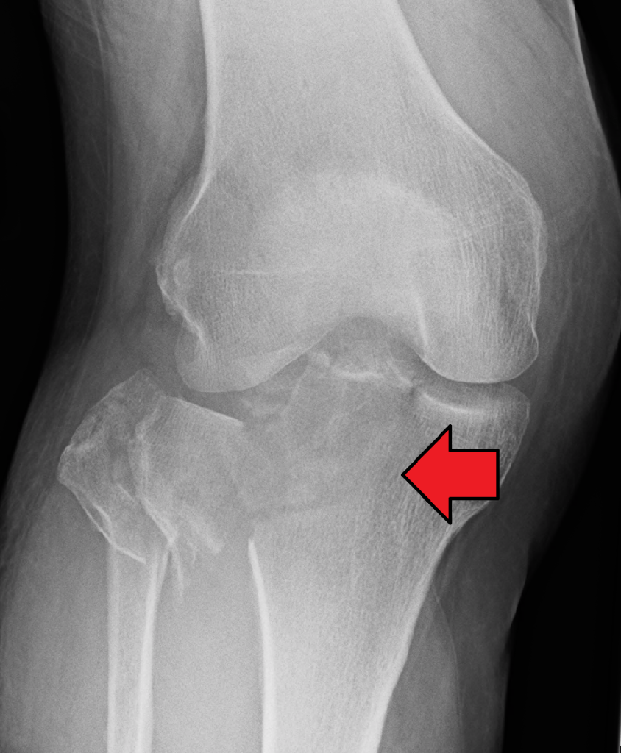
Fractures within the knee joint
Fractures of the knee join area occurs as a result of traffic accidents, falls from heights or fall on skis. Symptoms of the fracture include pain, pathological mobility and deformity. Nerve or vascular damage may also occur.
Sources: https://swiatrehabilitacji.pl/zlamanie-kosci-piszczelowej-objawy-leczenie-operacja-rehabilitacja/

Slide 9
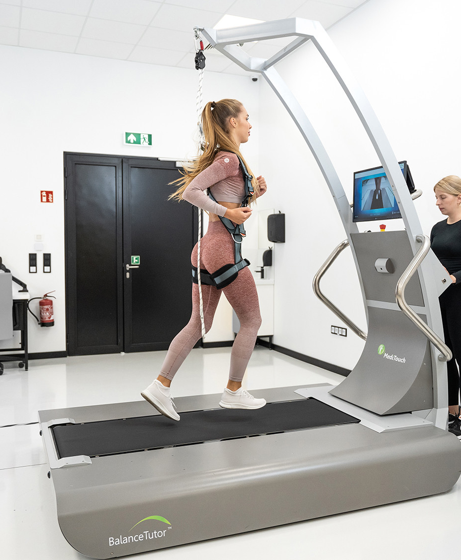
Physiotherapy after fractures within the knee joint
Physiotherapy begins almost from the beginning of wearing the cast. Physical therapy and gentle active or active-passive exercises are used. Once the cast is removed, muscles are strengthened and the goal is to regain pre-injury function.
Sources: https://sklep.meden.com.pl/reedukacja-i-nauka-chodu/10942-balancetutor-bieznia-do-treningu-i-oceny-posturalnych-perturbacji.html

Slide 10
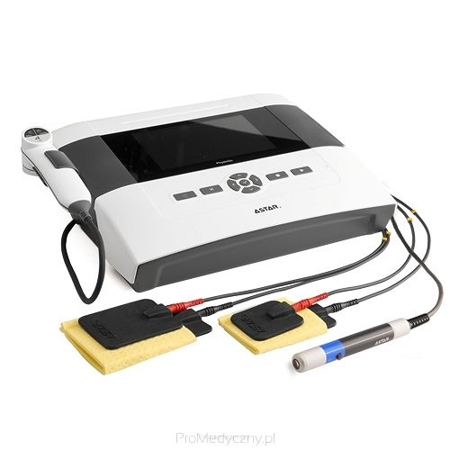
Physical Therapy
Physical therapy is widely used in physiotherapy. Among other things, it enables the stimulation of weakened muscles and has analgesic effects.
Sources: https://promedyczny.pl/category/sprzet-do-fizykoterapii

Slide 11
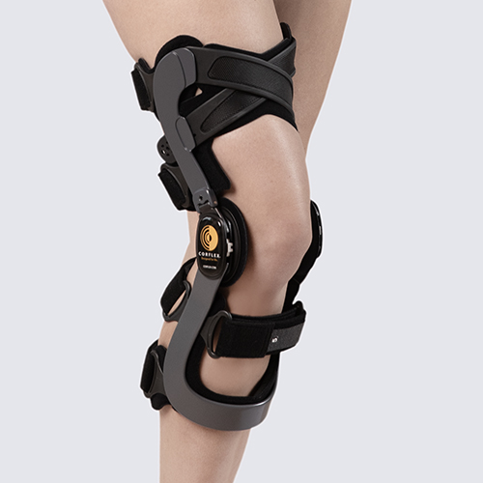
Orthopedic Equipment
After injuries to the knee joint, it is important to keep the lower limb in a certain way. This is made possible by orthopedic equipment.
Sources: https://nordicare.org.uk/catalog/category/view/s/knee/id/80

Slide 12
Bibliography
Physiotherapy Management in Meniscus InjuryMade Ayu Indah Puspa Sari, Ida Kurniawat P-ISSN: 2830-6317
Meniscus Injury and Physiotherapy Rehabilitation Waliul Islam DOI:10.31579/2835-
8465/016
Biomechanics of the anterior cruciate ligament: Physiology, rupture and reconstruction techniques Christoph Domnick, Michael J Raschke and Mirco Herbort doi: 10.5312/wjo.v7.i2.82
Knee arthroplasty for acute fractures around the knee Thomas Tampere, Matthieu Ollivier, Christophe Jacquet, Maxime Fabre-Aubrespy, Sébastien Parratte, DOI: 10.1302/2058-5241.5.190059
Physical therapies for improving balance and reducing falls risk in osteoarthritis of the knee: a systematic review S UMAIYAH M AT, M AW PIN TAN, SHAHRUL B AHYAH KAMARUZZAMAN, C HIN T ECK N G doi: 10.1093/ageing/afu112

