Slide 1

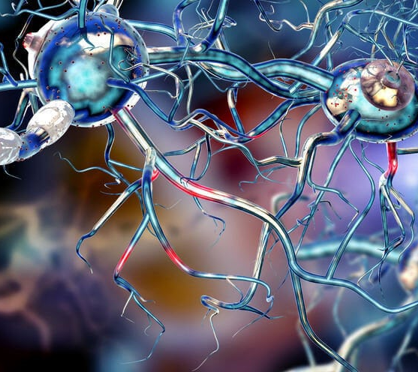
MULTIPLE SCLEROSIS
Karolina Kaczor
Fizjoterapia stacjonarne JMS
III rok - 30 listopada 2023
Semestr zimowy 2023/2024
https://www.ur.edu.pl/pl/uniwersytet/aktualnosci/logo-uniwersytetu-rzeszowskiego,20638
https://dietetycy.org.pl/dieta-stwardnienie-rozsiane/

Slide 2

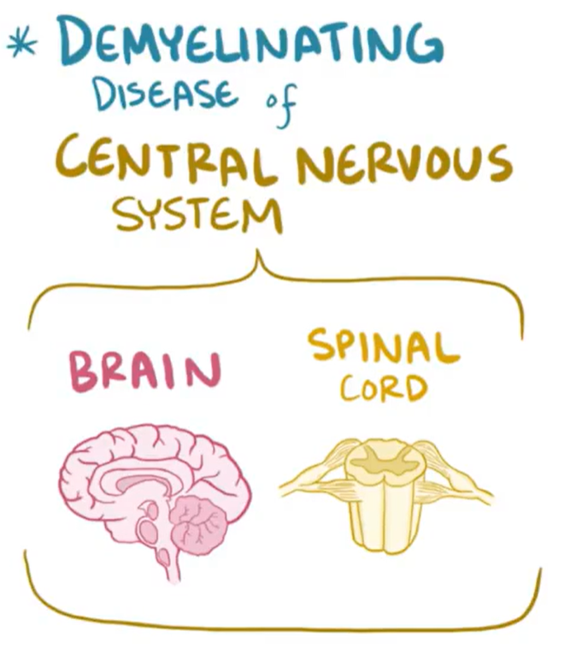
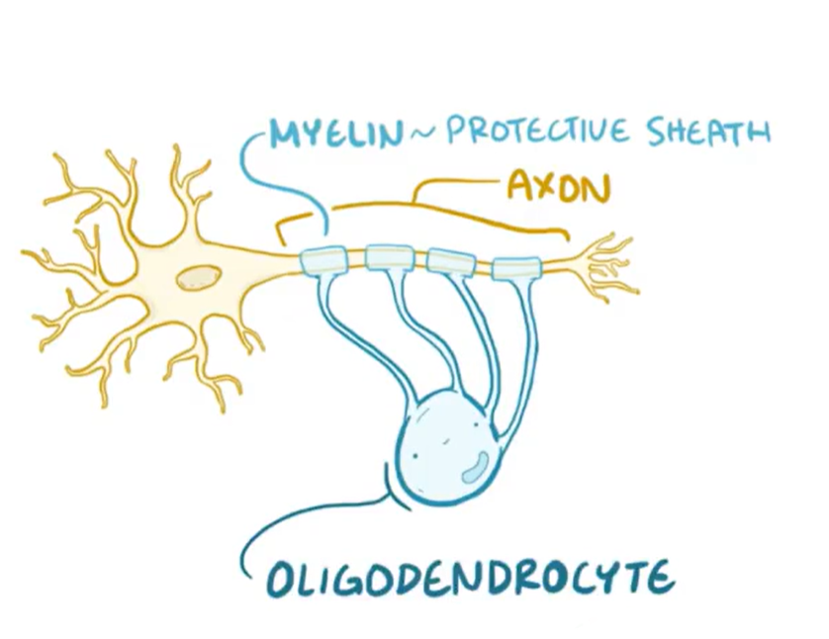
https://www.osmosis.org/learn/Multiple_sclerosis

Slide 3
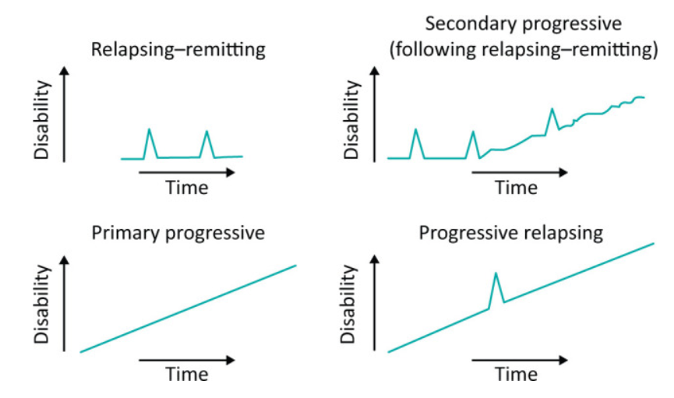
TYPES OF MULTIPLE SCLEROSIS
Ford H. Clinical presentation and diagnosis of multiple sclerosis. Clin Med (Lond). 2020 Jul;20(4):380-383

Slide 4






ETIOLOGY
Immunological factors
Infectious agents
Genetics
Environmental
https://www.stickpng.com/es/img/naturaleza/virus/virus-azul
https://www.stickpng.com/pt-br/img/jogos/virus/virus-azul-com-tentaculos
https://www.stickpng.com/pt-br/img/pessoas/cafe-da-manha-em-ingles/virus-azul-com-espigoes
https://pixabay.com/pl/illustrations/korona-wirus-pomara%C5%84czowy-%C5%BC%C3%B3%C5%82ty-5430811/

Slide 5

ENVIRONMENTAL FACTORS
Age
Gender
Geography
Vitamin D
Smoking
Stress
Obesity
https://www.everydayhealth.com/multiple-sclerosis/what-causes-ms/

Slide 6
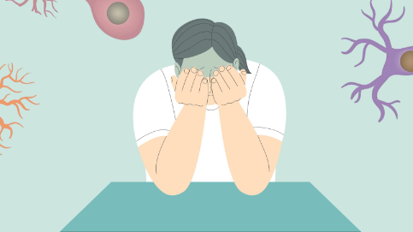
SYMPTOMS OF MULTIPLE SCLEROSIS
Fatigue
Spasticity
Numbness or tingling
Chronic pain
Problems with balance and coordination
Difficulty walking
Vision problems
Bladder dysfunction
Problems with thinking, learning and planning
Speech issues
Emotional changes
https://careclinic.io/ms-fatigue-management/

Slide 7
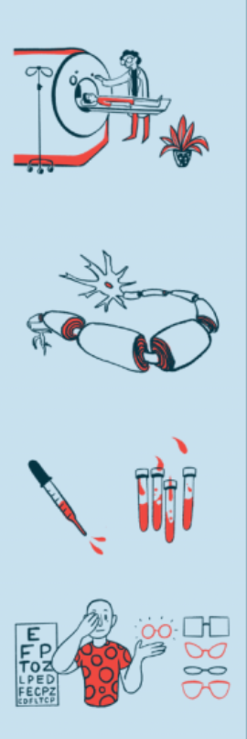
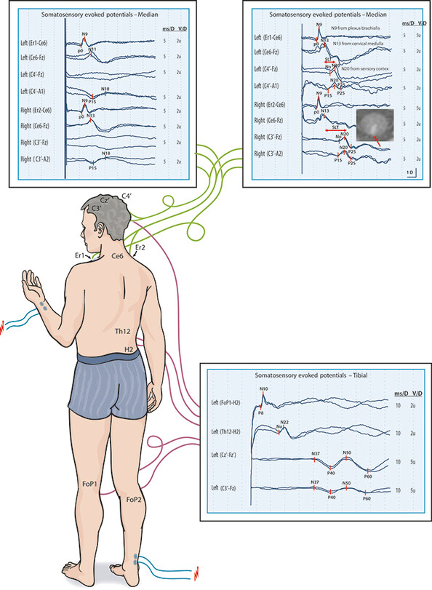
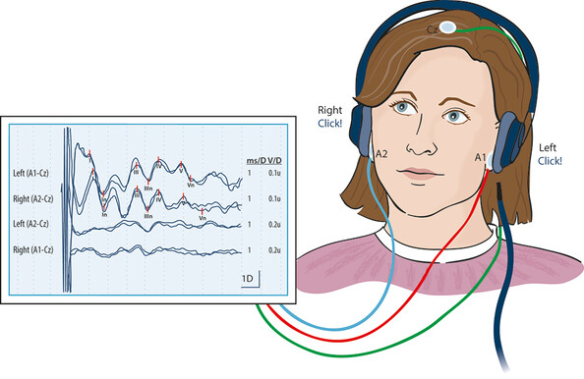
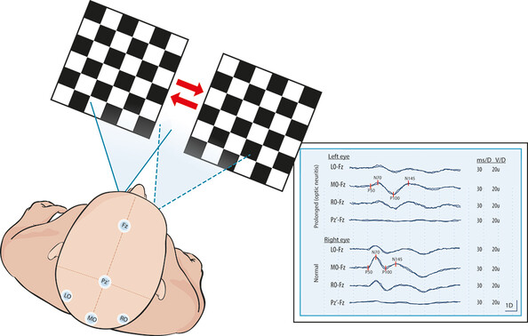
DIAGNOSIS
Medical History
Neurological Examination
MRI
Evoked potential
Spinal Tap
Sand T., Kvaløy M.B., Wader T., Hovdal H. Evoked potential tests in clinical diagnosis, Tidsskr Nor Legeforen nr. 9, 2013; 133: 960 – 5
https://multiplesclerosisnewstoday.com/multiple-sclerosis-diagnosis/

Slide 8


TREATMENT
Disease-Modifying Therapies (DMTs)
Symptomatic Treatment
Rehabilitation and Physical Therapy
Dietary and Vitamin D Considerations
https://www.cdc.gov/tb/statistics/reports/2021/outcomes.htm
https://www.tac.vic.gov.au/clients/how-we-can-help/treatments-and-services/services/evidence-based-treatment

Slide 9
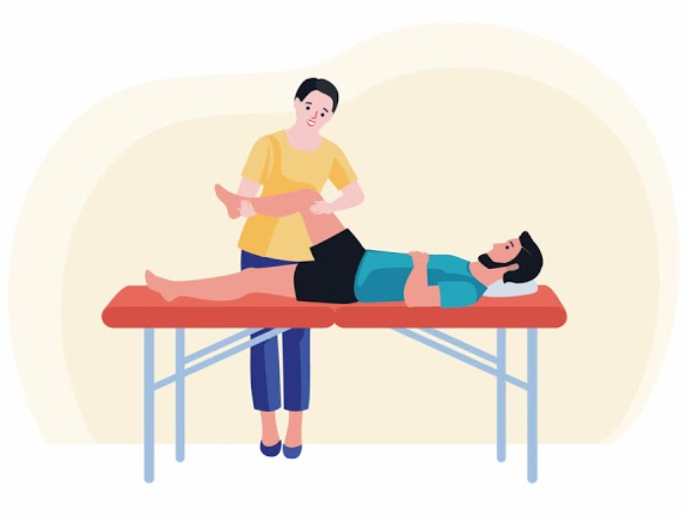
REHABILITATION
Physical Therapy
Occupational Therapy
Cognitive Rehabilitation
Assistive Devices and Adaptive Equipment
https://zapytajosm.pl/czy-moge-sie-meczyc-wszystko-o-sporcie-aktywnosci-fizycznej-i-rehabilitacji-w-stwardnieniu-rozsianym/

Slide 10

CONSULTATIONS
Neuropsychologist
Physical Therapist
Occupational Therapist
Speech Therapist
Dietitian
Urologist
https://www.vectorstock.com/royalty-free-vector/online-doctor-consultation-advertising-flat-banner-vector-25160360

Slide 11

LIFESTYLE MODIFICATIONS
Physical Activity
Balanced Diet
Stress Management
Rest
Temperature Regulation
Regular Medical Check-ups
https://www.everydayhealth.com/multiple-sclerosis/assess-lifestyle-habits/

Slide 12
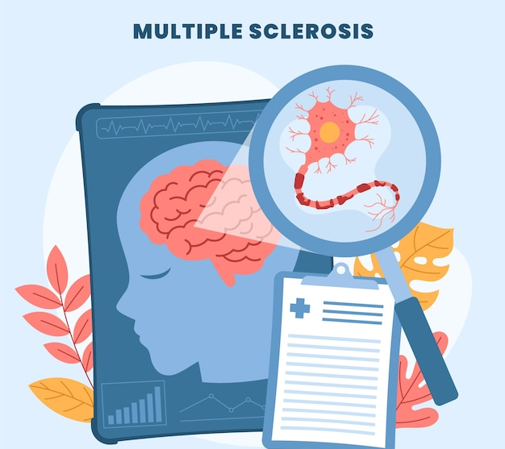
Counselling and Mental Health Support
Psychologist or Counsellor
Support Groups
Family Therapy
Mindfulness and Stress Reduction Techniques
https://www.freepik.com/free-photos-vectors/ms-disease-multiple-sclerosis

Slide 13
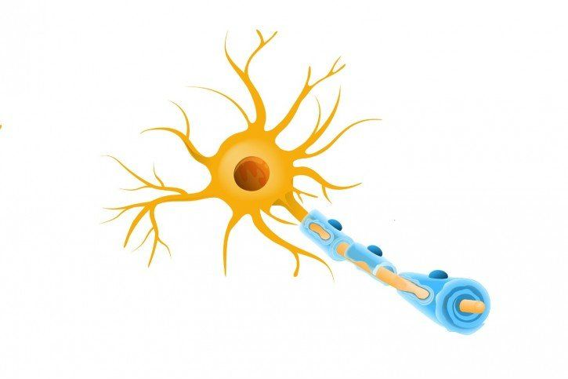
Quiz
1. What is Multiple Sclerosis (MS)?
A cardiovascular disorder
A neurological condition
A respiratory disease
2. How does the immune system contribute to MS?
Boosts nerve function
Attacks and damages myelin
Regulates blood pressure
3. Which vitamin is often recommended for individuals with MS due to its potential benefits?
Vitamin A
Vitamin C
Vitamin D
4. True or False: MS is more common in men than women.
https://fizjoplaner.pl/stwardnienie-rozsiane.html​
​

Slide 14
Dictionary
English | Polish
Evoked potential | Potencjał wywołany
Cognitive | Kognitywny, poznawczy
Inflammation | Zapalenie
Myelin sheath | Osłonka mielinowa
Optic neuritis | Zapalenie nerwu wzrokowego
Relapsing-remitting MS | Postać rzutowo-remisyjna MS
Spinal tap | Nakłucie lędźwiowe
https://fizjoplaner.pl/stwardnienie-rozsiane.html

Slide 15
BIBLIOGRAPHY
Ford H. Clinical presentation and diagnosis of multiple sclerosis. Clin Med (Lond). 2020 Jul;20(4):380-383
AXELERAD, ANY DOCU, et al. THE ROLE OF PHYSICAL EXERCISE IN MULTIPLE SCLEROSIS. Ovidius University Annals, Series Physical Education & Sport/Science, Movement & Health, 2020, 20.1.
Thompson AJ, Baranzini SE, Geurts J, Hemmer B, Ciccarelli O. Multiple sclerosis. Lancet. 2018 Apr 21;391(10130):1622-1636.
KUBSIK-GIDLEWSKA, Anna M., et al. Rehabilitation in multiple sclerosis. Advances in Clinical and Experimental Medicine, 2017, 26.4.
World Health Organization. (7 August 2023).Multiple sclerosis. Retrieved from https://www.who.int/news-room/fact-sheets/detail/multiple-sclerosis
MS Society .MS and mental health(n.d), accessed 28 November 2023, < https://www.mssociety.org.uk/about-ms/signs-and-symptoms/mental-health>.

