Slide 1


Kinesiology Taping
Anna Bednarz
III r. Fizjoterapia JMS
2023/2024 semestr zimowy

Slide 2
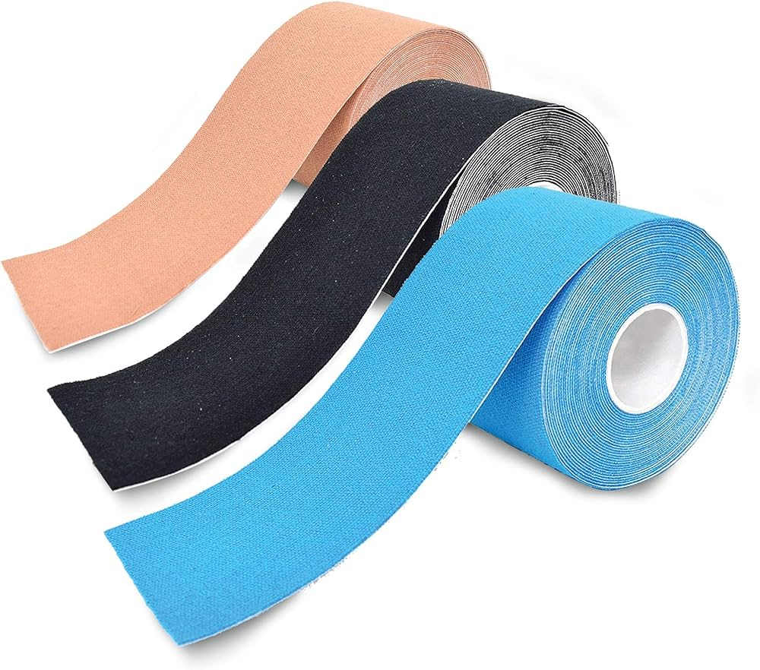
What is kinesiology taping?
It's a thin, flexible tape that is meant to relieve pain, reduce swelling or inflammation, and provide support to joints and muscles. The concept was introduced in the 1970s
by Dr Kenzo Kase.
https://m.media-amazon.com/images/I/81bjfRT0I7L._AC_UF1000,1000_QL80_.jpg

Slide 3
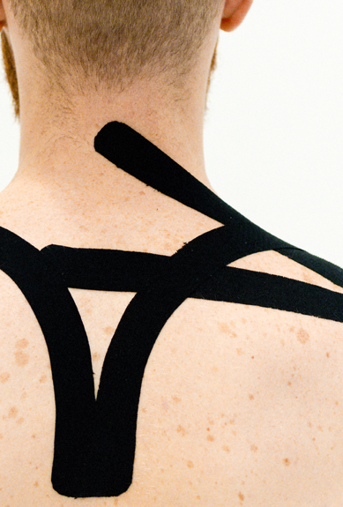
Kinesiology taping techniques
Muscle technique
Ligament technique
Fascial techique
Correction technique
Lymphatic technique
Functional technique
https://newlevelsport.pl/wp-content/uploads/2023/10/kinesiotaping-szybki-powrot-do-formy.png

Slide 4
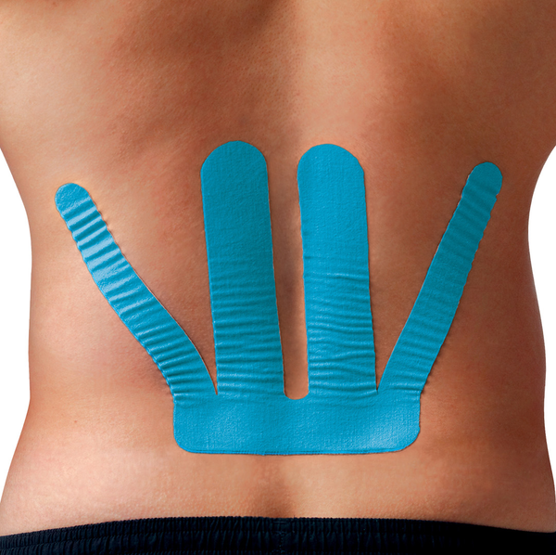
Muscle technique
It is known that it supports or weakens muscle work.
https://spidertech.com/cdn/shop/files/LOWERBACKPROCUTONMODEL_600x.png?v=1695311702

Slide 5
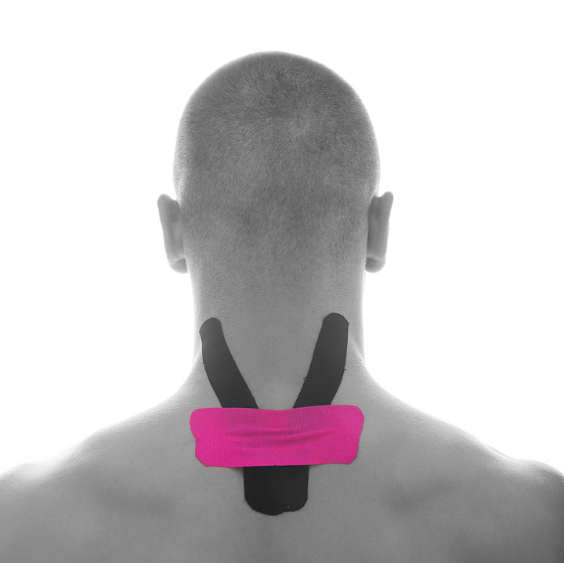
Ligament technique
The main function of this technique is the lifting effect it has on the ligaments.
https://cdn.shopify.com/s/files/1/0257/8012/5758/t/3/assets/zooomy-1608045667shutterstock-523189852-1250_1080x1080.jpg?v=1608045668

Slide 6
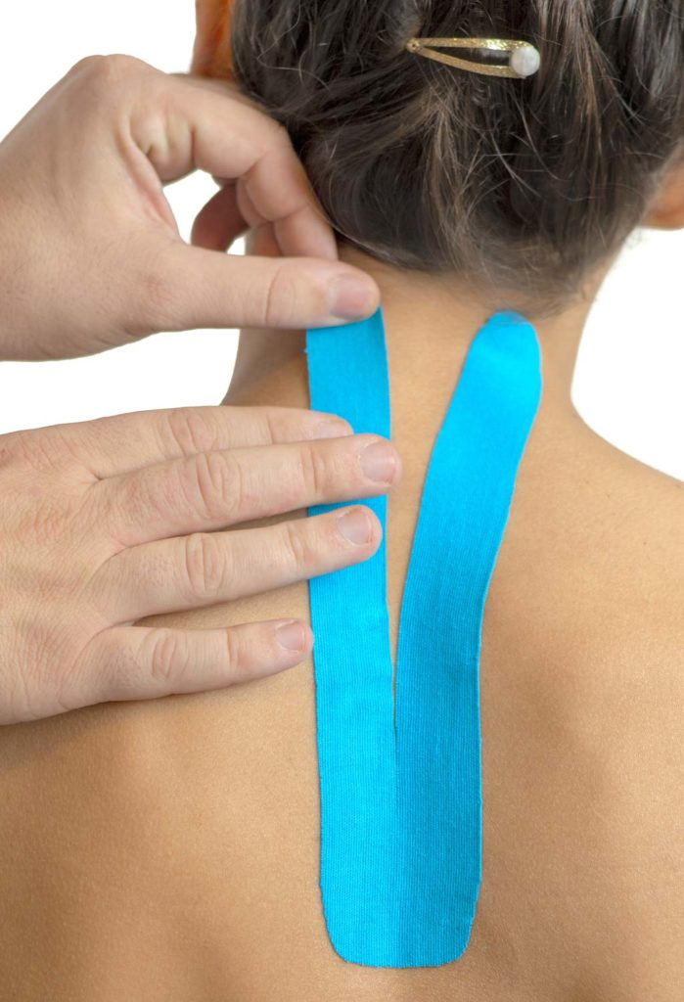
Fascial technique
The purpose of this technique is to correct the positioning of fascia.
https://www.studiomangraviti.it/wp/wp-content/uploads/2019/05/kinesio-taping-699x1024.jpg

Slide 7
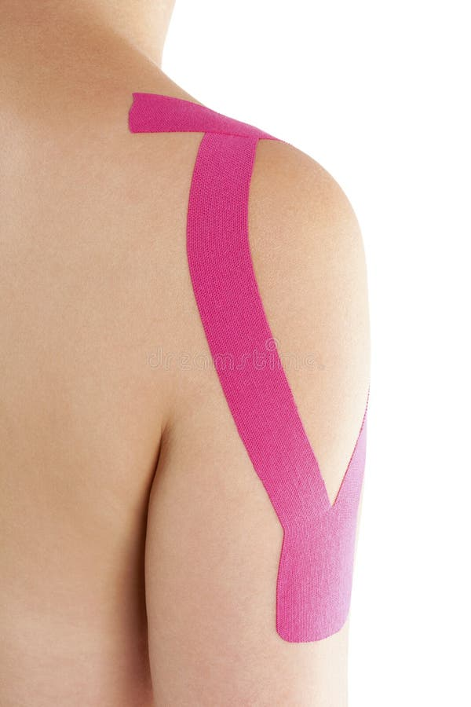
Correction technique
It is known to increase the elasticity of tissue, causing a neutral positioning of muscles, joints and ligaments.
https://thumbs.dreamstime.com/b/kinesio-tape-female-shoulder-isolated-white-background-rehabilitation-physiotherapy-67346088.jpg

Slide 8
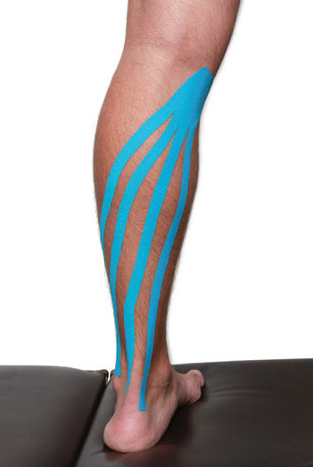
Lymphatic drainage technique
It is implemented to reduce swelling and to improve proper lymphatic circulation.
https://kinesiotaping.com/wp-content/uploads/2021/02/Kinesio-Tape-AH-2014-Spring-Featured-Kinesio-Applications-03.jpg

Slide 9
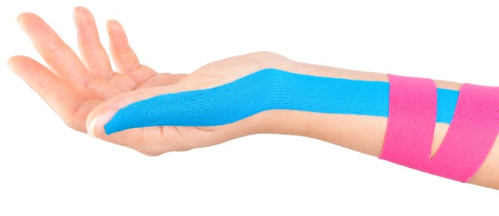
Functional movement technique
It supports muscle paresis and dysfunctions of the upper and lower limbs, which improves their mobility.
https://wp02-media.cdn.ihealthspot.com/wp-content/uploads/sites/201/2018/08/kinesiologytape.jpg

Slide 10
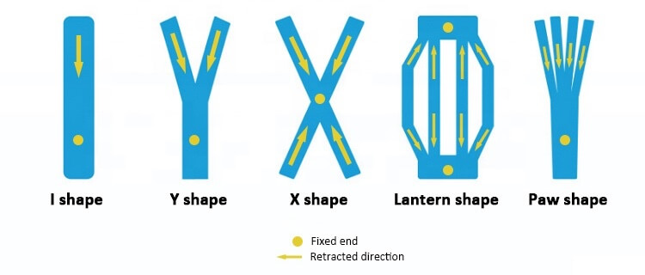
Shapes of the dynamic taping technique
In the dynamic taping technique may be in the form of letters I, Y, X,
Paw and Web (Lantern).
https://www.chinamedica.com/wp-content/uploads/2020/10/pre-cut-sports-tape-shape-copy.jpg

Slide 11
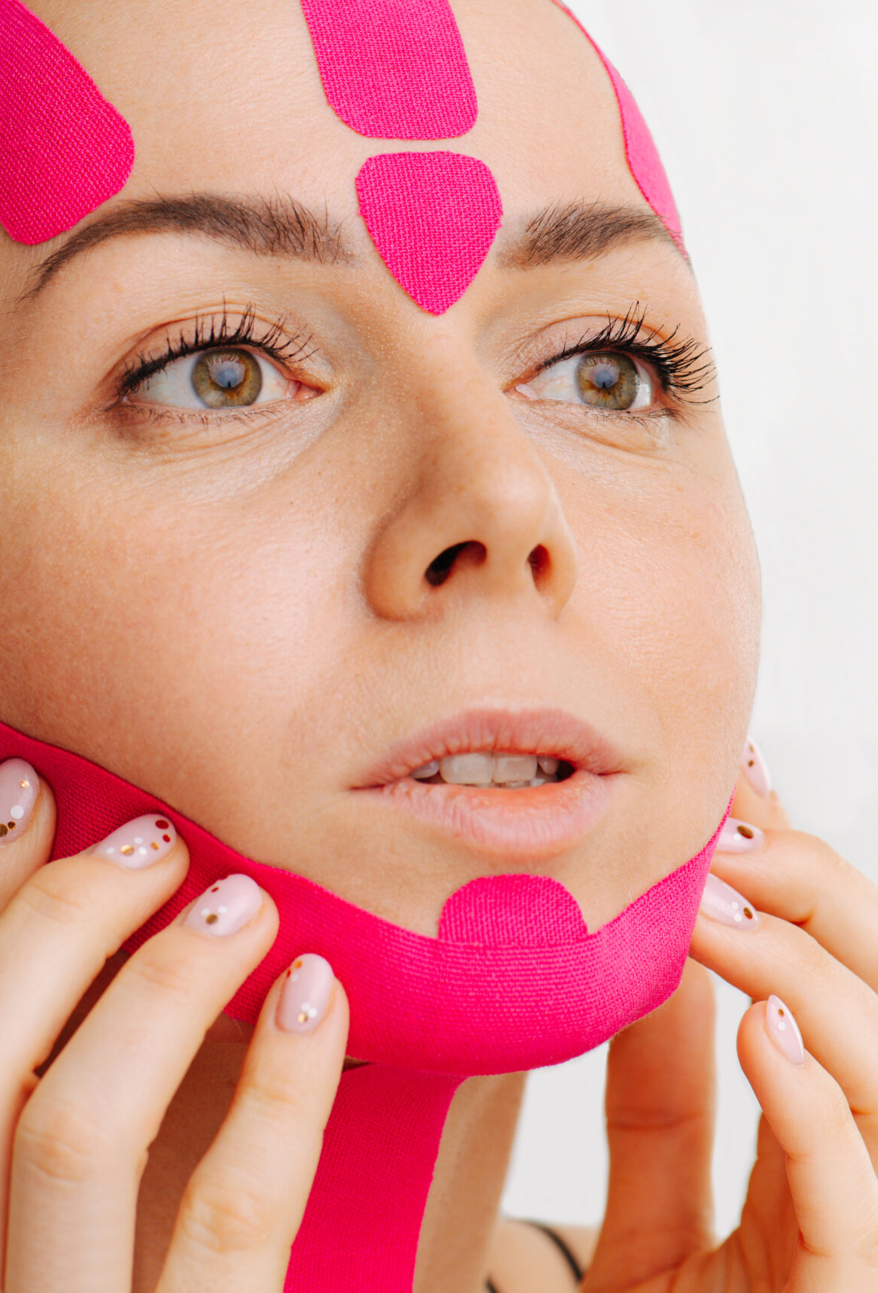
Different ways of use Kinesiology Taping
Treatment and prevention of injuries in sports
Reduction of facial swelling
Improving the appearance of the skin
Supporting anti-cellulite therapy
Improving body shape
Supporting the scar healing process
https://cdn.spafinder.com/2021/04/iStock-1225460308-scaled.jpg

Slide 12
Dictionary
therapeutic tool – narzędzie terapeutyczne
utilize – wykorzystać
malalignment – nieprawidłowe ustawienie
oedema – obrzęk
convolutions – zwoje
fascial – powięziowy
paresis – niedowład
align – wyrównywać
patterns – wzory
patch – plaster
lymph nodes – węzły chłonne
remaining – pozostały
swollen – opuchnięty
analgesic effect – działanie przeciwbólowe
implemented – wdrożony

Slide 13
Bibliography
Williams S., Whatman C., Hume P. A., & Sheerin K. (2012). Kinesio Taping in Treatment and Prevention of Sports Injuries. Sports Medicine, 42(2), 153–164. doi:10.2165/11594960-000000000-00000
Kinesio taping - a healing and supportive method in various fields of medicine, dentistry, sport and physiotherapy. June 2021. Baltic Journal of Health and Physical Activity 13(2):11-25. DOI:10.29359/BJHPA.13.2.02
Yang Jae-Man and Jung-Hoon Lee. "Is kinesio taping to generate skin convolutions effective for increasing local blood circulation?." Medical science monitor: international medical journal of experimental and clinical research 24 (2018): 288.
Daszkiewicz Maciej, "Aesthetic Cosmetology and Medicine” ISSN 2719-3241 | Index Copernicus 80.34 | 6/2020 (vol. 9)
Lietz-Kijak Danuta, et al. "The impact of the use of kinesio taping method on the reduction of swelling in patients after orthognathic surgery: a pilot study." Medical science monitor: international medical journal of experimental and clinical research 24 (2018): 3736.
Wilk Tomasz, Magdalena Nieweglowska-Wilk and Radoslaw Spiewak. "Kinesiology taping in cellulite: A proposal for a novel treatment and report of first results." Estetol Med Kosmetol 2.4 (2012): 115-117.

Slide 14

Thank you for your attention!

