Slide 1
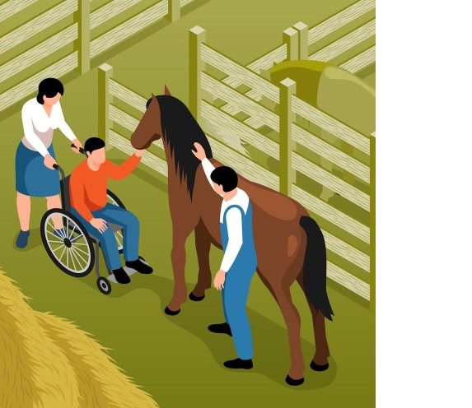
HIPPOTHERAPY
University of Rzeszów
Faculty of Medicine
Prepared by:
Eliza Kalukin
3rd year of Physiotherapy
2023/2024
https://cdn.vectorstock.com/i/preview-1x/24/03/hippotherapy-isometric-vector-38562403.jpg

Slide 2

What is hippotherapy?
Hippotherapy means treatment with the aid of a horse. Hippotherapy is a treatment method with concurrently favourable psychological, social, and educational effects on many organ systems including sensory, musculoskeletal, limbic, vestibular, and ocular systems.
https://www.thebrainpossible.com/uploads/news-pictures/7974--blog-post-image-20200724162703.jpg

Slide 3
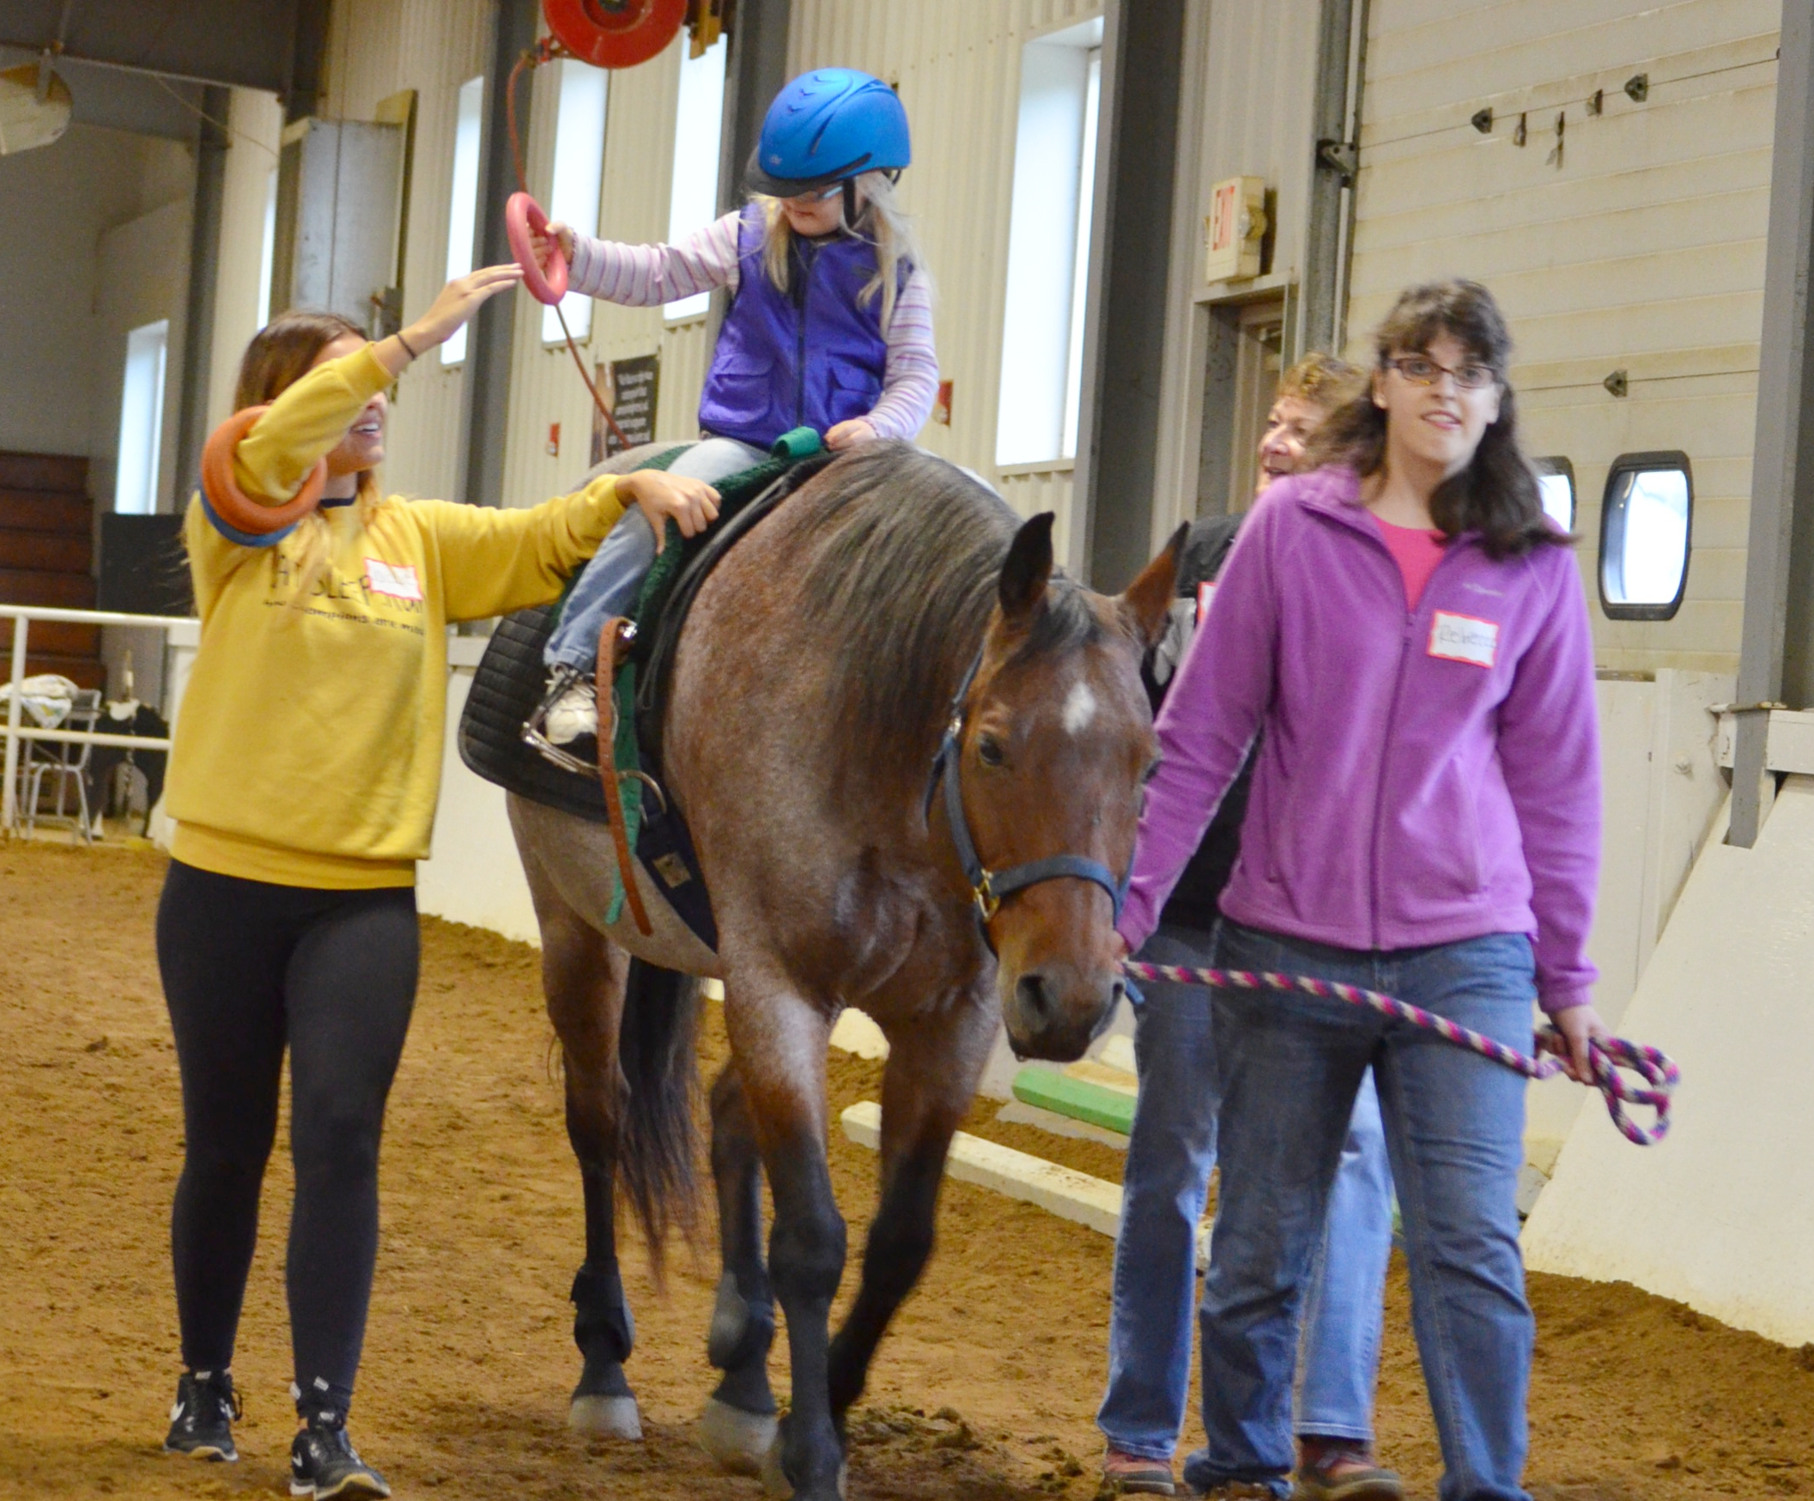
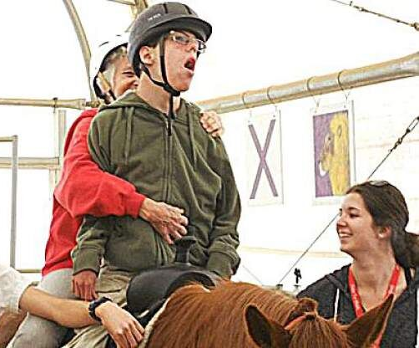
Hippotherapy team
therapist,
horse trainer,
riding instructors.
https://images.squarespace-cdn.com/content/v1/59e8ed226f4ca35dfdf5ebd3/1508783302563-DUJ5JS69HDB660R4WM7B/DSC_6007.JPG?format=1500w
https://bloximages.chicago2.vip.townnews.com/theunion.com/content/tncms/assets/v3/editorial/c/18/c1855575-805b-5fac-be03-bb7d40f7bab7/63a36fd2094c1.image.jpg

Slide 4
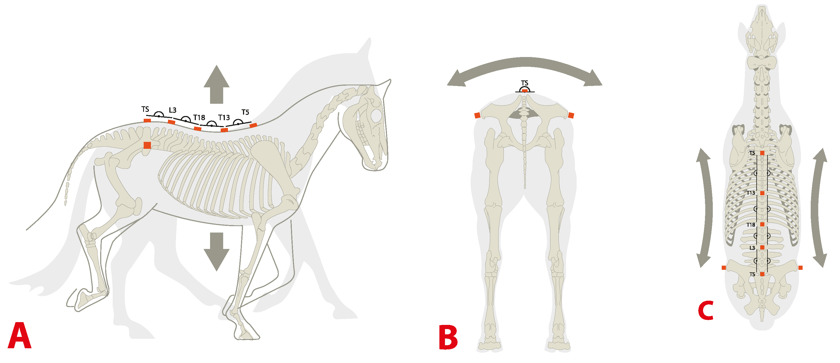
Why are horses used?
1. During ambulation the horse provides a rhytmic movement which stimulates anterior, and posterior swinging movements.
2. Movements of the horse encourage the rider to achieve a proper balance, and posture.
3. The horse, and those around provide the rider a large spectrum of sensory, and motor input.
https://pub.mdpi-res.com/animals/animals-11-00888/article_deploy/html/images/animals-11-00888-g002.png?1616228164

Slide 5
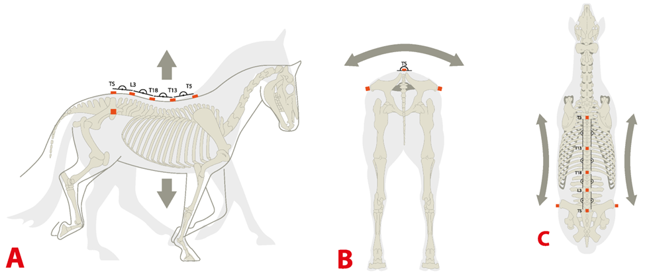
Mechanism of action of hippotherapy
Mechanism of action of hippotherapy can be divided into four main groups.
I: core connection
II: sensory connection
III: communication connection
IV: neuroconnection

Slide 6

Indications of hippotherapy
cerebral palsy,
traumatic brain damage,
Down syndrome,
autistic behavioural disorders,
muscular dystrophy,
amputated patients,
cerebrovascular disease (SVD),
multiple sclerosis,
psychiatric diseases,
spinal cord diseases,
rheumatismal joint diseases.

Slide 7
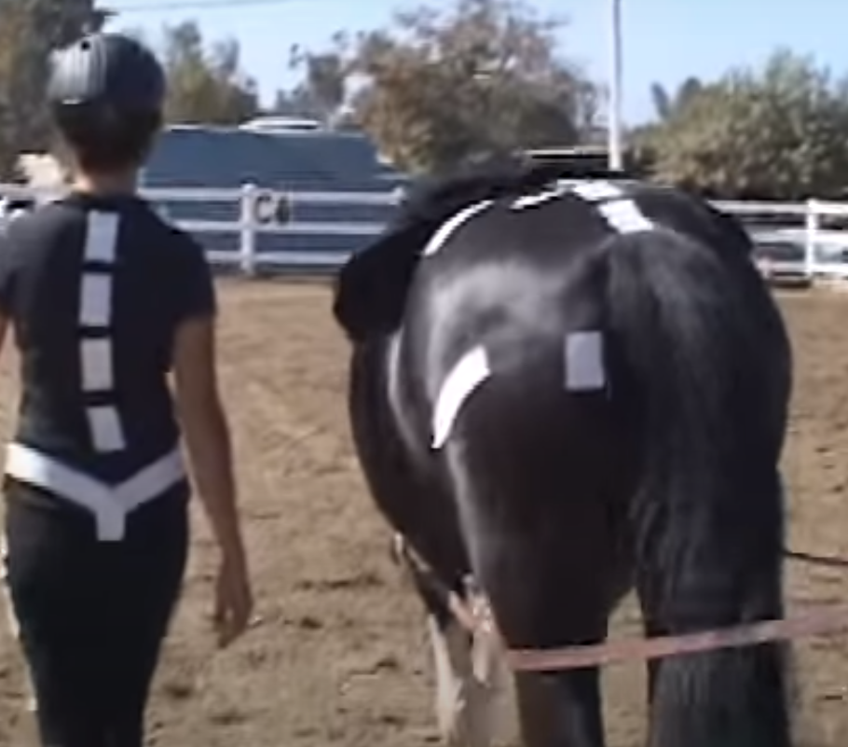
Hippotherapy as a physical therapy
In physical therapy, multidirectional movements of the horse are utilized in:
gait training,
balance,
postural control,
strengthening,
increasing range of motion.
https://www.youtube.com/watch?v=J_MvYAvYQkk

Slide 8
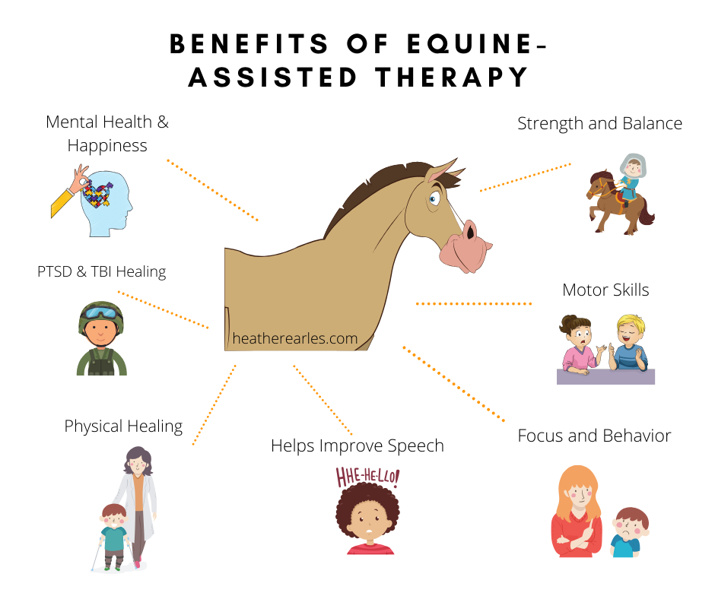
https://i.pinimg.com/originals/80/e2/fe/80e2fe84cc2754a8145a815ca9fb8ca2.png

Slide 9
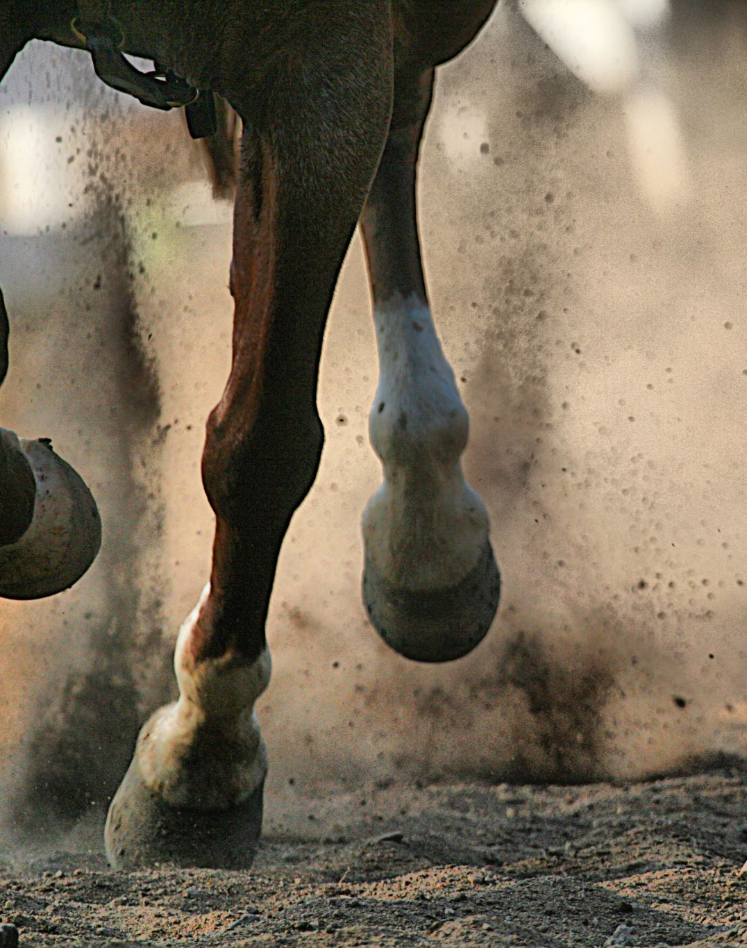
Example Exercises
Balance exercise:
put arms on your thighs,
put arm on the horse’s hindquarters,
Hand-eye coordination exercise:
throwing a ball to a target,
reaching in all directions.

Slide 10
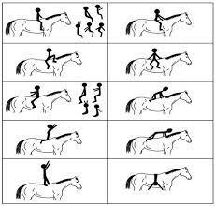

Example Exercises
https://encrypted-tbn0.gstatic.com/images?q=tbn:ANd9GcRNcYeFGS_l434SnQ1mMKLniDVipQFkJKKWzfCL2hsKlw&s

Slide 11
Vocabulary
horse’s hindquarters – zad konia
increasing range of motion – zwiększenie zakresu ruchu
Equine-assisted therapy – terapia na koniach
Buck – bryknięcie
cerebral palsy – porażenie mózgowe
Down syndrome – zespół Downa
autistic behavioural disorders – autystyczne zaburzenia zachowania
muscular dystrophy –dystrofia mięśnowa
cerebrovascular disease (SVD) – choroba naczyń mózgowych
multiple sclerosis – stwardnienie rozsiane
psychiatric diseases – choroba psychiczna
spinal cord diseases – choroba rdzenia kręgowego
rheumatism joint diseases – choroba reumatyczna stawów
gait training – trening chodu,
PTSD (Post-traumatic stress disorder) – zespół stresu pourazowego
TBI (traumatic brain injury) – urazowe uszkodzenie mózgu
Trot - kłus

Slide 12

Quiz
What are some potential benefits of hippotherapy?
Improved balance and coordination
Increased muscle strength and flexibility
Improved speech and language skills
All of the above
Hippotherapy is a therapeutic approach that uses ……… to provide therapy.
Dogs
Horse
Cats
Who can benefit from hippotherapy?
Children with physical disabiliteies
Individuals with neurological conditions
People with speeh and language disorders
All of the above
What is hippotherapy ?
A form of therapy that uses horses to provide physical, occupational, or speech therapy
A therapy specifically designed for hippos
A therapy that involves using hippos to provide emotional suport

Slide 13
References
Tuba Tulay Koca, Hilmi Ataseven, „What is hippotherapy? The indications and effectiveness of hippotherapy”, North Clin Istanbul 2015;2(3):247-252
Ewelina Matusiak-Wieczorek, Elżbieta Dziankowska-Zaborszczyk, Marek Synder, Andrzej Borowsk, „ The Influence of Hippotherapy on the Body Posture in a Sitting Position among Children with Cerebral Palsy”, Public Health 2020;17(18):6846
KwonJY, Chang HJ, YiSH, LeeJY, Shin HY, Kim YH, „Effect of hippotherapy on gross motor function in children with cerebral palsy: a randomized contolled trial, Jaltern Complement Med. 2015;21:15-21
Frevel D, Mäurer M., „Internet-based home training is capable to improve balance in multiple sclerosis: a randomized controlled trial”, Eur J Phys Rehabil Med. 2015;51:23-30
Sharon White-Lewis, „Equine-assisted therapies using horses as healers: A concept analysis”, Nursing Open, 2020;7:58-67

Slide 14

Thank you for your attention!

