Slide 1

Frozen shoulder
Faculty of Medicine, Rzeszów University
Master’s degree studies in Physiotherapy
Year 3
Jakub Gargaś gr. II
Nr. albumu 121622
23.11.2023

Slide 2
Contents
What is frozen shoulder?
Symptoms
Anatomy
Description
Physical Examination
Treatment
Physical therapy
Quiz
Bibliography

Slide 3
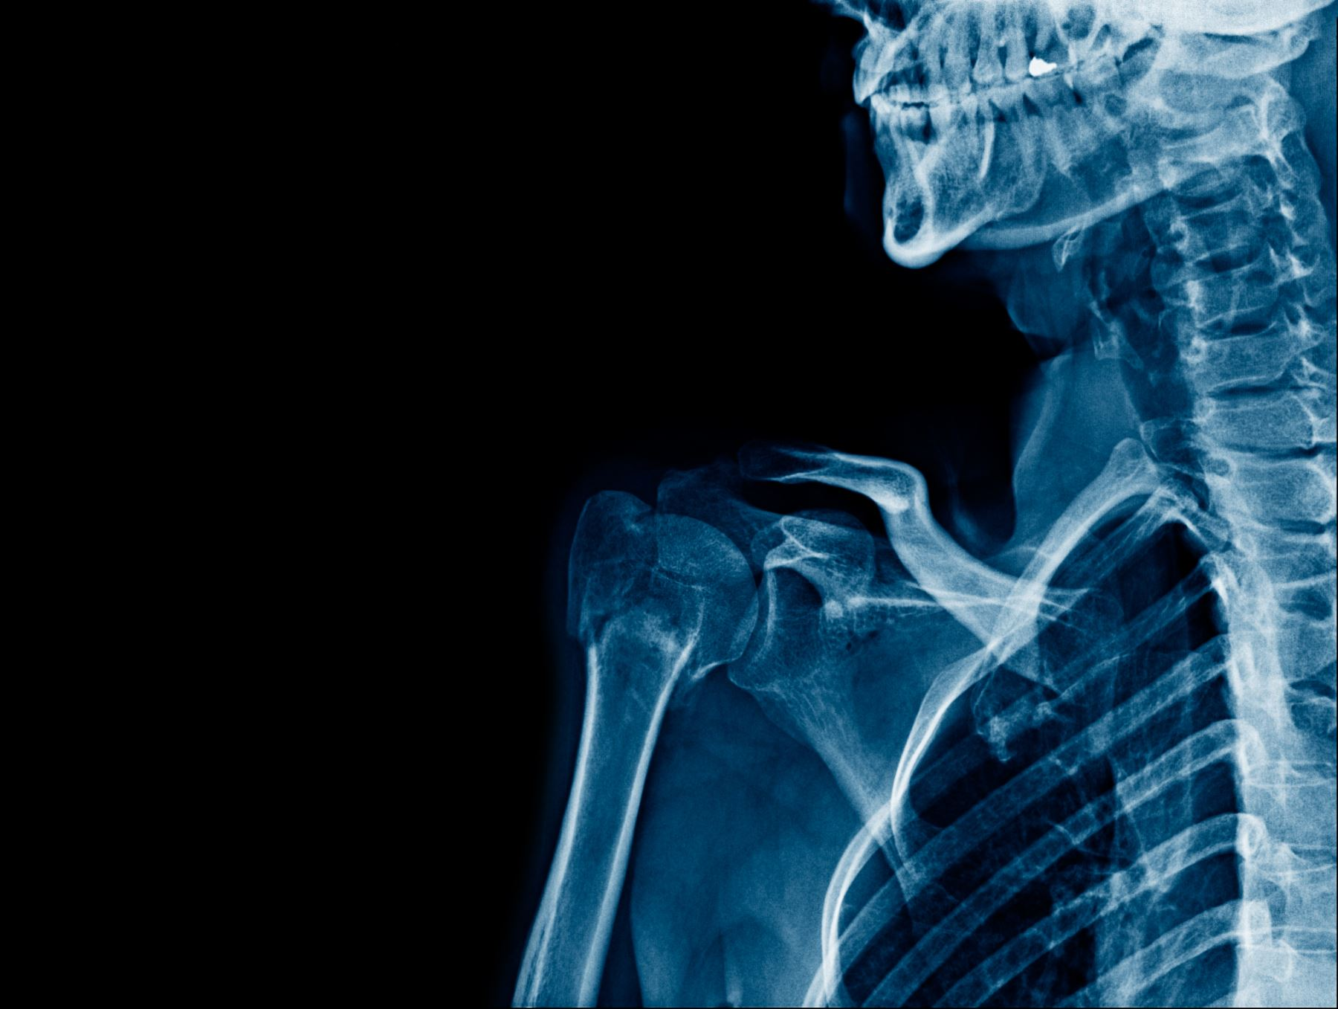
What is frozen shoulder?
Frozen shoulder is a term for problems in the shoulder joint caused by tiny injuries and strain.
It usually happens to people between 40 and 60 years old, and it's more common in women than in men.

Slide 4
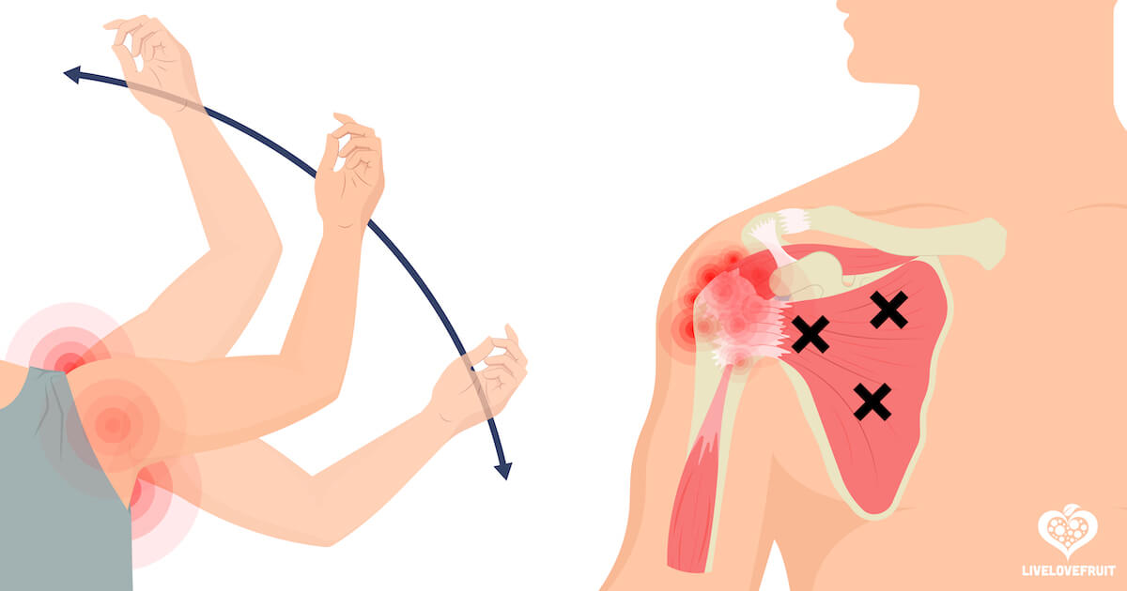
Symptoms
Persistent Shoulder Pain
Gradual Stiffness
Limited Range of Motion

Slide 5
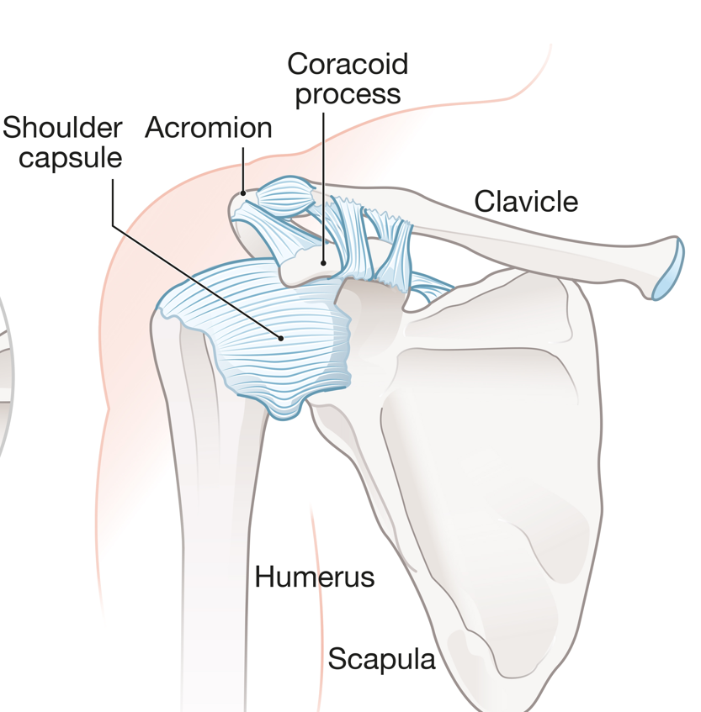
Anatomy
The shoulder made up of 3 bones:
upper arm bone
shoulder blade
your collarbone
And the shoulder capsule surrounds the joint

Slide 6
Description
Stages of frozen shoulder
Stage 1: Freezing
Stage 2: Frozen
Stage 3: Thawing

Slide 7
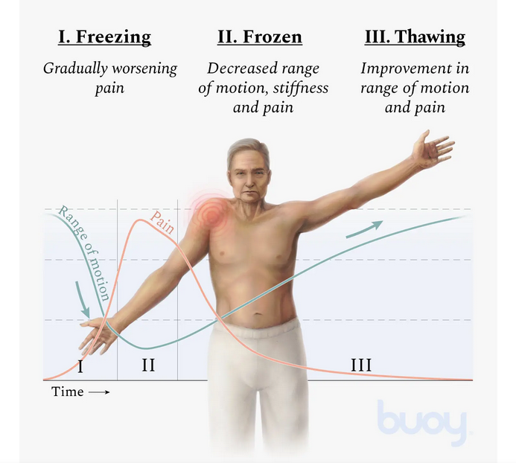

Slide 8
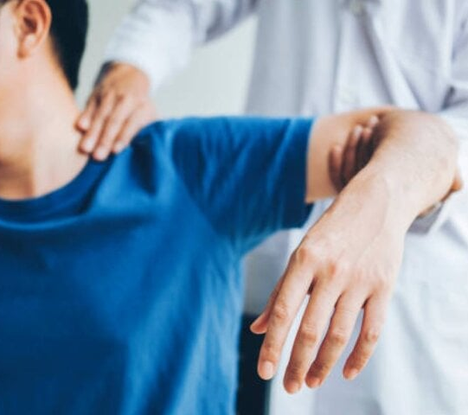
Physical Examination
Muscle Strength Testing
Range of Motion Assessment
Functional Assessment

Slide 9
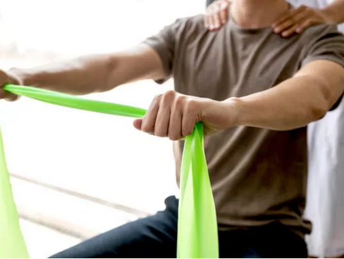
Treatment
Physical Therapy
Heat and Ice Therapy
Corticosteroid Injections
Home Exercises

Slide 10
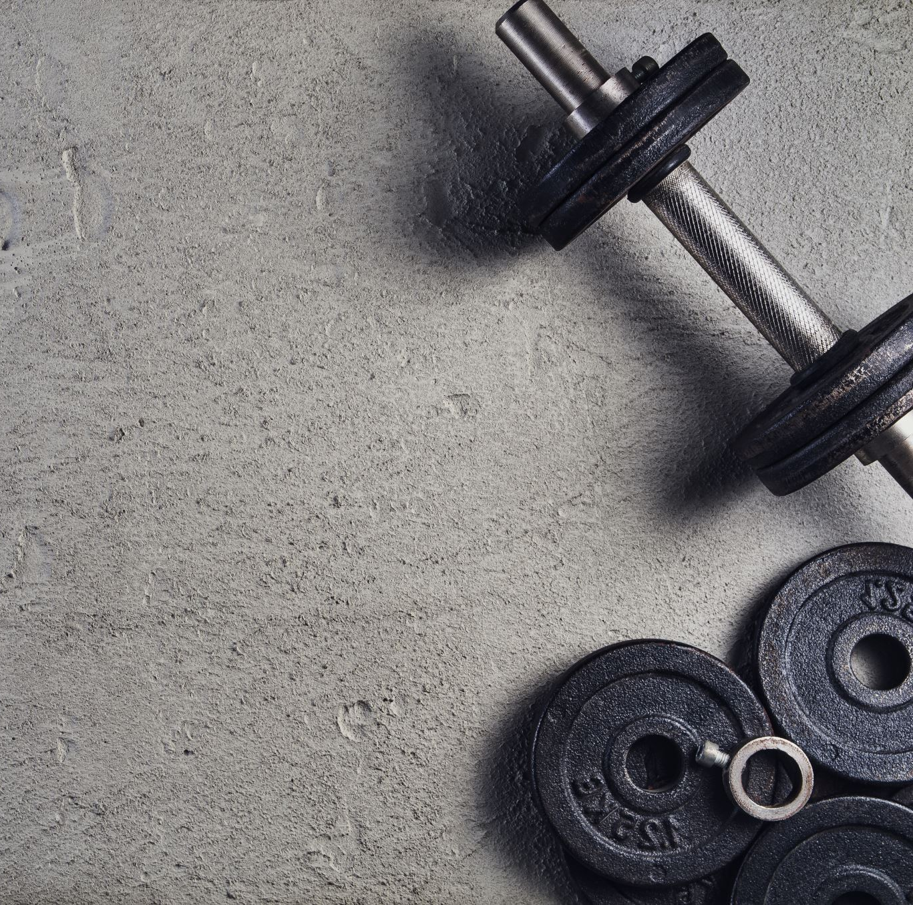
Physical therapy
Sample exercises for a frozen shoulder:
External rotation — passive stretch
Forward flexion — supine position
Crossover arm stretch

Slide 11
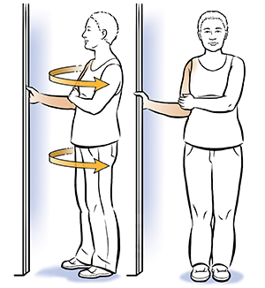
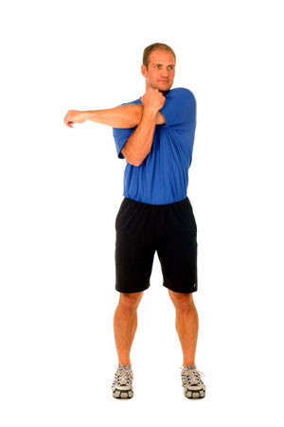
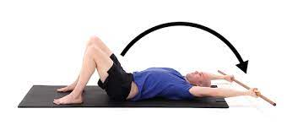

Slide 12
Quiz
Which is second stage of frozen shoulder?:
- Frozen
-Thawing
-Freezing
2. Who is more likely to have frozen shoulder?:
-women
-men

Slide 13
Bibliography:
"Physical therapy in the management of frozen shoulder", Hui Bin Yvonne Chan, BSc(Hons), Pek Ying Pua, BPhty, MManipPhty, Choon How How, MMed, FCFP, doi: 10.11622/smedj.2017107
"Treatment Strategy for Frozen Shoulder", Chul-Hyun Cho , Ki-Choer Bae , Du-Han Kim, doi.org/10.4055/cios.2019.11.3.249
"Frozen shoulder", C M Robinson , K T M Seah, Y H Chee, P Hindle, I R Murray, DOI: 10.1302/0301-620X.94B1.27093
Zdjęcia użyte w prezentacji:
https://thearmdoc.co.uk/frozen-shoulder/
https://livelovefruit.com/10-useful-stretches-frozen-shoulder/
https://www.buoyhealth.com/learn/frozen-shoulder#symptoms
https://www.mp.pl/pacjent/objawy/88166,bol-barku
https://www.csog.net/what-is-frozen-shoulder-causes-symptoms-and-treatment-options/
https://www.performancehealthacademy.com/shoulder-cross-arm-stretch.html
https://websites4sports.blob.core.windows.net/uploads/schoolfiles/74/files/3954_shoulder.pdf
https://www.saintlukeskc.org/health-library/exercises-shoulder-flexibility-external-rotation#

