Slide 1
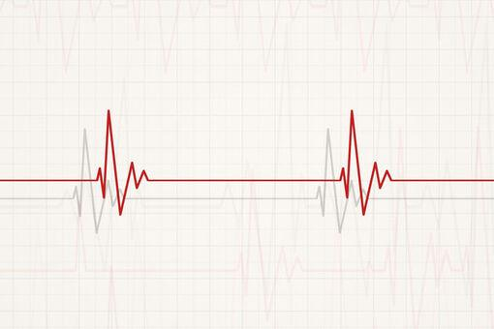

Cardiac Rehabilitation
Natalia Rolek
III R Fizjoterapia JMN
17.01.2025
rok akademicki 2024/2025
https://cdn.medme.pl/zdjecie/15074,510,340,1/bradykardia-zatokowa.jpg

Slide 2
Dictionary
Cardiac rehabilitation - rehabilitacja kardiologiczna
Myocardial infarction - zawał mięśnia sercowego
Acute coronary artery syndrome - ostry zespół wieńcowy
Chronic stable angina - przewlekła stabilna dławica piersiowa
Congestive heart failure - zastoinowa niewydolność serca
Coronary artery bypass -pomostowanie tętnic wieńcowych
Valvular surgery - operacja zastawkowa
Cardiac transplantation - transplantacja serca
Outpatient care - opieka ambulatoryjna
Obstructive cardiomyopathies - kardiomiopatia przerostowa
Aortic stenosis - zwężenie zastawki aortalnej
Ventricular arrhythmias - arytmie komorowe
Diabetes - cukrzyca
A percutaneous coronary intervention - przezskórna interwencja wieńcowa

Slide 3
Presentation outline
Cardiac Rehabilitation helps to heal
Cardiac rehabilitation programs should focus on
Personnel
Indications
Contraindications
Program
Phase 1: Acute phase in the hospital
Phase 2: Subacute Outpatient Care
Phase 3: Comprehensive cardiac rehabilitation and Phase 4: Maintenance

Slide 4

Cardiac Rehabilitation helps to heal
Cardiac Rehabilitation is a personalized program that helps patients reduce and manage their symptoms while improving their quality of life. This program includes exercise counselling, stress reduction advice, education for heart-healthy living, nutritional guidance, and a smoking cessation strategy. Early recovery is aided by comprehensive treatment and lifestyle changes, which allow patients to regain independence and normalcy.
https://cdn.apollohospitals.com/health-library-prod/2023/03/cardiac-rehab-1.jpg

Slide 5
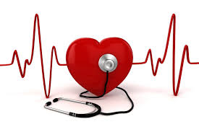
Cardiac rehabilitation programs should focus on:
Patient assessment nutritional counseling
Weight management
Blood pressure management
Lipid management
Diabetes management
Tobacco cessation
Psychosocial management
Physical activity counseling
Exercise training
https://reverehealth.com/_next/image/?url=https%3A%2F%2Frevere-health.hqdemo.app%2Fwp-content%2Fuploads%2FDepositphotos_41491341_l-2015.jpg&w=2048&q=75

Slide 6

Personnel
The cardiac rehabilitation team is made up of members including the following:
Patient
Patient's family
Physicians (surgeons, cardiologists, physiatrists, other specialists)
Pharmacists
Behavioral therapists
Dietitian
Case managers
Nurses
Physical therapists
https://cdn.vectorstock.com/i/1000v/83/47/group-of-hospital-medical-staff-standing-together-vector-21968347.jpg

Slide 7

Indications
Recent myocardial infarction
Acute coronary artery syndrome
Chronic stable angina
Congestive heart failure
After coronary artery bypass surgery
After a percutaneous coronary intervention
Valvular surgery
Cardiac transplantation
https://fortecardiology.sg/wp-content/uploads/2024/01/cardiac-rehabilitation.jpg

Slide 8
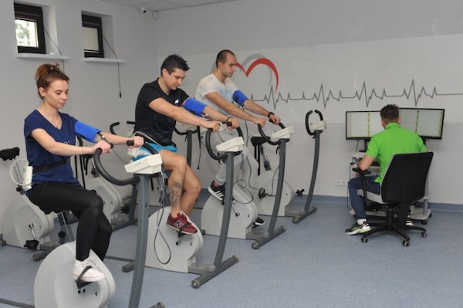
Contraindications
Unstable angina
Acute decompensated congestive heart failure
Complex ventricular arrhythmias
Severe obstructive cardiomyopathies
Severe or symptomatic aortic stenosis
Uncontrolled inflammatory or infectious pathology
Any musculoskeletal condition that prevents adequate participation in exercise
https://uzdrowisko-naleczow.pl/wp-content/uploads/2023/08/rehabilitacja-kardiologiczna.jpg

Slide 9
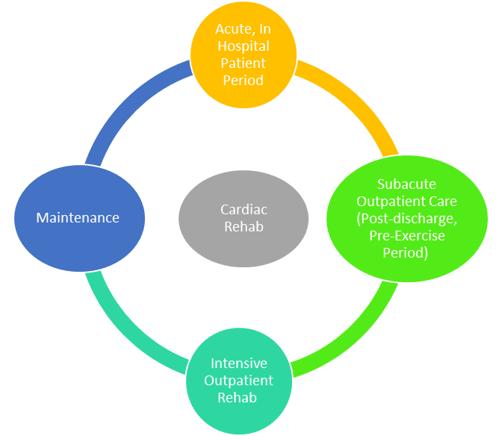
Program
A cardiac rehabilitation programme will most likely go through four main phases:
https://cdn.apollohospitals.com/health-library-prod/2023/03/image-640c6f512aa5e.png

Slide 10
Phase 1: Acute phase in the hospital
Patients with acute cardiac diseases, e.g., those recovering from heart surgery or a heart attack, may be referred to a cardiac rehabilitation team while still in the hospital. Depending on your physical condition, this stage will likely last between 2 and 5 days. The primary goal of the first phase of cardiac Rehabilitation is to enable you to return home from the hospital as quickly and safely as possible.

Slide 11
Phase 2: Subacute Outpatient Care (Post-discharge, Pre-Exercise Period)
Phase 2 occurs at an outpatient care facility after you leave the hospital. Between three and six weeks will pass during this second phase. The primary objective of Phase 2 is helping you become more independent and knowledgeable. You should learn how to self-monitor your heart rate and exertion levels during exercise. The primary objective is to enable you to enter Phase 3 and increase your level of independence.

Slide 12
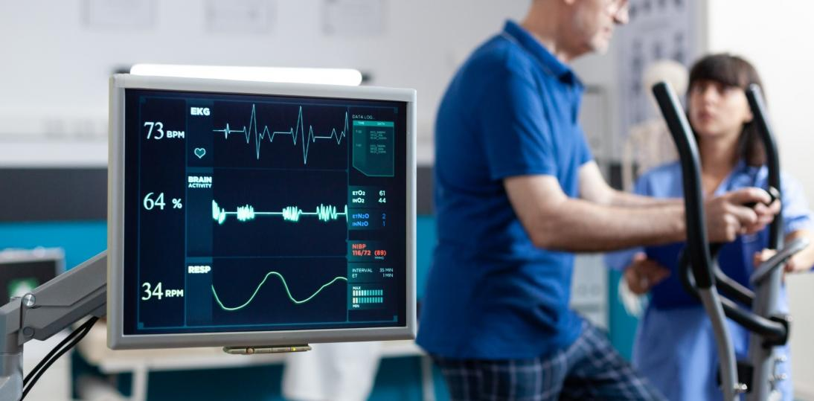
Phase 3: Comprehensive cardiac Rehabilitation
Phase 4: Maintenance
Phase 4 continues throughout your entire life. Phase 4 is to keep the lifestyle changes you started in Phase 3 going, continue your exercise routine, stop smoking, eat well, and control your stress.
Phase 3 introduces more independent exercises and self-monitoring, while Phase 2 is geared toward patients still severely affected by their heart condition.
https://medicalpress.pl/public/media/images/thumbs/artykuly/4005/thumb_1094_539_close-up-heart-rate-monitor-measuring-heartbeat-patient-doing-gymnastics-physical-recovery-retired-man-using-sport-equipment-exercise-physiotherapy-strength-1.jpg

Slide 13

Thank you for your attention!

Slide 14
Bibliography:
“Cardiac Rehabilitation” Tessler J, Bordoni B Study Guide from StatPearls Publishing, Treasure Island (FL), 07 Feb 2019 PMID: 30725881
English for physiotherapy, Joanna Ciecierska, Warszawa, Wydawnictwo Lekarskie PZWL
https://www.apollohospitals.com/health-library/cardiac-rehabilitation/?fbclid=IwY2xjawHzGEdleHRuA2FlbQIxMAABHUxXc_or0zZNOke81ks3WsQ5m93PoVR1NswAvkjfCOBSs0ovl59o079UoA_aem_O4OEs6yFtKS21e0ZxkWHMw

