Slide 1
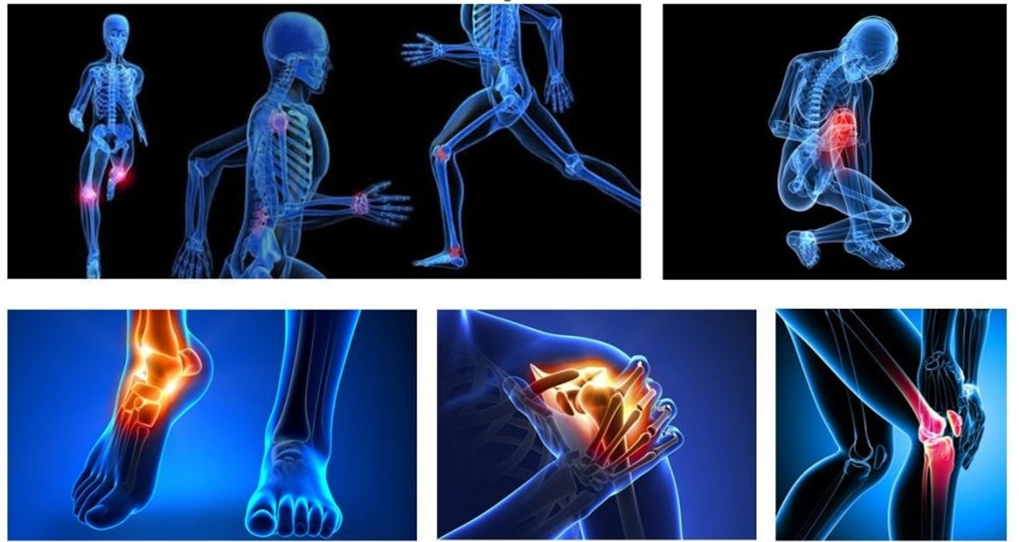

University of Rzeszów
Faculty of Medical Sciences
Sports injuries
Bartłomiej Gwizdała
Język Angielski
III R Fizjoterapia JMN 2024/25

Slide 2
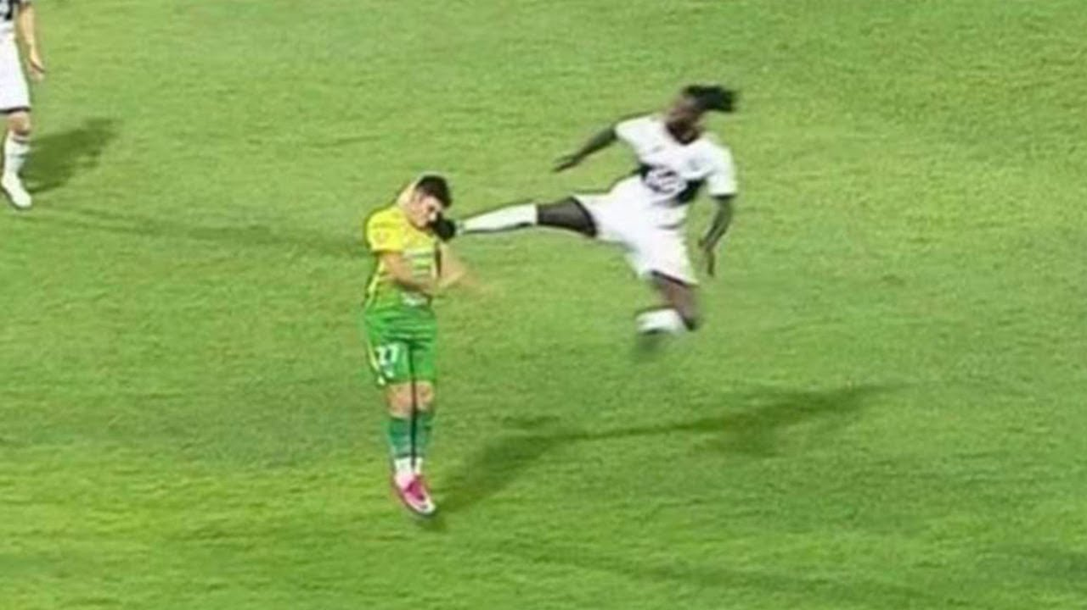
Vocabulary:
Direct - Bezpośredni
Cause, reason - przyczyna, powód
Tissue -Tkanka
Occur - pojawiać się
Internal forces - Siły wewnętrzne
Overuse - Nadużywanie
Dislocations - zwichnięcia
Extrinsic - Zewnętrzne
Intrinsic - Wewnętrzne
Connective tissues - Tkanki łączne
Sprain - Skręcenie
Bruise - Stłuczenie - stłuczenie
Severe Ciężki - poważny
Treatment - leczenie
Tendon - ścięgno
Sartorius muscle- mięsień krawiecki
Avulsion - złamanie gdzie mały kawałek kości przymocowany do ścięgna lub więzadła zostaje oderwany od głównej części kości.
Inversion and Eversion - odwrócenie i nawrócenie
Tear - Rozdarcie, zerwanie

Slide 3
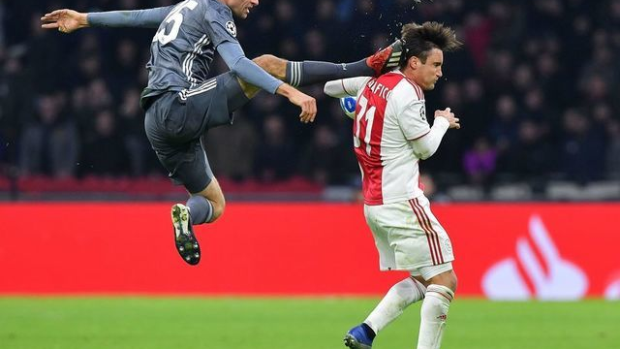
What are the types of sports injuries?
What is an injury?
TYPES OF SPORTS INJURIES
MECHANICAL
* Direct injuries
* Indirect injuries
CHRONIC (overload)

Slide 4
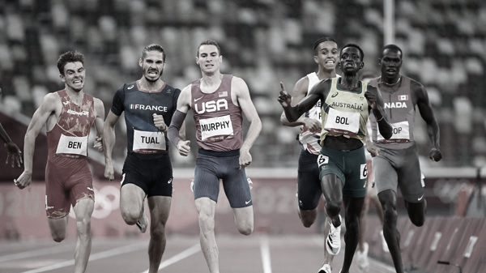
Which body tissues are damaged?
Type:
- hard tissue (fractures)
- soft tissue (strains, sprains and bruises)
95% of sports injuries are minor soft tissue traumas.

Slide 5

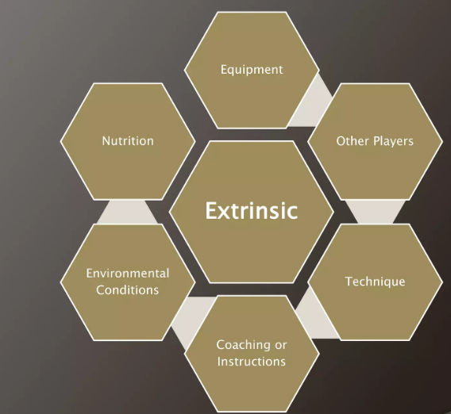
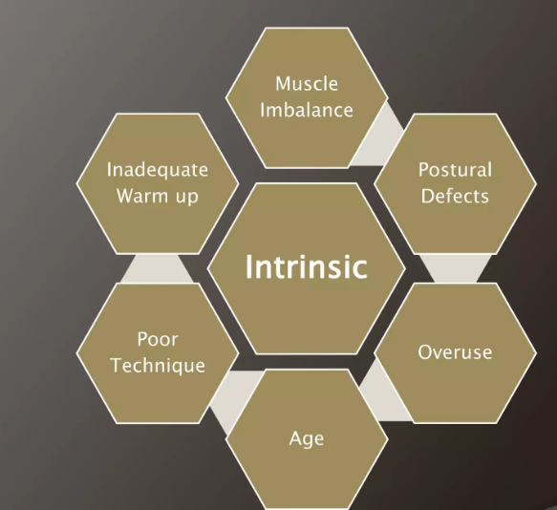
Risk factors for sport injury

Slide 6
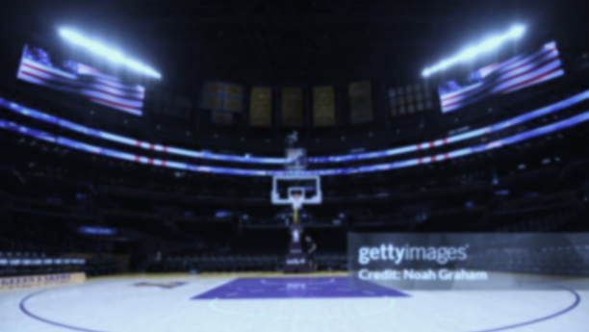
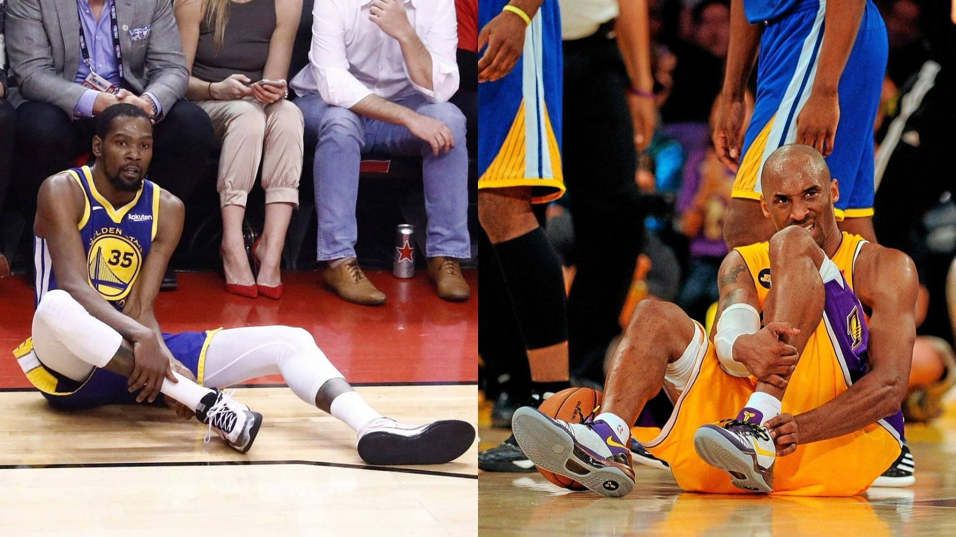
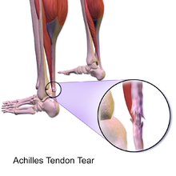
Typical sports injuries in selected sports Basketball
Achilles Tendon Tear

Slide 7
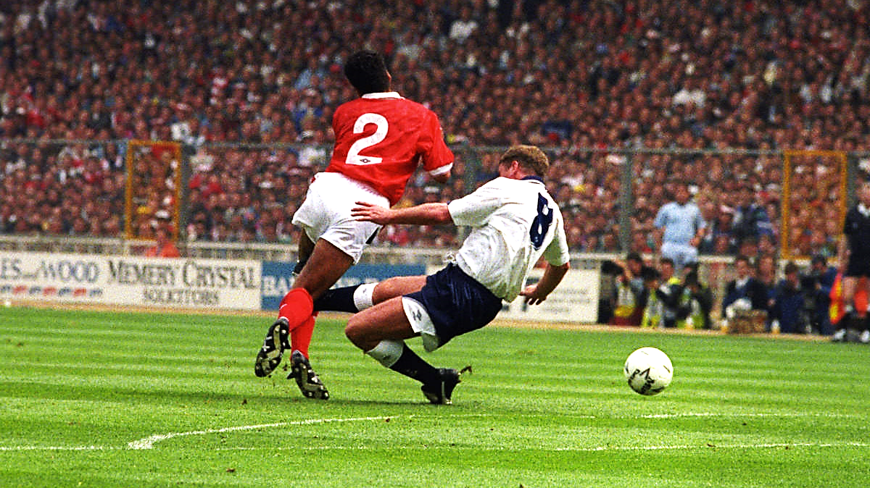
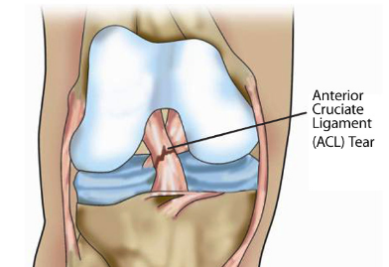
Typical sports injuries in selected sports
Football
Anterior Cruciate Ligament (ACL) Tear

Slide 8
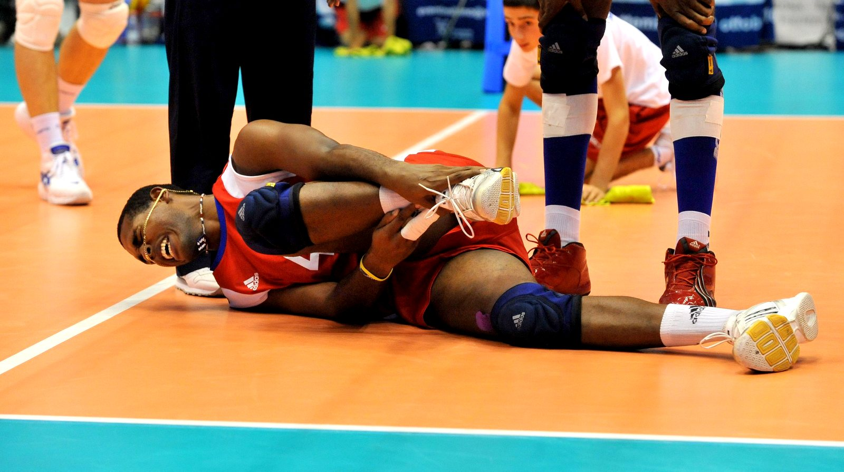
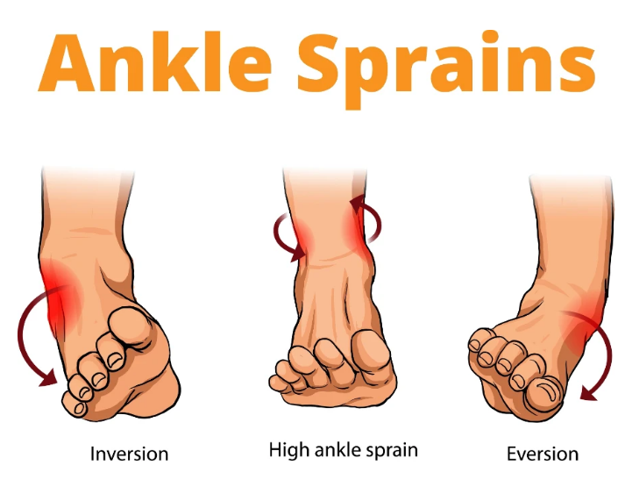
Typical sports injuries in selected sports volleyball
Ankle Sprains

Slide 9

Typical sports injuries in sports
Athletic Running
Achilles tendon injuries
Strains or tears in muscles
Avulsion fractures in sprinters
Athletic Jumping
Bruising
Ankle sprains
Meniscus injuries
Pain in patellar cartilage
Athletic Throwing
Tears of the biceps brachii
Avulsion the humerus
Muscle tears
Spiral fractures
Handball
Finger injuries:
Elbow dislocations
Muscle tears

Slide 10
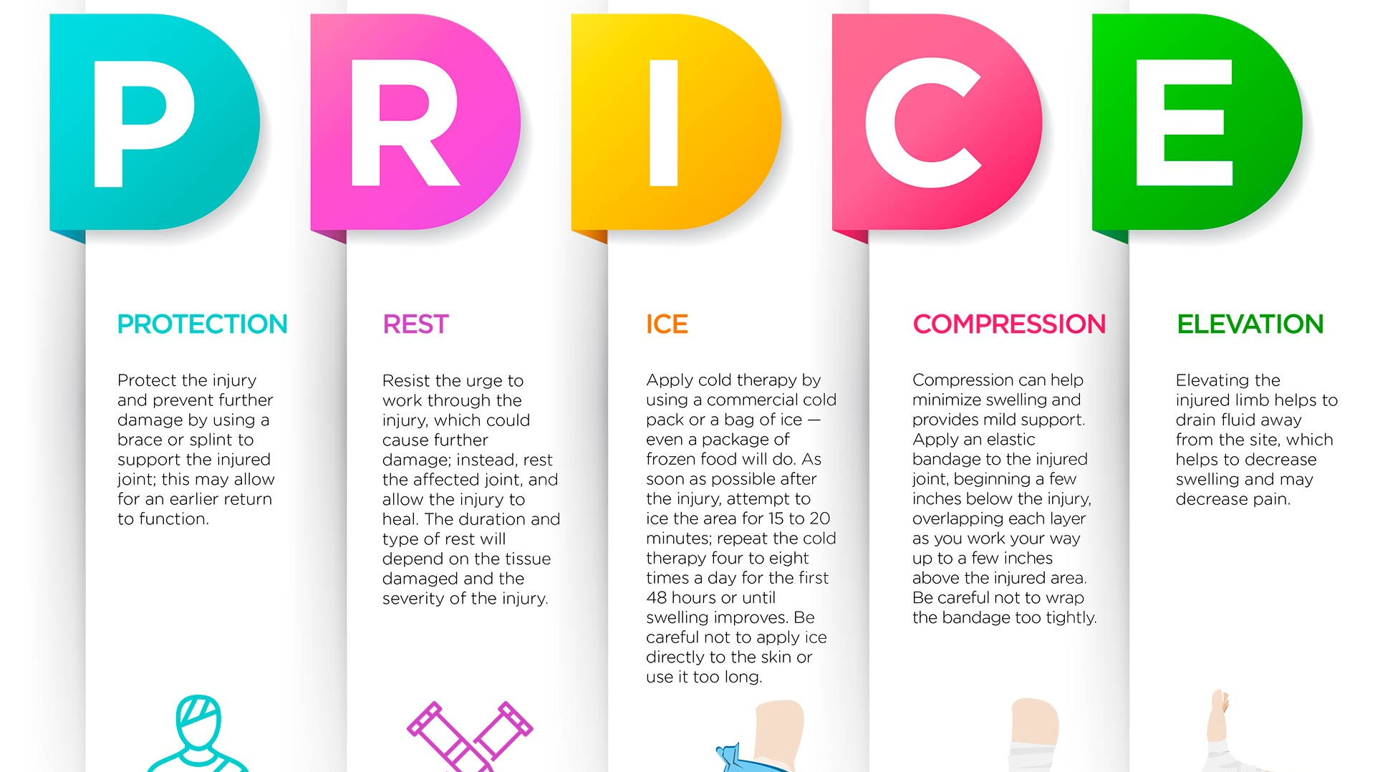
First aid after a sports injury

Slide 11
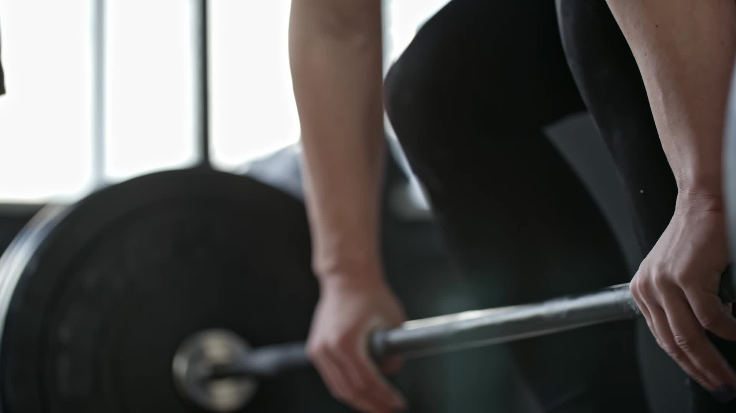
DO NOT STOP TRAINING
WHO recommendations for sports activities recommend physical activity every day for at least about 30 minutes, between the ages of 18-65,
plus muscle strengthening exercises 2-3x a week

Slide 12

QUIZ
1.What is full name of shot term of ACL?
a) Anaconda Cobra Lazyness
b) Anterior Cruciate Ligament
c) It depends on ...
d) There was no such information in the presentation
2. What is the most common method used for sports injures treatment?
a) PRICE
b) POLICE
c) It depends on ...
d) There was no such information in the presentation

Slide 13

Bibliography:
Eerkes, Kevin MD. Volleyball Injuries. Current Sports Medicine Reports 11(5):p 251-256, September/October 2012. | DOI: 10.1249/JSR.0b013e3182699037
Krajewska-Kułak Elżbieta, Łukaszuk Cecylia, Lewko Jolanta [i in.] (red.): Holistyczny wymiar współczesnej medycyny. T. 5 : praca zbiorowa, 2019, Uniwersytet Medyczny w Białymstoku, 1390 s., ISBN 978-83-948644-9-1
Dziak A, Tayara S Urazy i uszkodzenia w sporcie Kraków 2000 ISBN: 83-910437-0-3
Garrick JG, Requa RK. Injuries in high school sports. Pediatrics. 1978 Mar;61(3):465-9. doi: 10.1542/peds.61.3.465. PMID: 643419.
https://www.hopkinsmedicine.org/health/conditions-and-diseases/sports-injuries/sports-injury-statistics
https://www.niams.nih.gov/health-topics/sports-injuries
Magiera.L , Walaszek. E Masaż sportowy z elementami odnowy biologicznej BIOSPORT Kraków 2019

Slide 14
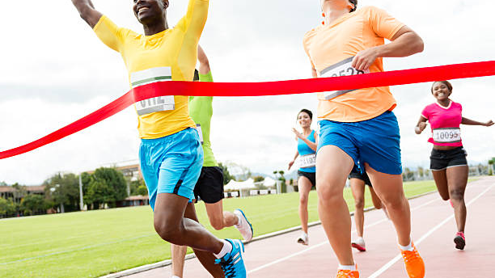
THANK YOU FOR YOUR ATTENTION

