Slide 1
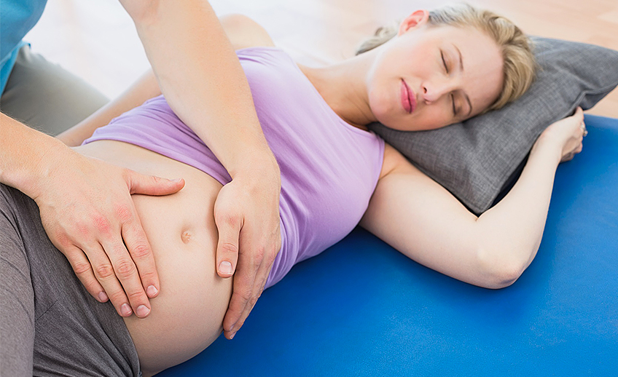

Physiotherapy for pregnant women
Author: Wiktoria Hołyszko
Rzeszów University
Physiotherapy, year 3
JMGR, extramural studies
Date: 26.11.2023r.
https://images.app.goo.gl/wnUcYr6h6mhsLYYF7

Slide 2
Medical definition of childbirth
Pregnancy is the term used to describe the period in which a fetus develops inside a woman's womb or uterus. Pregnancy usually lasts about 40 weeks, or just over 9 months, as measured from the last menstrual period to delivery. Health care providers refer to three segments of pregnancy, called trimesters.

Slide 3
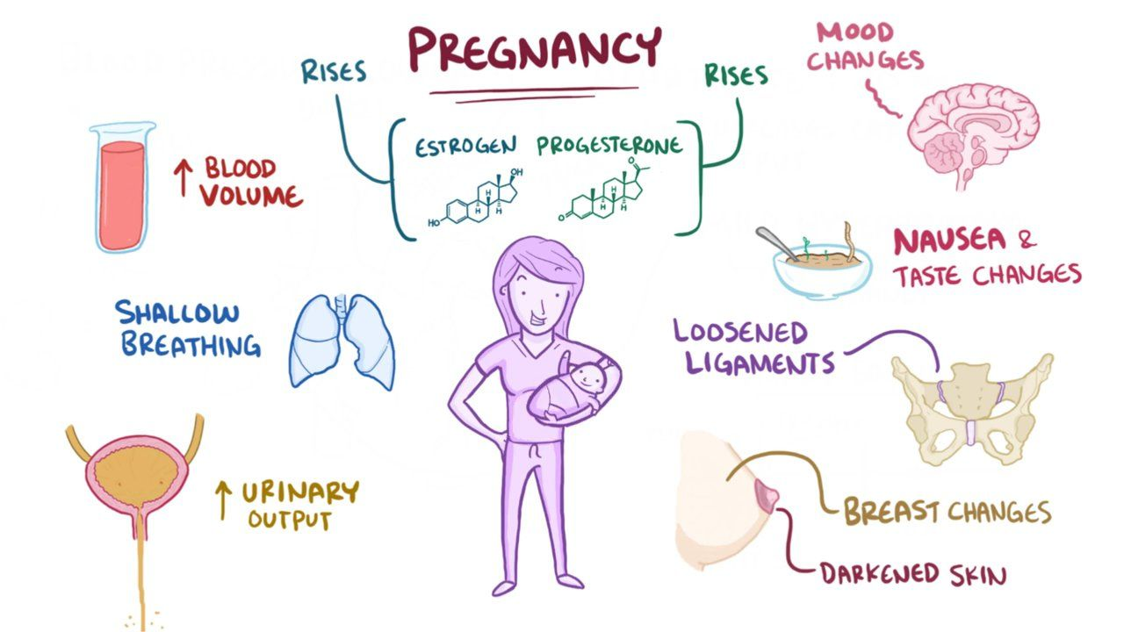
Biomechanical changes in a woman's body during pregnancy
https://images.app.goo.gl/U1yu4E2tyuWQrR8L6

Slide 4
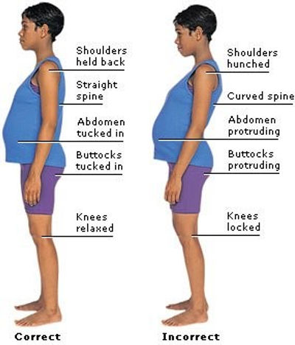
Body posture changes during pregnancy
During pregnancy, posture and gait are altered; the centre of gravity moves forward, increasing lumbar lordosis, while the head and trunk are borne further back. This change impacts on gait, as the body sways laterally and the legs are separated slightly more than normal, producing a frontal plane movement.
https://images.app.goo.gl/ao4FdBJfZFqk2vzK7

Slide 5
Contraindications to exercise for pregnant women
Absolute contraindications:
Severe respiratory diseases (eg, chronic obstructive pulmonary disease, restrictive lung disease and cystic fibrosis)
Severe acquired or congenital heart disease with exercise intolerance
Uncontrolled or severe arrhythmia
Placental abruption
Vasa previa
Uncontrolled type 1 diabetes
Intrauterine growth restriction (IUGR)
Active preterm labour
Severe pre-eclampsia
Cervical insufficiency

Slide 6
Benefits of physiotherapy for pregnant women:
Back Pain
Regain Muscle Strength
Make childbirth easier and less painful
Shortened Postpartum Recovery
Reduce Pelvic Floor Muscle Dysfunction
Improve sleep
Alleviate other pregnancy sympthoms

Slide 7
Examples of simple exercises during your pregnancy
Low impact cardiovascular exercises
Antenatal Pilates or Yoga
Pelvic floor muscle exercises
Stretching exercises
Rectus abdominis muscle exercises
Stabilizing exercises

Slide 8
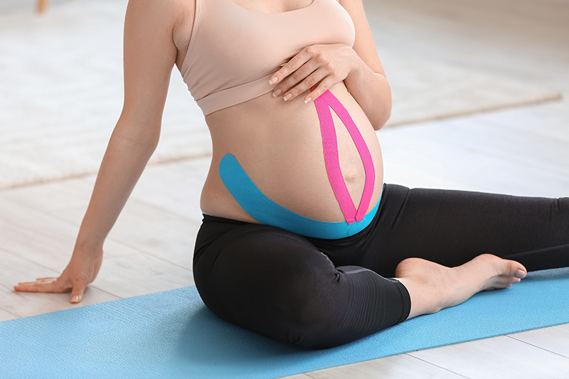
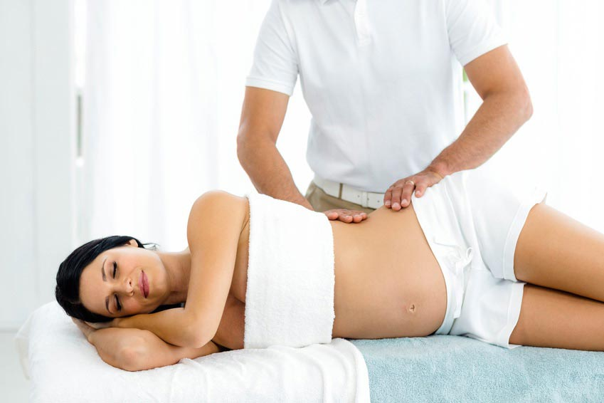
Other physiotherapeutic methods used during pregnacy
Kinesiology Taping Massage
https://images.app.goo.gl/YW16s24ohgGy8QD38
https://images.app.goo.gl/iQHfAkFLnwSdUM7M7

Slide 9
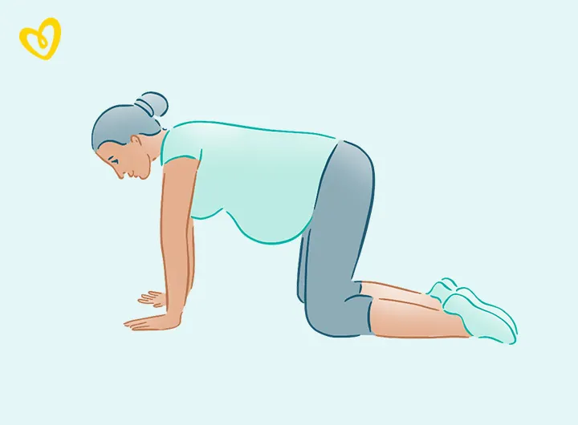
Four simple Pregnancy Exercises for Every Trimester
Four-point kneeling:
Kneel on all fours with your hips in line over your knees and your shoulders in line over your hands.
Straighten your back.
Take a deep breath, and as you slowly exhale, pull in your abdominal muscles, a.k.a. “engaging” those muscles. Imagine you’re pulling your belly button into your spine.
Return to your starting position and repeat five times.
https://images.ctfassets.net/9wtva4vhlgxb/4pvsKWoUqySgSd3PZnGLoG/9e8a46f2f3c96b1b2e8514d19cd58c60/US__Pregnancy_exercises_Desktop_7.jpg?w=720&fm=webp&q=70

Slide 10
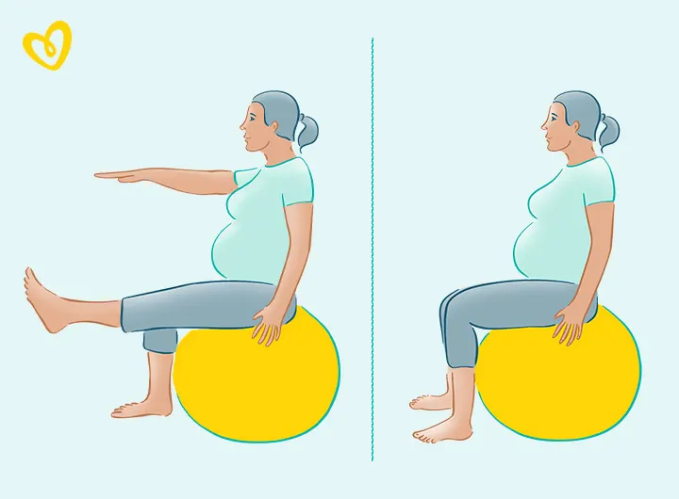
Seated ball balance
This is a yoga ball exercise that works your abdominals and helps improve balance and stability.
Sit in the center of the ball with a neutral back and feet flat on the floor, hip width apart.
Pull your belly button toward your spine to engage your abs.
Keep breathing and holding your muscles as you straighten and lift one leg up and extend the opposite arm (so, left leg/right arm, and vice versa).
Hold for a few seconds.
https://images.ctfassets.net/9wtva4vhlgxb/3YM1s5GuFNToF8on58RAGd/96154f80c9a8378755a8bbe1fa3c8212/US__Pregnancy_exercises_Desktop_2.jpg?w=720&fm=webp&q=70

Slide 11
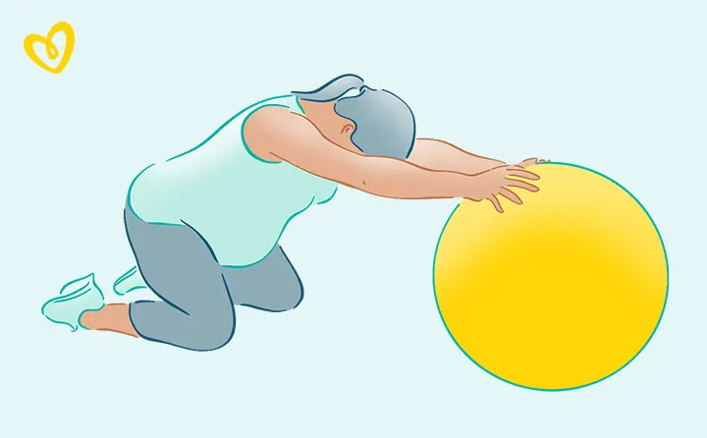
Shoulder stretch
For back pain, stretching is just as important as toning. This yoga ball exercise can help deepen your stretch gently.
Kneel on the floor with your ball in front of you, holding it on either side with your hands.
As you roll the ball forward, sit back on your hips and keep your gaze downward.
Stretch as much or as little as needed and hold for a few seconds.
Return to a kneeling position and repeat a handful of times.
https://images.ctfassets.net/9wtva4vhlgxb/5mKeREOufUGXMAUw3Hm1Ah/4e4bfa9ba578c3aa2f3aff67b00a1ec5/US__Pregnancy_exercises_Desktop_4.jpg?w=720&fm=webp&q=70

Slide 12
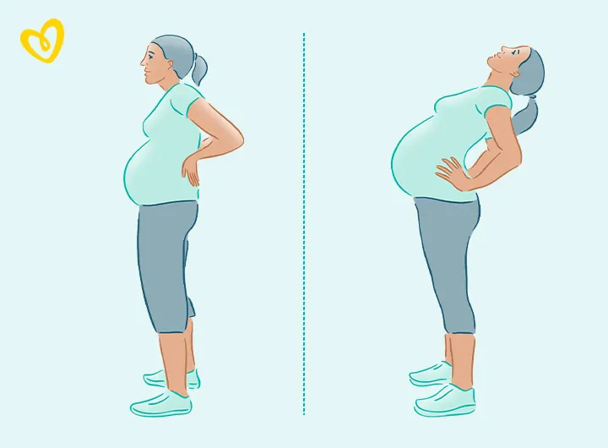
Back bend
Gentle back bends help counteract the tendency to lean forward as your belly expands.
Stand up straight with your feet hip width apart and your palms on the back of your hips.
Slowly and gently (don’t bend too much, just about 15 to 20 degrees), lean back.
Hold for about 20 seconds and slowly return upright.
Repeat about five times.
https://images.ctfassets.net/9wtva4vhlgxb/3NIluIBuloN6Uvus0IS0ee/b6fc94420b3fc167570d86d7e318c269/US__Pregnancy_exercises_Desktop_8.jpg?w=720&fm=webp&q=70

Slide 13
Vocabulary
Fetus- płód
Womb- łono
Uterus- macica
Lumbar lordosis- lordoza lędźwiowa
Severe respiratory diseases- ciężkie choroby układu oddechowego
Severe acquired or congenital heart disease with exercise intolerance- ciężka nabyta lub wrodzona choroba serca z nietolerancją wysiłku fizycznego.
Uncontrolled or severe arrhythmia- niekontrolowana lub ciężka arytmia
Placental abruption- oderwanie łożyska
Uncontrolled type 1 diabetes- niekontrolowana cukrzyca typu 1
Intrauterine growth restriction (IUGR)- wewnątrzmaciczne ograniczenie wzrostu
Active preterm labour- aktywny poród przedwczesny
Severe pre-eclampsia- ciężki stan przedrzucawkowy
Cervical insufficiency- niewydolność szyjki macicy

Slide 14

Bibliography:
Biomechanical changes in pregnant women, 2009- Agnieszka Opala-Berdzik, Bogdan Bacik, Małgorzata Kurkowska.
About pregnancy, 2017- Eunice Kennedy Shriver National Institute of Child Health and Human Development.
Why can’t I exercise during pregnancy? Time to revisit medical ‘absolute’ and ‘relative’ contraindications: systematic review of evidence of harm and a call to action, 2020- Victoria L Meah ,Gregory A Davies,Margie H Davenport.
Morphological and Postural Changes in the Foot during Pregnancy and Puerperium: A Longitudinal Study, 2021- Monserrat Alcahuz-Grinan, Pilar Nieto-Gil, Pedro Perez-Soriano, Gabriel Gijon-Nogueron.
7 Benefits of Physical Therapy for Pregnancy, 2023- Dr. Lambros Lambrou.
Exercise in Pregnancy: A Clinical Review, 2015- Sally K. Hinman, Kristy B. Smith, M. Seth Smith.
Exercise During Pregnancy: Get Moving With Safe and Simple Pregnancy Exercises, 2021.

Slide 15
Thank you for your attention

