Slide 1

Massage in physiotherapy
KAROLINA KMIECIK
IIIR FIZJOTERAPIA JMN
ROK AKADEMICKI 2023/2024
SEMESTR ZIMOWY
https://www.ur.edu.pl/files/ur/import/Aktualnosci/2019/5/logo_UR_blue.jpg

Slide 2
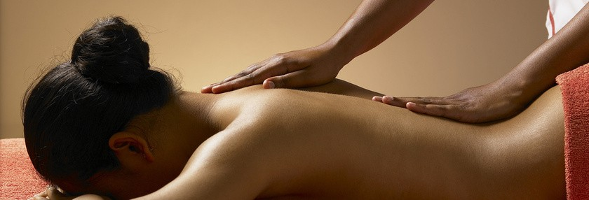
MASSAGE DEFINITION
https://www.doz.pl/czytelnia/a16178-Masaz__rodzaje_wskazania_przeciwwskazania_techniki_masazu_stosowanego_w_fizjoterapii
Massage is an impact on the body that uses mechanical stimuli, mainly in the form of pressure on tissues, in order to induce reactions.

Slide 3
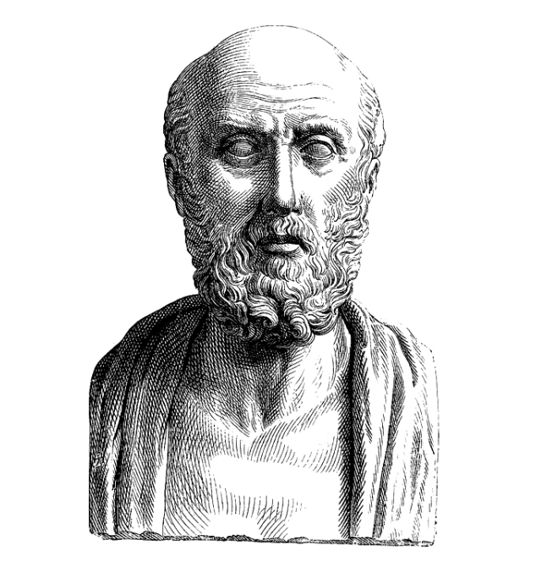
HISTORY OF MASSAGE
the oldest therapeutic treatment
comes from China and India
is found in the first books of Hippocrates
using massage after surgery brings relief
greatest merits in Poland
https://www.podkop.com/2023/01/13/hipokrates/

Slide 4
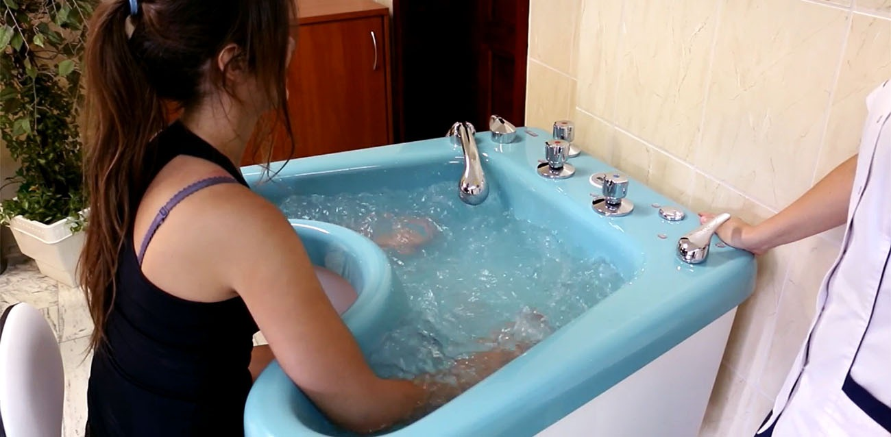
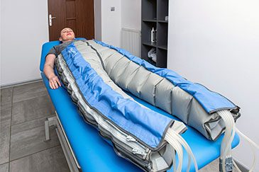
DIVISION OF MASSAGES
Classic massage
Special massage
Lymphatic drainage
Segmental massage
Isometric massage
Periosteal massage
Water massage
Pneumatic massage
https://sklep.meden.com.pl/blog/aktualnosci/masaz-wirowy-wskazania-przeciwwskazania-oraz-efekty-stosowania
https://manualmedfizjo.pl/masaz-pneumatyczny-boa/

Slide 5
FORMS OF MASSAGE
Short stimulus – 5-15min. - Massage until a local reaction occurs
Medium stimulus – 15-30min. - During the massage, there must be a local reaction and partly appropriate general reactions
Long-stimulus – 30-45min. - During the massage, there must be a local reaction and general reactions

Slide 6
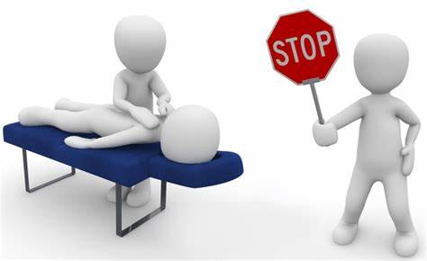
RED FLAGS
High Temperature
Hemorrhage
Inflammation
Blood Disorders
Pregnancy
Cancer
Skin rupture
Heart defects
przeciwskazania - Bing images

Slide 7
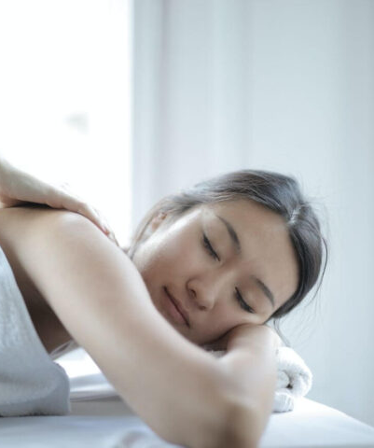
INDICATIONS
Myalgia
Overwork
Tiredness
High stress
Problems with blood circulation.
Masaż klasyczny – poznaj techniki i wskazania do zabiegu – Estetico

Slide 8
TECHNIQUES IN CLASSICAL MASSAGE
STROKING - It is used to start and end each classical massage session. In addition, stroking improves circulation and eliminates potential stagnation and swelling
RUBBING – after a stroking session, it's time to rub the muscles. With the help of the thumbs or the base of the hand, circular outward movements are made. Local pressure causes the swollen cells to be crushed, which causes the secretion of histamine

Slide 9
TECHNIQUES IN CLASSICAL MASSAGE
SHAKING – is a technique of performing classical massage, the main purpose of which is to relax muscle tension.
KNEADING – this removes the fluid that accumulates in the tissues. Kneading helps in the fight against injuries in the first place.

Slide 10
TECHNIQUES IN CLASSICAL MASSAGE
VIBRATION – this technique is primarily aimed at reducing the tension of muscle fibers;
PATTING – this technique causes severe congestion in the area of the body where it is used.

Slide 11
EFFECTS OF CLASSICAL MASSAGE
reduction of stiffness and tension in the muscles
reducing stress and anxiety
improved well-being
postural correction
improving joint flexibility
easier deep breathing
improvement of the condition of the skin
reduction of muscle pain
acceleration of healing of some injuries

Slide 12
PAIN IN THE LUMBAR SPINE AND MASSAGE
The results of the conducted studies indicate high effectiveness of the treatment
chronic back pain with classical massage in terms of reducing the level of pain
and improving the range of motion of the spine

Slide 13
PAIN IN THE LUMBAR SPINE AND MASSAGE
Conclusions: A series of 10 classical massage treatments has a statistically significant effect on reduction of spinal pain in the lumbosacral spine and on the improvement of the patient's functional status.

Slide 14
DICTIONARY
Myalgia - ból mięśni
Hemorrhage – krwotok
Cancer- nowotwór
Joint – staw
Injuries – uraz
Stroking - głaskanie
Rubbing – rozcieranie
Kneading – ugniatanie
Patting – oklepywanie

Slide 15
BIBLIOGRAPHY
A. Zborowski - Masaż Klasyczny, 2008r.
Anna Kałużna, Krystian Kałużny, Bartosz Kochański, Kamil Kluska, Olga Płoszaj, Walery Zukow, Wojciech Hagne Evaluation of the resultsof treatmentof chronicback painin thelumbosacralsegmentby use of theclassical massage Katedra i Klinika Rehabilitacji, Wydział Nauk o Zdrowiu, Uniwersytet Mikołaja Kopernika w Toruniu;
Kamila Pilok, Jakub Taradaj , Tomasz Halski , Kamil Kręcijasz, Robert Dymarek, Kuba Ptaszkowski , Joanna Resel, Lucyna Słupska The attempt of objective evaluation of the lower leg classical massage effects – three cases report Instytut Fizjoterapii, Państwowa Medyczna Wyższa Szkoła Zawodowa w Opolu
Classic massage - relaxation techniques, relaxation massage device, July 2022

Slide 16
THANK YOU FOR YOUR ATTENTION

