Slide 1

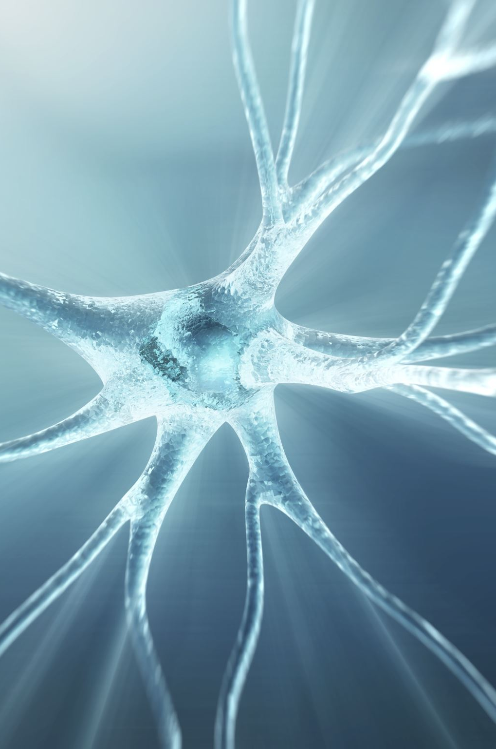
Parkinson's disease - physiotherapy
Ewelina Boroń
III Rok Fizjoterapia
Niestacjonarne studia jednolite magisterskie
Rok akademicki 2023/2024

Slide 2
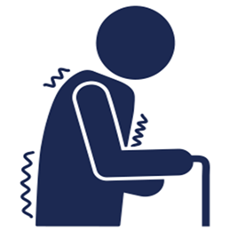
Parkinson's disease
Chronic, progressive disease characterized by Rigidity, Bradykinesia, Tremor and Postural instability.
Onset is insidious, slow rate of progression
It is superseded only by Alzheimer’s Disease as the most common neurodegenerative disorder

Slide 3
etiology
The etiology of Parkinson's disease remains an enigma at this time. Speculations on the subject have covered a broad range of possibilities. Two have seemed particularly attractive – heredity and viral infection.
Age is the biggest risk factor for PD, with the median age of onset being 60 years of age.

Slide 4
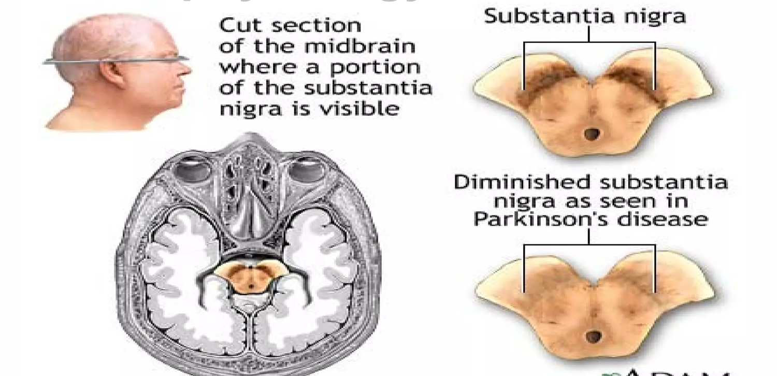
Pathogenesis and pathophysiology
PD is a disorder of the dopamine (DA) producing neurons of the substantia nigra in the basal ganglia.
https://www.researchgate.net/figure/The-substantia-Nigra-region-of-healthy-person-and-PD-patient-11_fig1_330249916

Slide 5

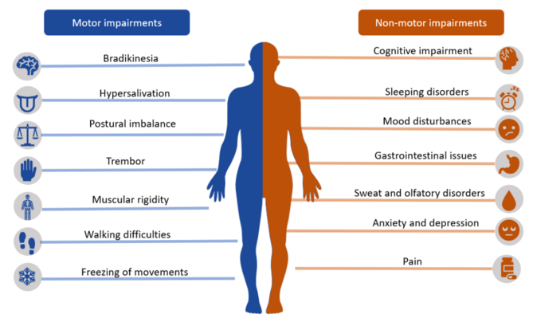
Symptoms of Parkinson’s disease
https://en.m.wikipedia.org/wiki/File:Parkinson_disease_symtpoms.png

Slide 6

Treatments for Parkinson’s disease
Surgical Management:
Ablative Surgery
Pallidotomy
Thalamotomy
Deep Brain Stimulation
Neural transplantation
Pharmacological Management:
Neuroprotective therapy
Monoamine Oxidase Inhibitors
Symptomatic Therapy
Levodopa (L-dopa) is the mainstay of
symptomatic treatment for PD.
Dopamine Agonists
Anticholinergic Agents
Nutritional Management
A high-protein diet can block the effectiveness of L-dopa. Thus the patients are advised high- calorie, low-protein diet.

Slide 7
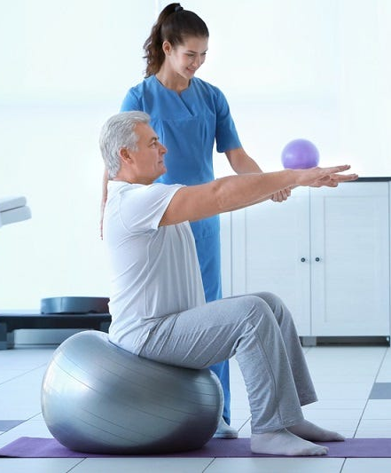
Goals for Physiotherapy:
Improve joint range and mobility
Strengthen weak muscles
Improve posture
Improve balance
Improve gait
Reduce fatigue
Reduce pain
Increase aerobic capacity
https://newliferehab.in/

Slide 8
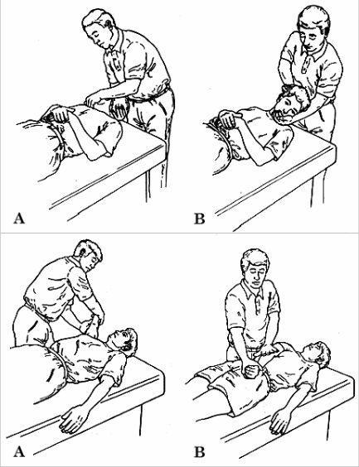
The following exercises and activities are applicable in Parkinson's disease:
Aerobic and improving range of motion exercises
Strength and endurance exercises
Balance, coordination and flexibility improvement exercises
Stretching exercises
Special methods such as PNF
https://ptindia.tripod.com/aug/article2.htm

Slide 9
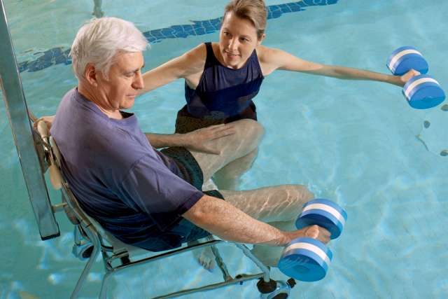
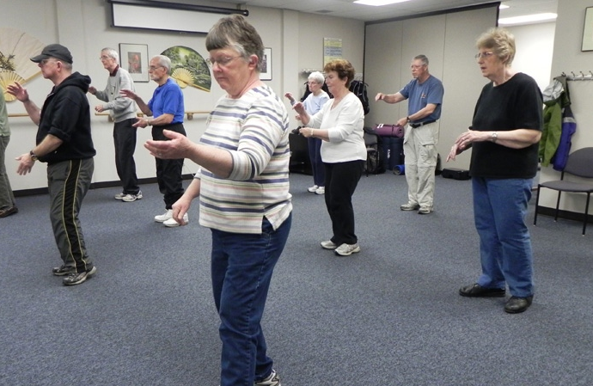
Other forms of exercise:
Tai Chi
Choreotherapy and music therapy
Exercises in water
https://www.uclahealth.org/news/water-exercises-good-people-with-parkinsons-disease
https://www.ctvnews.ca/tai-chi-reduces-falls-in-parkinson-s-patients-study-finds-1.766190

Slide 10
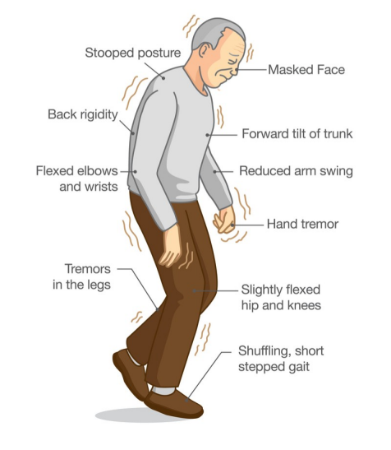
Alterations to gait in Parkinson’s
•Slower
•Reduced step length
Freezing
•Increased flexion in posture
•Reduced arm swing
•Reduced body movement
•Decreased foot clearance
https://www.istockphoto.com/pl/wektor/objawy-choroby-parkinsona-gm881702426-245452115

Slide 11
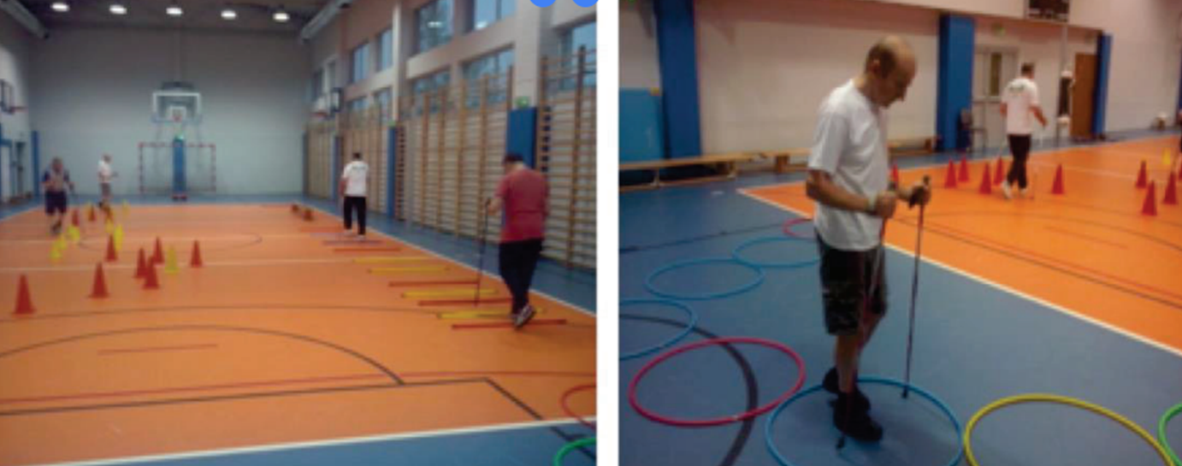
Locomotor Training:
Lengthen stride
Broaden base of support
Improve heel-toe gait pattern
Increased speed
Increase trunk Rotation and arm swing
Strategies for improving upright alignment include having the patient walk with verbal cues to ,,walk tall,,
Gait training using an overhead harness also assists upright posture
Using visual and auditory cues to improve attention during a movement task

Slide 12
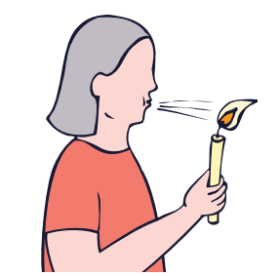
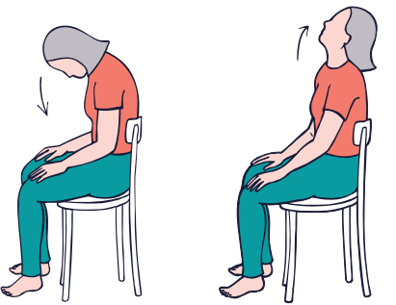
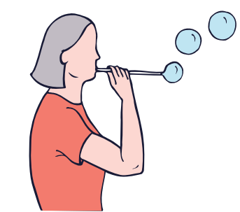
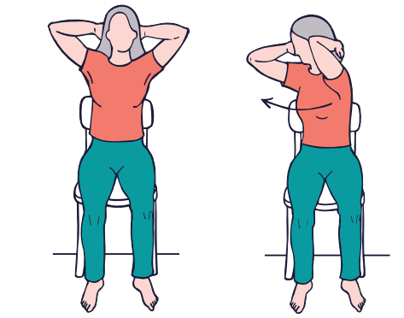
Sample exercises for people with Parkinson's disease
1. Blow on the candle flame so as not to extinguish it.
2. Forward and backward head bends.
3. Making soap bubbles.
4. Arm twist to the right and left.
http://parkinsonfundacja.pl/datastore/download/broszura_cwiczenia_srodek_do_inter.pdf

Slide 13
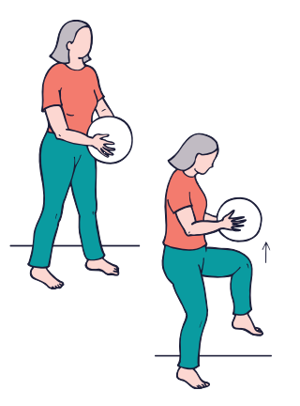
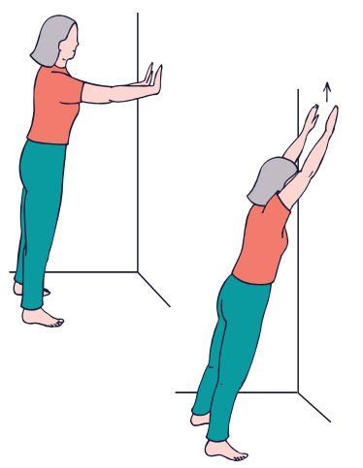
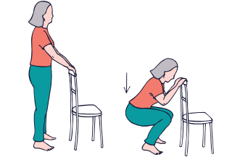
Sample exercises for people with Parkinson's disease
Bouncing the ball with the knee.
Moving the hands up the wall as high as possible.
3. Squats while holding a chair.
http://parkinsonfundacja.pl/datastore/download/broszura_cwiczenia_srodek_do_inter.pdf

Slide 14
Vocabulary:
substantia nigra – istota czarna
heredity – dziedziczność
basal ganglia – zwoje postawy mózgu
alignment – wyrównanie
aerobic capacity – wydolność tlenowa
extinguish – gasić

Slide 15
Bibliography:
Manza, M. A., Mark, M. H. (1994). Parkinson’s disease and depression: The relationship to disability and personalisty. The Journal of Neuropsychiatry and Clinical Neurosciences
Morris ME. Movement disorders in people with Parkinson disease: a model for physical therapy. Phys Ther. 2000
Dereli E.E., Yaliman A. Comparison of the effects of a physiotherapist supervised exercise programme and a self-supervised exercise programme on quality of life in patients with Parkinson’s disease. Clin. Rehabil. 2010
Lees AJ, Hardy J, Revesz T Parkinson's disease. Lancet 2009 Jun 13:373(9680):2055-66.

