Slide 1
Personal protective equipment

Slide 2
Plan of the presentation:
1. Personal protective equipment- concept
2. Eye/ Face protection
3. Hearing protection
4. Head protection
5. Hand protection
6. Foot protection
7. Fall protection
8. Body protection

Slide 3
Personal protective equipment- all equipment worn or held by the worker in order to protect against the hazards
must be provided when necessary because of hazards that lead to injury.
Use of PPE does NOT ELIMINATE the hazard!
Must be worn to provide protection

Slide 4
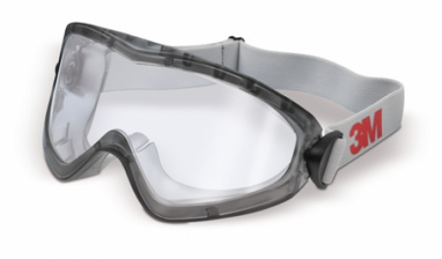
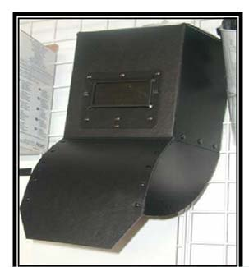
2. EYE/FACE PROTECTION
GOGGLES
SAFETY GLASSES
FACE SHIELDS
WELDING MASK

Slide 5
Types of eye/face hazards:
Impact
Heat
Chemicals
Dust
Light and/or Radiation

Slide 6
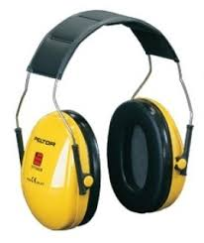
3. HEARING PROTECTION
Protective EARPLUGS
Protective EARMUFFS

Slide 7
4. HEAD PROTECTION
Protective HELMET

Slide 8
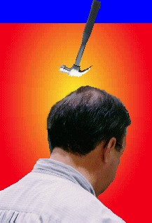
Potential hazards
Head Impact
Splashes, Spills
& Drips
Electrical Shocks
accidents that result in shocks and burns
falling or flying objects cause sprains, fractures, and concussions
materials can irritate and burn eyes and skin

Slide 9
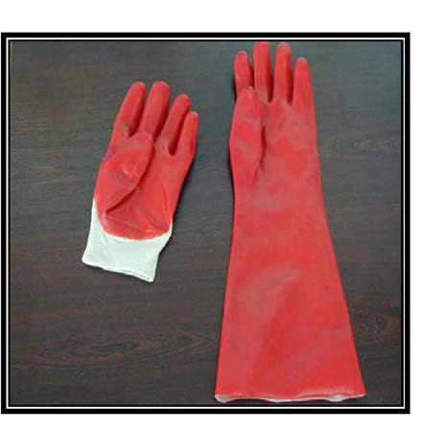
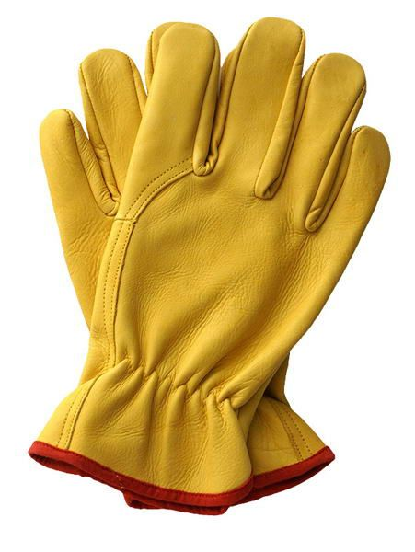
5. HAND PROTECTION
Protective
GLOVES

Slide 10
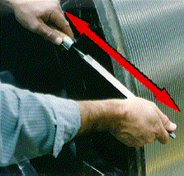
Potential hazards
Traumatic Injuries
Contact Injuries
Repetitive Motion
cuts, punctures, sprains or crushing caused by equipment
contact with toxic chemicals, biological substances, extreme temperatures
the same hand movement over extended time periods

Slide 11
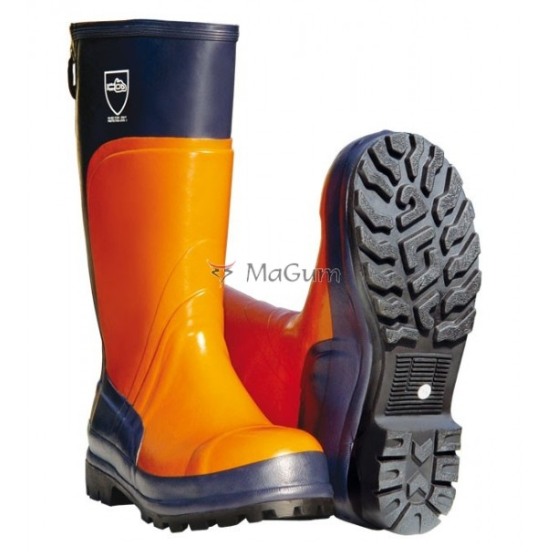
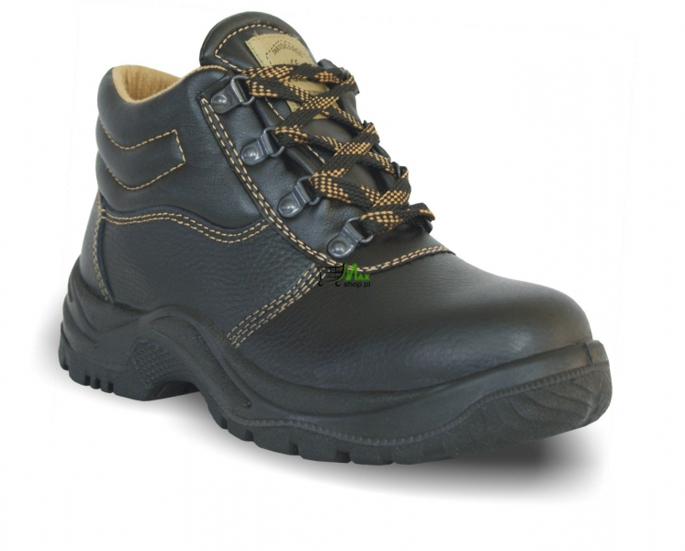
6. FOOT PROTECTION
Protective FOOTWEAR

Slide 12
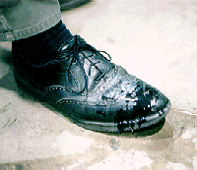
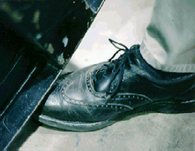
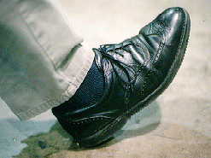
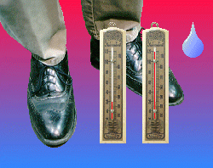
Potential hazards
Impact Injuries
Spill & Splashes
Compression Injuries
Electrical shocks
Slipping
Heat & Cold

Slide 13
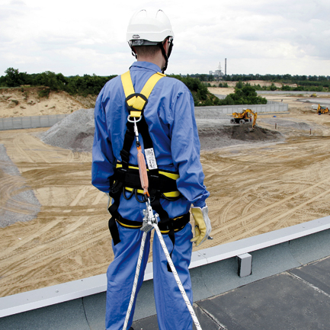
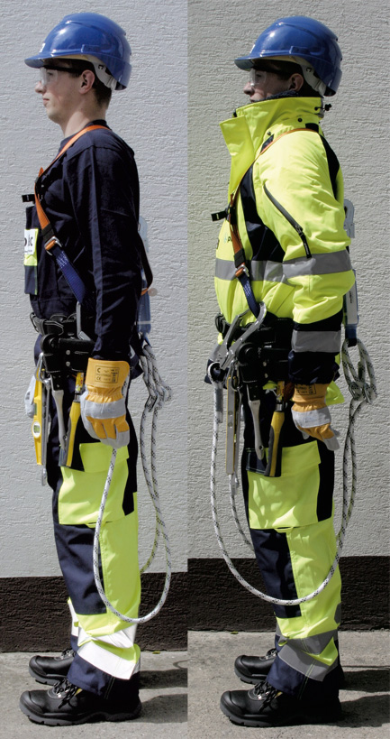
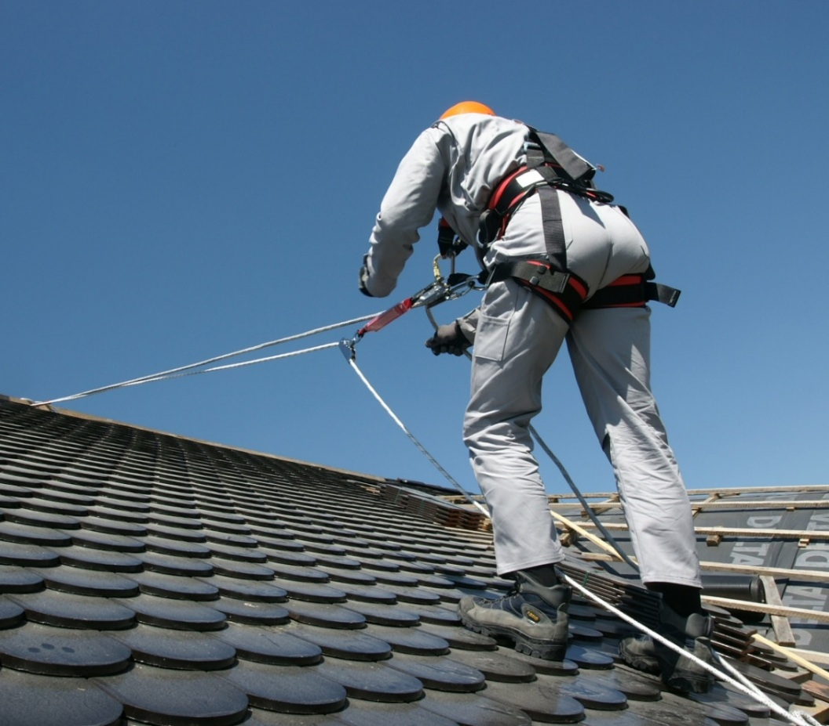
7. FALL PROTECTION
Body Harnesses
Lifeline

Slide 14
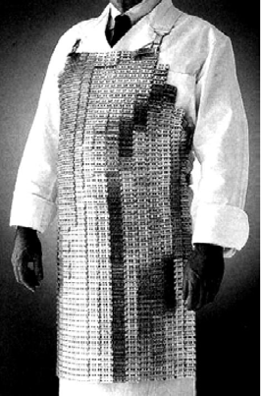
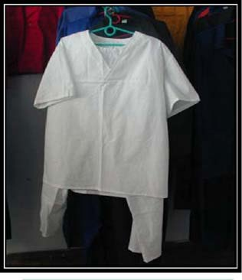
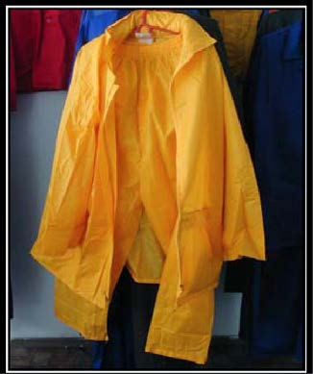
8. BODY PROTECTION
Protective
APRON

Slide 15
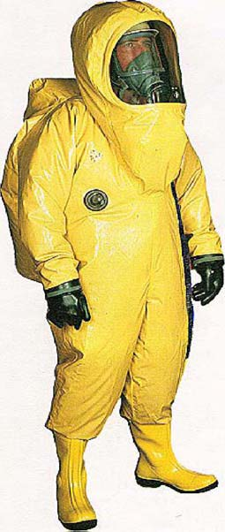
Protective COVERALLS

Slide 16
Types of Body Hazards:
Temperature
Chemical Contact
Radiation

Slide 17
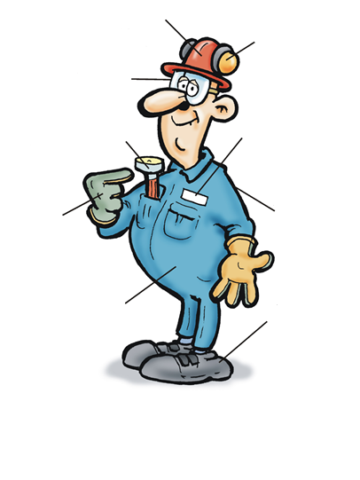
PROTECTIVE HELMET
WORKING CLOTHING
PROTECTIVE
EARMUFFS
PROTECTIVE GLASSES
PROTECTIVE CLOTHING
PROTECTIVE GLOVES
PROTECTIVE FOOTWEAR

Slide 18
Personal protective equipment- środki ochrony indywidualnej
Required- wymagany
Exposure- narażenie
Excessive- nadmierny
Safety Glasses- okulary ochronne
Face shield- osłona twarzy
Welding mask- maska spawalnicza
Protective Earmuffs- nauszniki ochronne
Protective Earplugs- ochronne wkładki do uszu
Protective Footwear- obuwie ochronne
Lifeline- linka asekuracyjna
Body Harnesses- szelki ochronne
Protective Apron- fartuch ochronny
Protective Coverall- kombinezon ochronny

Slide 19
9. Webliography
http://archiwum.ciop.pl
http://www.ekonomik.rzeszow.pl/
https://www.osha.gov

Slide 20
THANK YOU
FOR YOUR ATTENTION!
☺

