Slide 1

1
ORIENTEERING SPORTS
Good morning everyone, thank you for coming, my name is Barbara and I would like to take this opportunity to talk to you about orienteering sports.
Barbara Furdak
1WF SUM

Slide 2
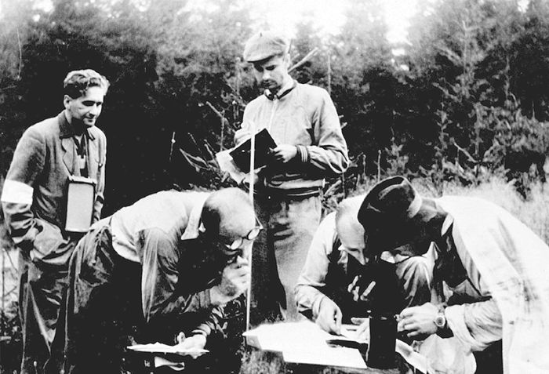
History
2
I would like to begin by some information from history

Slide 3


3
The international orienteering flag
-The history of orienteering begins in the late 19th century in Sweden, the actual term "orienteering" was first used in 1886 and meant the crossing of unknown land with the aid of a map and a compass.
-The first orienteering competition open to the public was held in Norway in 1897
-In 1961, orienteering organizations representing 10 European nations founded the International Orienteering Federation (IOF).
-Foot orienteering became a recognised Olympic sport in 1977
-The international orienteering flag – white and orange, square flag

Slide 4
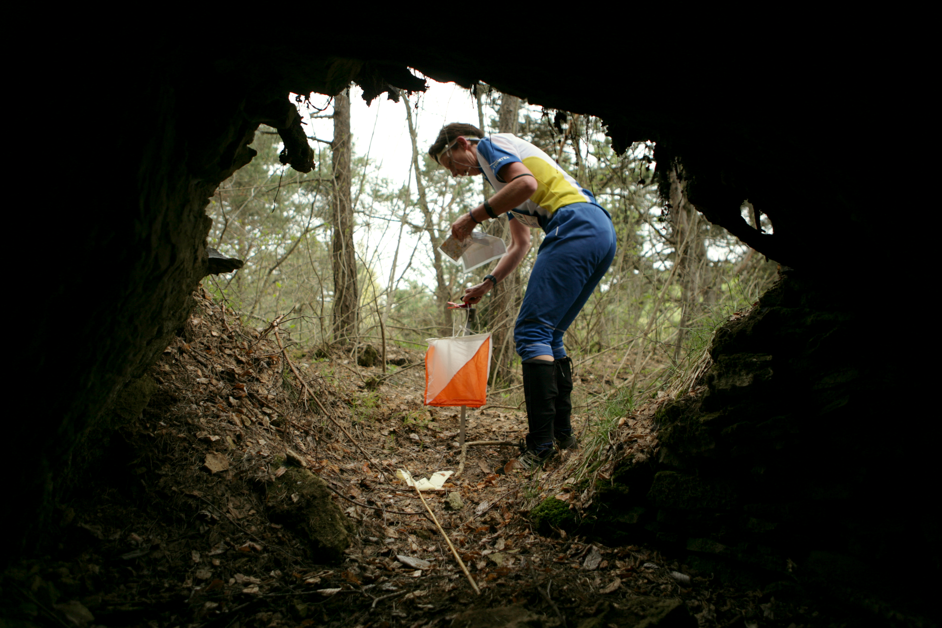
What is this?
4
Orienteering is a competitive international sport that combines racing with navigation. It is a timed race in which individual participants use a specially created, highly detailed map to select routes and navigate through diverse and often unfamiliar terrain and visit control points in sequence.

Slide 5
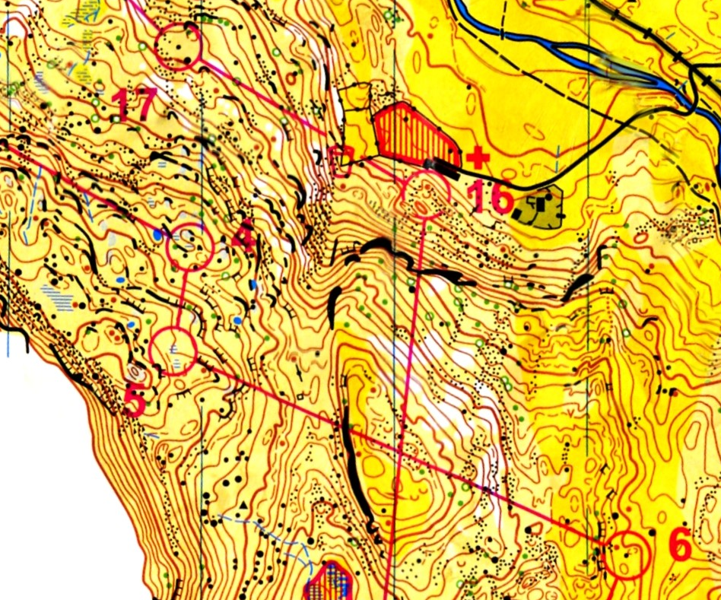
Now, what about types of this sport?
Orienteering sports combine significant navigation with a specific method of travel. Because the method of travel determines the needed equipment and tactics, each sport requires specific rules for competition and guidelines for orienteering event logistics and course design.
Types
5
As we can see below, there are many kind of orienteering:
-Canoe orienteering
-Car orienteering
-Foot orienteering
-Mountain bike orienteering
-Mountain marathoning
-Mounted orienteering
-Radio orienteering
-Rogaining
-Ski-orienteering
-Sport Labyrinth – micro orienteering
-Trail orienteering
-Adventure racing - is a combination of two or more disciplines, and usually includes orienteering as part of the race.

Slide 6
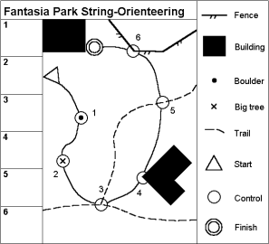
Standard orienteering course
6
Now I will show you how standard orirnteering course looks like:
A standard orienteering course consists of start, a series of control sites that are marked by circles, connected by lines and numbered in the order they are to be visited, and finish. The site control circles are centered on the feature that is to be found; This feature is also defined by control descriptions, and a list with map, or printed on map. Out in the terrain, a control flag (below) marks the location that the orienteer must visit.

Slide 7
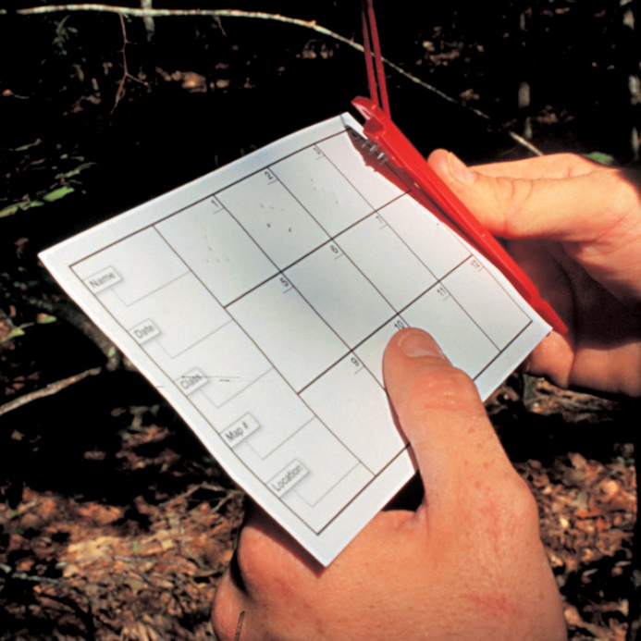
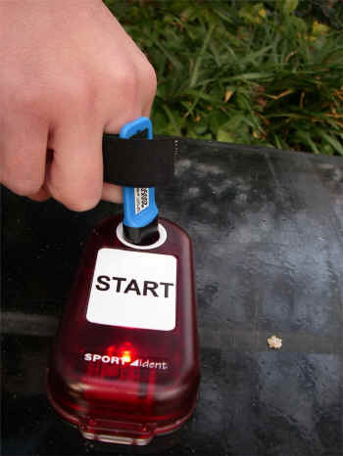
Standard orienteering course
7
To verify a visit, the orienteer may use a punch hanging next to the flag to mark his or her control card. Different punches make different patterns of holes in the paper. Many clubs now use electronic "punching" instead, using a finger stick with a chip inside it that records your time at each control you visit
Different punches make different patterns of holes in the paper
Electronic "punching"

Slide 8
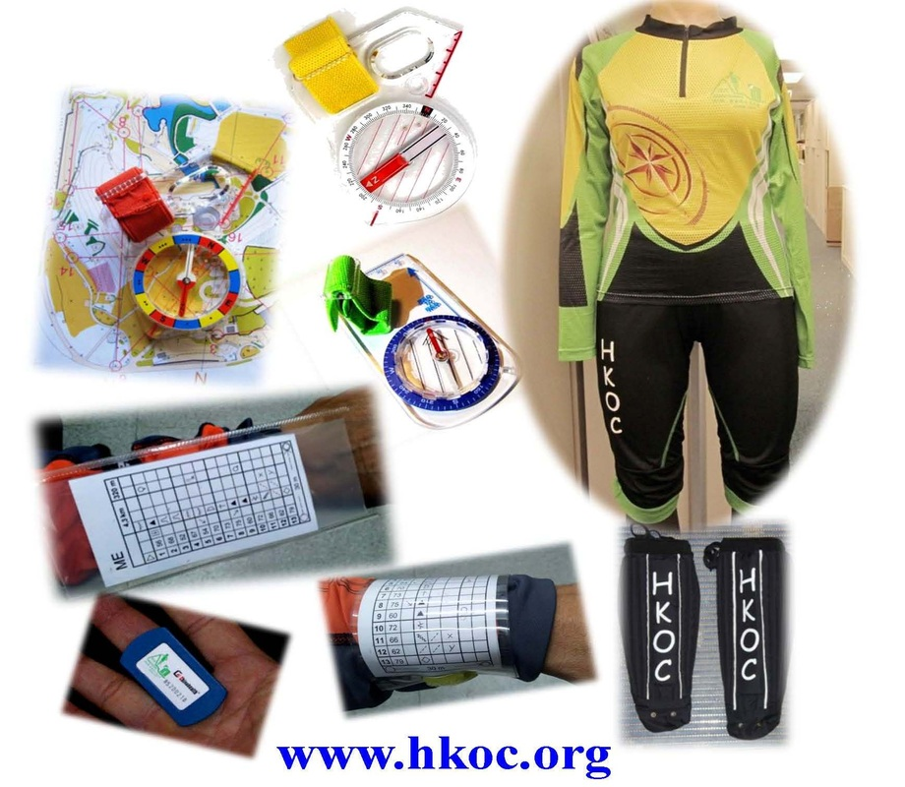
Equipment
8
It is important to notice what kind of equipment you need during a race:
-RACING SUIT: A lightweight, stretchy suit protects from undergrowth whilst allowing maximum freedom of movement even if it gets soaking wet.
-SHOES: Light, strong shoes with non-slip soles allow sure grip on all types of ground – including mud and bare rock.
-MAP: The map provided by the organiser shows the course with the control points which must be visited. The map is designed to give detailed information on the terrain – hills, ground surface, and features such as boulders or cliffs.
-COMPASS: There is a wide variety of sophisticated compasses to choose from. Basically they can be divided into two main categories: base plate and thumb compasses.
-CONTROL CARD: To prove that they have visited all control points in the right order, the orienteers have to punch their control card at each control using an electronic device.

Slide 9
Top Tips for Beginners
26
Let me move on to basic skills that you need to practice to help you progress with orienteering.
Fold your map - Always make sure that you fold your map so that you can easily see the part of the map where you are.
Orientate your map - Always make sure that your map is the correct way round or orientated. This means that the features which are in front of you on the ground are in front of you on the map. You can also orientate your map using a compass by making sure that the north lines on the map point the same way as the north or red end of the compass needle.

Slide 10
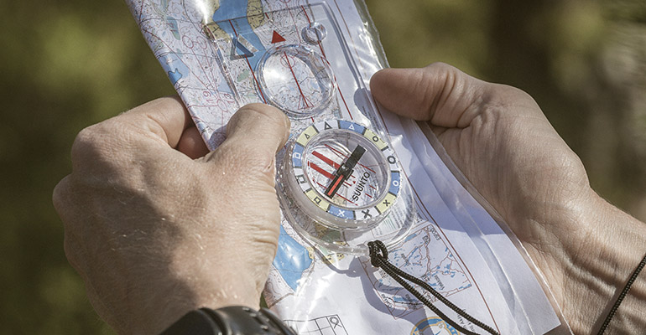
28
Thumb your Map - To help you know where you are on the map it helps if you mark your position on the map with your thumb. As you move along the ground you should move your thumb to your new position on the map. It is usual to move your thumb to the new position at a ‘check point’ such as a path junction or some other obvious feature where you will stop or slow down and check where you are.
Check your control card - Once you have found a control you always need to check that the code on your control description sheet matches the code on the control. You should also check that the control is situated on the correct feature on your map. You will then know for sure that you have reached the correct control.

Slide 11
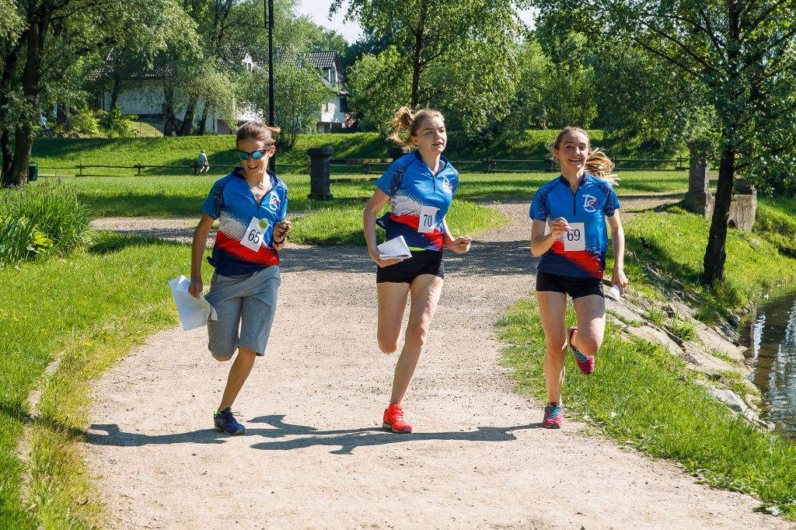
And finally the most important skill to remember. Orienteering should always be fun and enjoyable!
31
Have fun and enjoy yourself

Slide 12
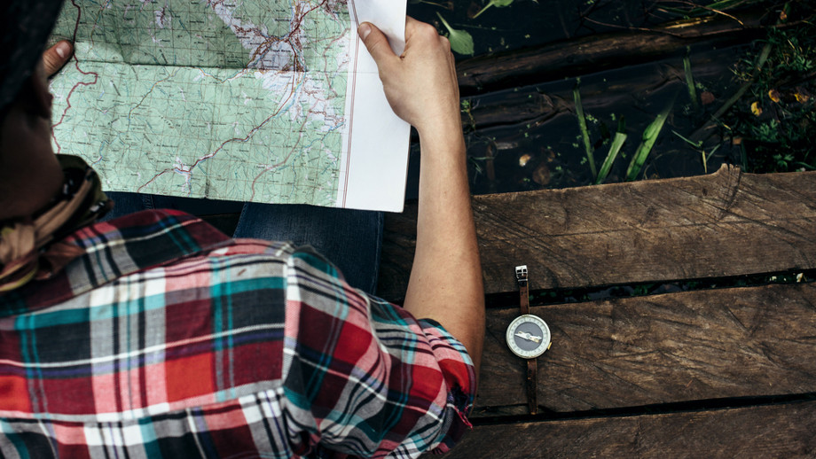
In the end I would like to say that it does not matter how young, old or fit you are, as you can run, walk or jog the course and progress at your own pace.
32
It’s a great sport for runners, joggers and walkers who want to improve their navigation skills or for anyone who loves the outdoors.

Slide 13
Vacabulary
33
Orienteering sports – sporty na orientację
Canoe orienteering – spływ kajakowy na orientację
Mounted orienteering – jazda konna na orientację
Rogaining – drużynowy bieg na orientację
Trail orienteering – wyścig na orientację na wózkach
Adventure racing – połączenie różnych rodzajów wyścigów na orientację
Punch – stempel
Non-slip soles – podeszwa antypoślizgowa
International Orienteering Federation (IOF) – Międzynarodowa Federacja Orientacji Sportowej

