Slide 1
CHILDREN’S LEARNING
STYLES

Slide 3
Ladies and gentlemen, thank you very much for coming along here today.
I hope my presentation isn’t going to take too long and that you will find it interesting.

Slide 4
The purpose of today’s presentation is to discuss children’s learning styles.
I am going to begin by explaining what learning styles are, secondly I will show types of learning styles, and finally I will tell how you can determine your child’s learning styles.

Slide 5
Let’s begin by explaining what learning styles are.
Learning styles is a term that refers to different ways in which we learn, process, and retain information. All young children learn through meaningful hands-on experiences—through touching, doing, and moving. And children also learn through seeing and hearing. As you observe your child, you will begin to identify strengths and preferences that tell you something about your child’s preferred learning style.

Slide 6
Now I’d like to focus on types of learning styles.
These are the four main types of learning styles:

Slide 7

VISUAL

Slide 8
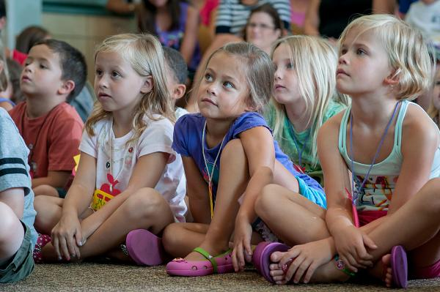
AUDITORY

Slide 9
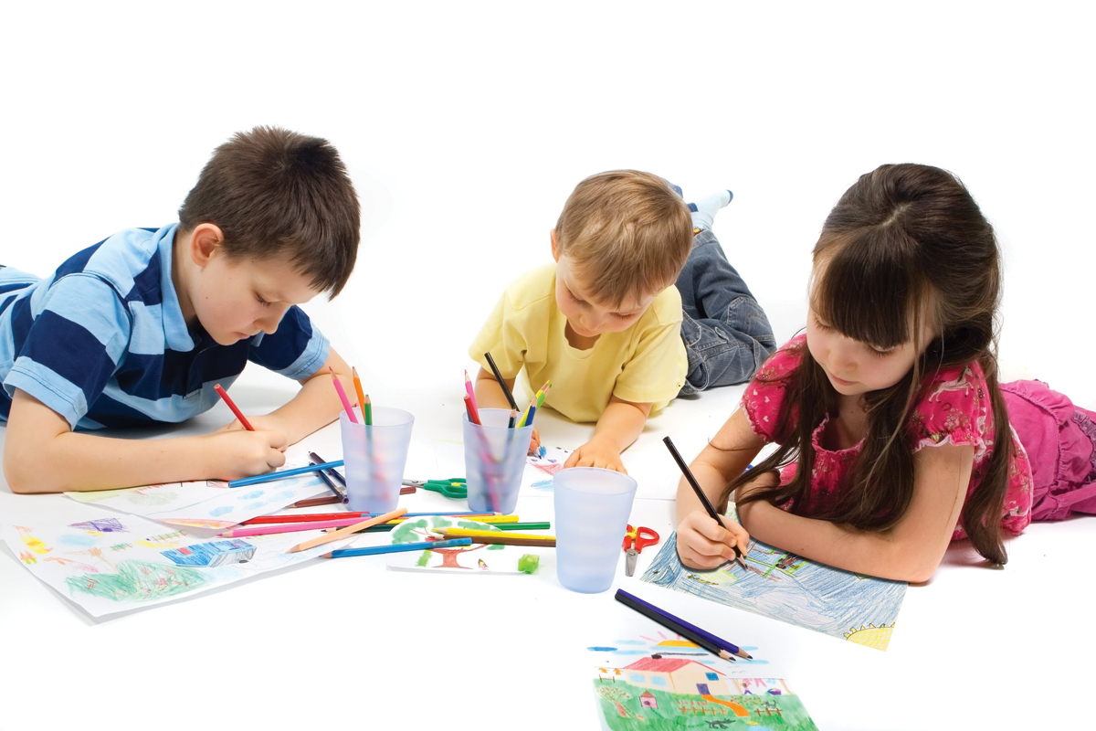
TACTILE

Slide 10
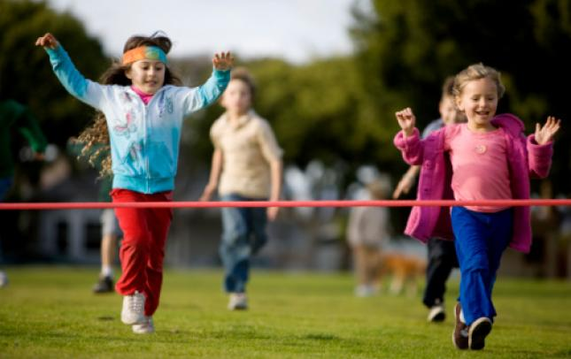
KINESTHETIC

Slide 11
I’d like to expand this issue.

Slide 12
Visual learners:
learn through seeing. Children who are visual processors tend to observe a parent’s or teacher’s body language and facial expressions for content and learn through demonstrations and descriptions. They tend to have well-developed imaginations and often think in pictures. Too much movement or action in a classroom may cause distraction for them.

Slide 13
Auditory learners:
learn through listening. Children who are auditory processors learn through participating in discussions and talking things through. Verbal directions may help clarify instructions or written information.
Too much noise may be distracting and children with this strength may learn best in a quiet environment.

Slide 14
Tactile learners:
learn through touch. Children who are more tactile prefer activities or projects that allow them to use their hands.
Your child may prefer doodling or drawing to aid memory.

Slide 15
Kinesthetic learners:
learn through moving and doing. Children who are more kinesthetic learn through physical sensations and may have trouble sitting still for long periods.

Slide 16
That’s all I have to say about types of learning styles.

Slide 17
Finally I’d like to focus on determining children's learning styles.
The best way to learn about your child’s learning style is to observe what he or she is doing.
Actions, interests, and preferences will provide information about how he or she is processing information.

Slide 18
If your child has developmental delays, you may find that you often focus on what your child isn’t yet doing. Instead, try to focus on his strengths and favorite activities. All children, even the most challenged,
have interests and preferences.
Identifying these helps increase a child’s motivation for learning.

Slide 19
To sum up, as adults, we can help children better understand their strengths and individual differences, while supporting challenges. You can seek out real-world experiences that extend your child’s learning. For example, if your child is interested in fish and aquatic life, visit an aquarium. Your child will retain more information and develop a broader understanding of the world if information is meaningful and presented in a way that meets his or her individual learning style.

Slide 20
Ladies and gentlemen, if you have any questions, I'd be happy to answer them now.

Slide 21
References:
- Gardner, H. (1993). Multiple Intelligences: The Theory in Practice. New York, NY: BasicBooks.
- Edwards, L. (2002). The Creative Arts: A Process Approach for Teachers and Children. Upper Saddle River, NJ: Merrill Prentice Hall.

