Slide 1

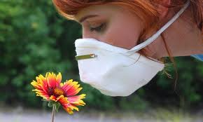
Allergy tests
Sylwia Stachowicz
Pielęgniarstwo stacjonarne
Uniwersytet Rzeszowski

Slide 2



Allergy testing involves having a skin or blood test to find out what substance or allergen may tigger an allergic response in a person.

Slide 3
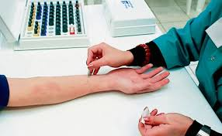
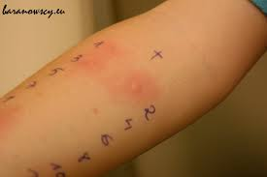
There are two types of skin test.

Slide 4
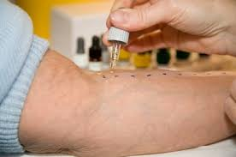
During the first type of skin test a drop of a suspected allergen is pricked or scratched on the surface of the skin.

Slide 5

During the second type of skin test a small amount of the suspected allergen is injected into the skin.

Slide 6

Skin testing is fast.
For both types of skin tests positive reactions usually appear within 20 minutes.

Slide 7
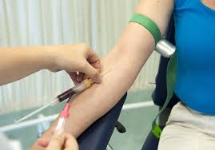
The blood test used to test for allergens
It's used to measure the number of IgE antibodies in your blood that have been produced by your immune system in response to a suspected allergen.

Slide 8
An allergy blood test is often used because:
The patient is taking a medicine that can interfere with skin testing
The patient suffers from a severe skin condition
Testing with a strong allergen might cause an extra large positive reaction
For babies and very young children may be better than several skin tests.

Slide 9


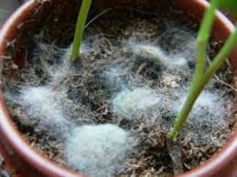





Allergy test can help find:
Airborne allergens
Food allergens

Slide 10
1 If you suspect that you may have an allergy what should you do?
a) allergy tests
b) nothing
c) take vitamin C
2 What are allergy tests?
a) urine test
b) skin and blood test
c) feces test
3 How many we have kinds of allergy skin tests?
a) 15
b) 2
c) 1

Slide 11
4 How much time you have to wait for the skin tests?
a) 30 min
b) 1 h
c) 20 min
5 What is measured by allergy blood test?
a) IgE
b) white cells
c) heamoglobin
6 When we do an allergy blood test?
a) The patient suffer from eczema
b) The patient doesn't want to skin test
c) The patient is afraid of the skin test

Slide 12


