Slide 1

Family Law in UK
Przygotowała: Paulina Daniel
Prawo, III rok
Studia stacjonarne, Rok akademicki 2016/2017
Prowadzący: mgr Anita Krok

Slide 2
Sources of law
The Matrimonial Causes Act 1973
The Children Act 1989
Other important statues are:
The Married Women's Property Act 1882
The Domicile and Matrimonial Proceedings Act 1973
The Matrimonial and Family Proceedings Act 1984
The Family Law Act 1986
The Child Support Act 1991
The Civil Partnership Act 2004
Marriage (Same Sex Couples) Act 2013
The adoption and children Act 2002

Slide 3
Domicile
Domicile- is the status or attribution of being a lawful permanent resident in a particular jurisdiction. Domicile can be either:
Domicile of origin
Domicile of dependence
Domicile of choice

Slide 4
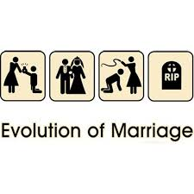
Marriage
is a socially or ritually recognized union between spouses that establishes rights and obligations between them, between them and their children, and between them and their in-laws.

Slide 5

Divorce
is the termination of a marriage or marital union, the canceling and/or reorganizing of the legal duties and responsibilities of marriage, thus dissolving the bonds of matrimony between
a married couple under the rule of law of the particular country and/or state.

Slide 6

Nullity
a marriage is either void from the outset or voidable.

Slide 7

Same-sex marriage
is marriage between
people of the same sex, either as a secular civil ceremony or in a religious setting.

Slide 8
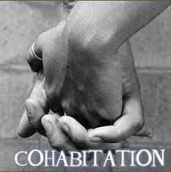
Cohabitation
is an arrangement where two people who are not married live together.

Slide 9
Glossary:
Sources of law- źródła prawa,
Familly law- prawo rodzinne,
Domicile- stałe miejsce zamieszkania,
Marriage- małżeństwo,
Divorce- rozwód,
Nullity- nieważność,
Cohabitation- konkubinat,
Sam-sex marriage- małżeństwo osób tej samej płci,

Slide 10
Sources:
http://uk.practicallaw.com/1-590-4465
https://en.wikipedia.org/wiki/Cohabitation
https://en.wikipedia.org/wiki/Marriage
https://en.wikipedia.org/wiki/Divorce

Slide 11
THANK YOU FOR YOUR ATTENTION!

