Slide 1
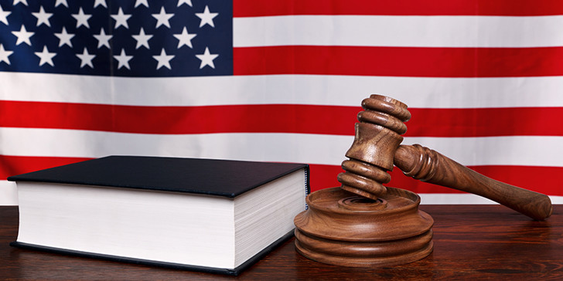
Law of the United States

Slide 2

Plan of the presentation
The Roots of the American Legal System
Sources of Law
Federal Law
State Law
American Common Law
Jury in the United States
The most ridiculous United States Laws

Slide 3
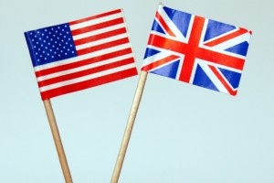
The Roots of the American Legal System
English law has had the greatest impact on the law of the United States. The law in the US was also influenced by French law, Spanish law
and German law. This is related to colonialism.

Slide 4
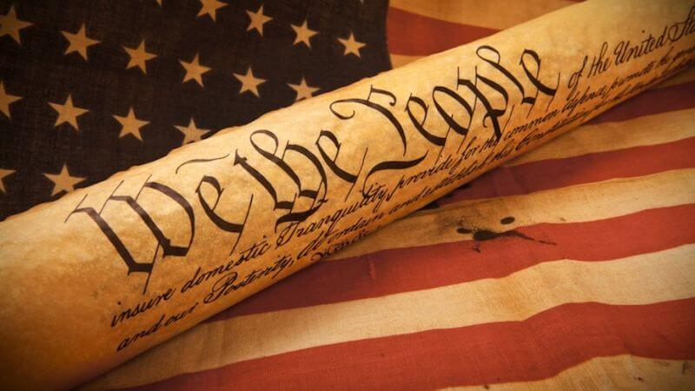
The Constitution is the highest legal act in force in the United States, the basis of the legal system and the political system.

Slide 5
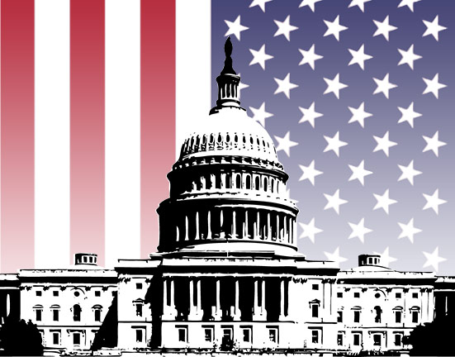
FEDERAL LAW

Slide 6
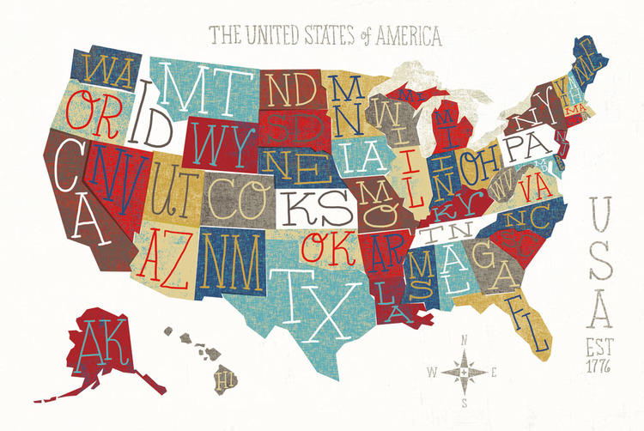
STATE LAW
Each state has its own state law

Slide 7
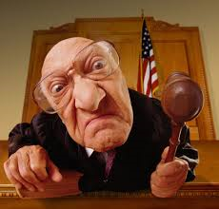
American Common Law
American judges, like common law judges elsewhere, not only apply the law, they also make the law, to the extent that their decisions in the cases before them become precedent for decisions in future cases.

Slide 8
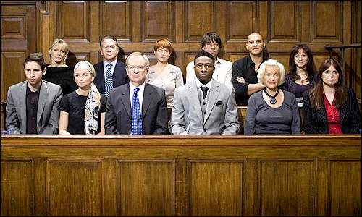
Jury in the USA

Slide 9
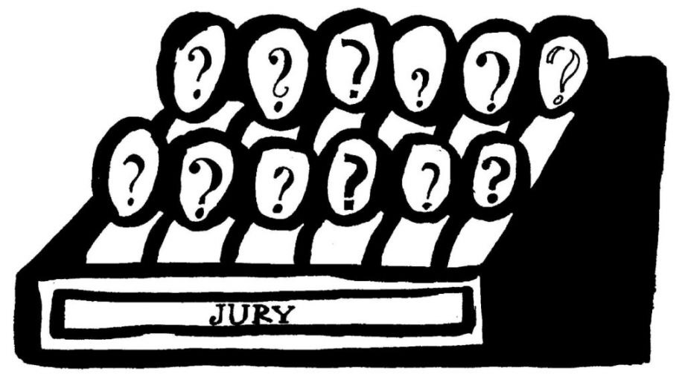
Scheme of jury selection
The judge sends the summons to the jury (randomly chosen)
The parties select members of the bench from among the summoned
Interview with jury members
Court approval of jury members

Slide 10


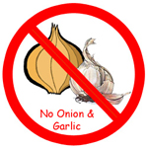
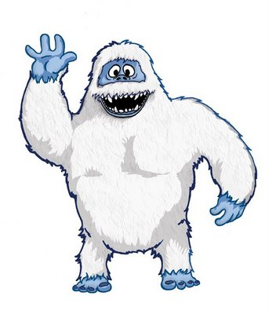
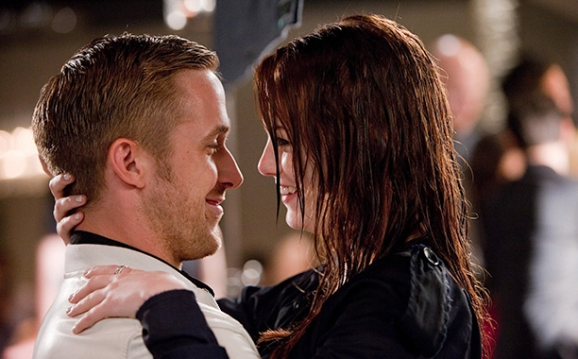
The most ridiculous United States Laws
If you have mustaches, it’s illegal for you to kiss a woman. (Eureka, Nevada)
It’s illegal for a man to give his fiancé a box of candy that weighs more than 50 lbs (22,5 kg). (Idaho)
You can be arrested or fined for harassing Bigfoot. (Washington)
It’s illegal to attend a public event or use public transport within 4 hours of eating an onion or garlic. (Indiana)
In San Antonio, flirting is against the law. (Texas)

Slide 11
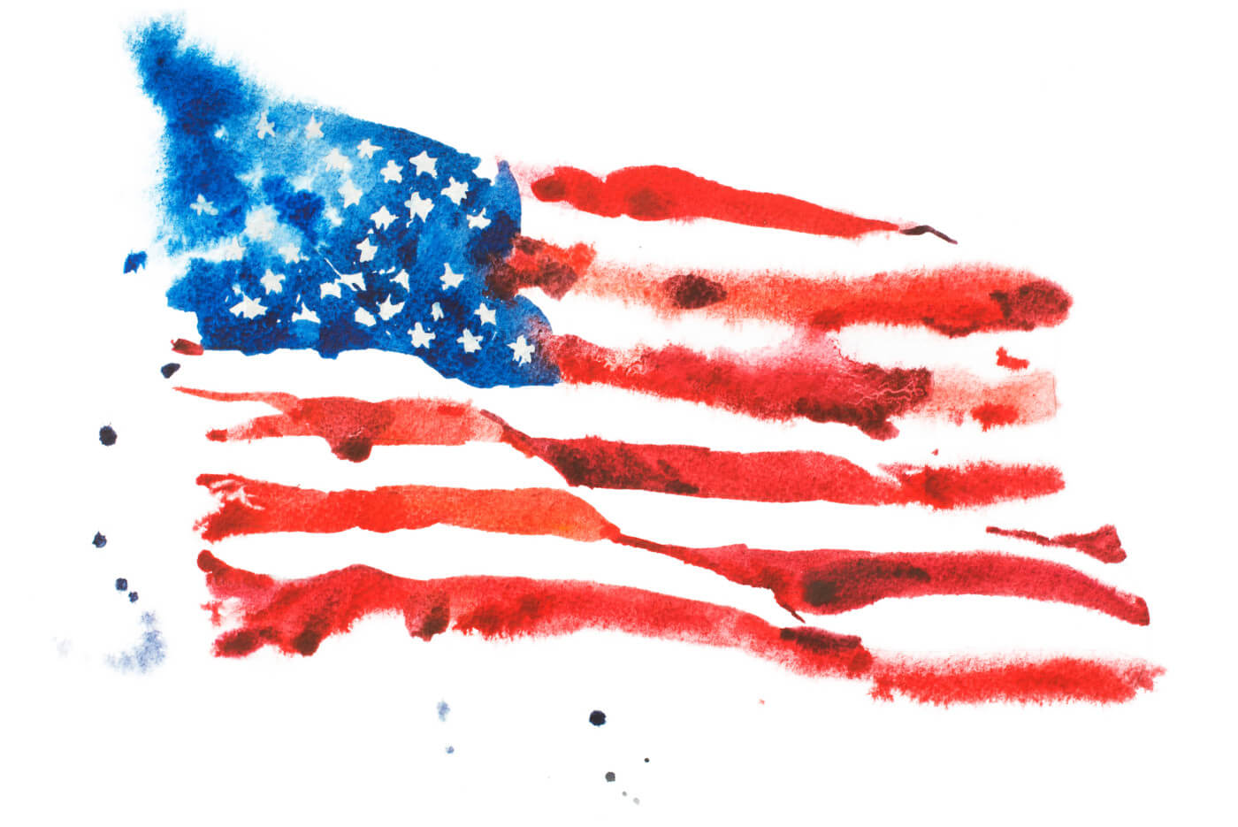
Thank you for your attention!
Katarzyna Gibała 2016/17

Slide 12
Sources
https://www.usa.gov/laws
http://www.uscourts.gov/
https://www.law.cornell.edu/uscode/text
https://pl.usembassy.gov/pl/
http://www.student.lex.pl/czytaj/-/artykul/american-dream-czyli-system-prawny-usa
http://www.usa.xmc.pl/wladza-sadownicza/

Slide 13
Dictionary
legislative branch – władza ustawodawcza
executive branch – władza wykonawcza
judicary branch – władza sądownicza
interpret – interpretować
overturn – obalać
diverged – rozejść się
tort law – p. deliktów
family law – p. rodzinne
property law – p. własności
contract law – p. umów
criminal law – p. karne
Jury – ława przysięgłych
trial – proces
scheme – schemat/plan
summonded – wezwani
unanimity – jednomyślność/zgodność
ridiculous laws – śmieszne/niedorzeczne prawa
derived – pochodzący
federation – federacja
Independence – niepodległość
have impact on/ be influenced by - mieć wpływ
the basis – podstawy
consist – składać się
amendment – poprawka
The Bill of Rights – Karta Praw
case law – orzecznictwo
apply to – mieć zastosowanie
estabilish – ustanawiać
preservation -ochrona

