Slide 1
NATIONAL INSURANCE
Aleksandra Błaszczyk
IN THE UNITED KINGDOM

Slide 2
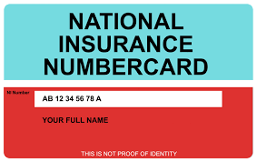
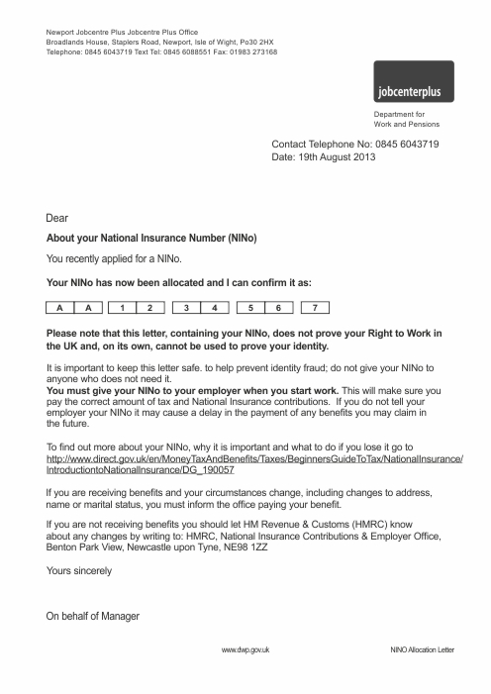
What does it look like?

Slide 3
Overview
People pay National Insurance contributions to qualify for certain benefits including the State Pension.
People have to pay National Insurance if they are 16 or over and either:
an employee earning above £155 a week
self-employed and making a profit of £5,965 or more a year
National Insurance number is needed before people start to pay National Insurance contributions.

Slide 4
Classes and stop paying
There are different types of National Insurance (known as ‘classes’). The type people pay depends on their employment status and how much they earn, and whether they have any gaps in their National Insurance record.
If people are employed, they stop paying Class 1 National Insurance when they reach the State Pension age.
If somebody is self-employed he/she stops paying:
Class 2 National Insurance when person reaches State Pension age
Class 4 National Insurance from 6 April (start of the tax year) after person reaches State Pension age

Slide 5
National Insurance number
People have a National Insurance number to make sure that their National Insurance contributions and tax are recorded against their name only.
It’s made up of letters and numbers and never changes.
You can find your National Insurance number:
on payslip
on P60
on letters about tax, pension or benefits
in the National Insurance section of personal tax account

Slide 6
Who uses National Insurance Number
These organisations need to know what the number is:
HM Revenue and Customs (HMRC)
employers
the Department for Work and Pensions (which includes Jobcentre Plus and the Pension, Disability and Carers Service), if you claim state benefits, or in Northern Ireland the Department for Social Development
To prevent identity fraud, people should keep their National Insurance number safe.
Don’t share NI with anyone who doesn’t need it!

Slide 7
National Insurance classes
The class people pay depends on their employment status and how much they earn, and whether they have any gaps in the National Insurance record.
Classes of NI:
Class 1
Class 1A or 1B
Class 2
Class 3
Class 3A
Class 4

Slide 8
How much people pay
People pay different amounts for National Insurance if they are:
employed
self-employed
Directors, landlords and share fishermen
There are different National Insurance rules for:
company directors
landlords running a property business
share fishermen for example you’re working on a British fishing boat but not under a contract of service

Slide 9
What if somebody is not working?
Benefits could be affected if there are gaps in the National Insurance record. National Insurance credits can help to fill gaps in record and protect benefits.
People can get credits if they can not pay National Insurance contributions, for example, if:
they can not work due to illness
they are caring for someone

Slide 10
Change of circumstances
Everyone must tell HM Revenue and Customs (HMRC) if he/she:
changes his/her personal details, for example name, address or marital status:
starts being self-employed
stops being self-employed

Slide 11
Changing personal details
People have to report if they:
If they are changing your address
There are different ways to update address if person:
only pays tax through Self Assessment
is leaving the UK to live abroad
already lives abroad
If person is changing his/her name
Change name if person:
paid a salary or pension through PAYE
registered for Self Assessment
he/she needs to update both if both apply to he/she.
person's name will be updated automatically if he,she changes gender.

Slide 12


Slide 13
How to get it?
People need to apply by phone for a National Insurance number.
National Insurance number application line:
Telephone: 0345 600 0643
Textphone: 0345 600 0644
  Monday to Friday, 8am to 6pm
Welsh language: 0345 602 1491
  Monday to Friday, 8:30am to 5pm
To apply for benefits without a National Insurance number, people can contact Jobcentre Plus instead.
People can also have a translator if they do not speek english.

Slide 14
Dictionary
Self-employed – samozatrudniony
Fishermen – rybak
tax – podatek
National Insurance Number – narodowy numer ubezpieczeniowy
Contributions – wkłady, finansowanie
Landlord – wynajmujący, właściciel
Identity fraud – fałszywa tożsamość
Payslip – odcinek płacowy
State pension age – wiek emerytalny

Slide 15


