Slide 1
The influence of social websites towards young people, as well as in general towards human’s psyche.
Ewa Wojciechowska
Pedagogika medialna

Slide 2
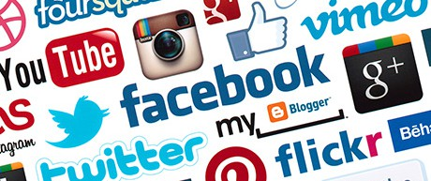
Social websites have become a part of our lives. They are most important to teenagers, who use those sites not only to keep in touch with friends, but also to meet new people, usually ones that they wouldn’t be able to meet. Therefore, social websites have many positive features, but there are some flaws as well. An analysis conducted in USA indicates, that female teenagers who use such websites, more often use drugs.

Slide 3

Social websites vs. interpersonal bonds
Social websites allow everyone to “post” at any time information about what they are doing, where they have been, what are they going to do, as well as how are they feeling or is there anything important happening right now. All this may be coming along with photos or videos, which allows others to “see” us in different situations.

Slide 4
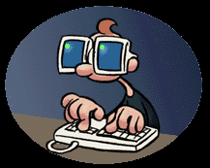
Bad example for youngsters
Studies conducted by Columbia University indicate that teenagers acquire a lot of habits and features, which they have spotted on the social websites. According to what patients stated:
-40% of the teenagers have seen on social websites photos of adolescents drunk or using drugs.
- half of them have seen the photos at the age of 13 or less
- over 90% have seen them for the first time at the age of 15 or less

Slide 5
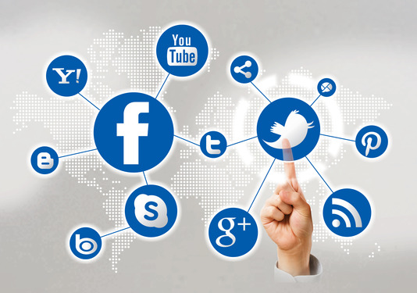
What was the influence of that towards their behavior later on? According to the analysis conducted by the scientists:
- Seeing photos of adolescents smoking increases the probability of smoking by five hundred percent
- Photos of drunk adolescents increase the change of drinking by three hundred percent
- Photos of adolescents using drugs increases the chance of teenagers reaching for marihuana by two hundred percent

Slide 6
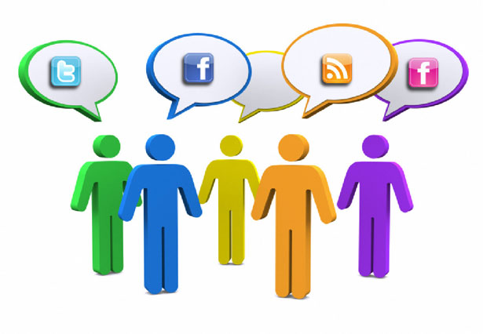
Teenagers at the age of 12-17 years old, who used social websites, were observed during the analysis. Therefore all of them were at the age, during which they are concerned about being accepted as well as respected.

Slide 7

As much as 87% of the parents simply did not believe that such websites are connected with more often drinking of the alcohol. As far as usage of drugs is concerned, 89% of the parents did not believe in the relation.

Slide 8
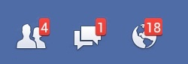
Scientists have discovered that using social websites may have an influence on human’s psyche, causing a constant feeling of fear and destructive behavior. Over half of the surveyed admitted that they could not sleep because of the constant feeling of need of checking the status update on websites, such as Facebook or Twitter.

Slide 9

According to the survey conducted on behalf of British Business School, users of Facebook and Twitter often feel anxiety and behave inappropriately. Over half of surveyed feels “addition to social websites” and feels wrong when looses access to them. What is more, fifty three percent of the surveyed stated that social websites have changed their behavior. Fifty one of those people stated that the change was rather negative.

Slide 10

The data also states that over sixty percent of the people admitted that from time to time, they turn off all electronic devices in order to take a break and every third person admits to turning off PC and cell phone few times a day to rest from the virtual world.

Slide 11
Netografia
https://portal.abczdrowie.pl/nastolatki-korzystajace-ze-spolecznosciowek-czesciej-pija-i-pala

