Slide 1
The wonderful discovery…
-history of radiology

Slide 2
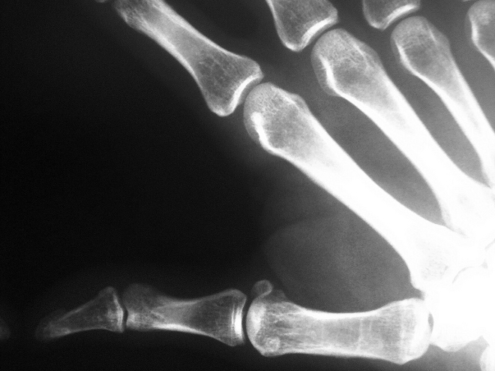
Can you reveal your inner self? With the help of X-rays, yes you can! But do we ever ponder about the person who discovered these rays? Although we all familiar with the term X-ray, the man Wilhelm Conrad Roentgen who made this an astounding discovery remains unfamiliar to most of us even to this day. His great discovery explored the internal structure of the body.
Let us have a journey into the wonderful life of a man who discovered these phenomenal rays.

Slide 3
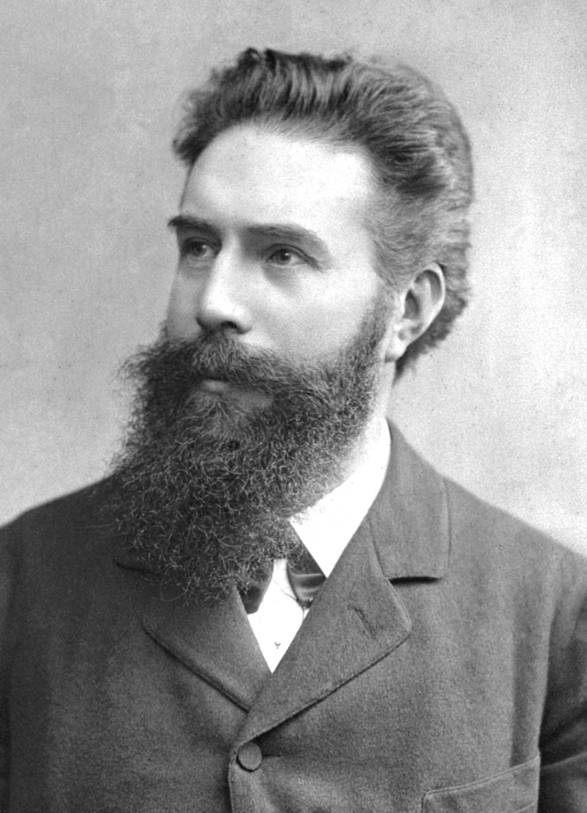
Wilhelm Condrad Roentgen - the discovered of the mysterious rays…
was a German physicist,
who on 8 November 1895, produced
and detected electromagnetic radiation
in a wavelength range known as X-rays or Röntgen rays. It was
an achievement that earned
him the first Nobel Prize
in Physics in 1901.
Notes:
Wavelenght range-

Slide 4
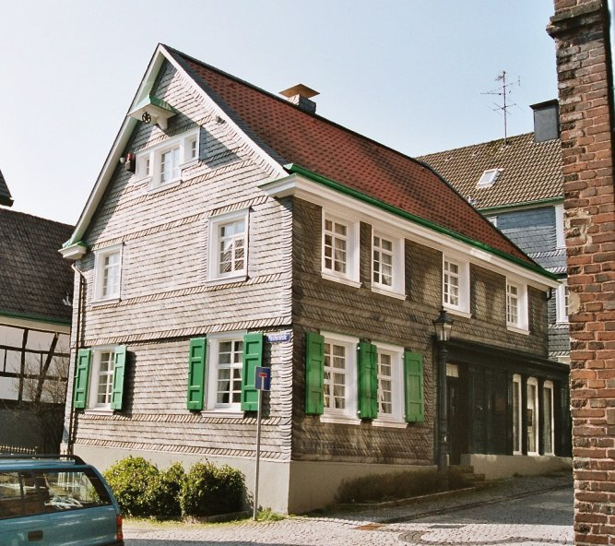
Biography…
The tale of Willhelm Conrad Roentgen begins from a small town in Eastern Prussia called Lennep. It was the 27 th day of March in year 1845, when Wilhelm came into this world. When Wilhelm was three years old his family had to move to the town in Holland.
In 1862 when 17 year old Wilhelm arrived
in Utrecht, he entered the Utrecht Technical School. During those days,
he lived with Dr Gunning who was an eminent chemist of those times. He was the first one to recognize the spark
of talent in Roentgen.
Birthplace of Roentgen in Remscheid-Lennep

Slide 5
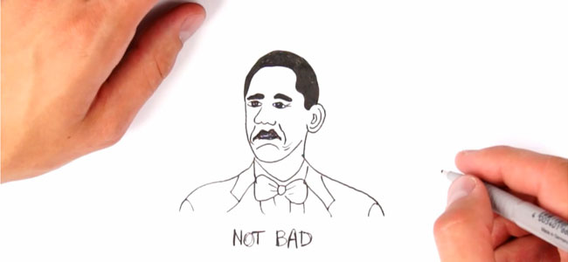
A funny incident?- education…
Once Roentgen was accused of drawing a caricature of his teacher on blackboard, but the truth was that Roentgen was innocent and was falsely framed by one of his classmates. Although Roentgen was aware of the true cluprit, he denied to divulge his identity and was expelled from the university. He tried his luck once again in an entrance oral exam, but the examiner was none other than teacher whose caricature had been drawn in school.
Notes:
Divulge-wyjawiać entrance oral exam-wejściowy ustny egzamin dissgresed education-skompromitowana edukacja

Slide 6
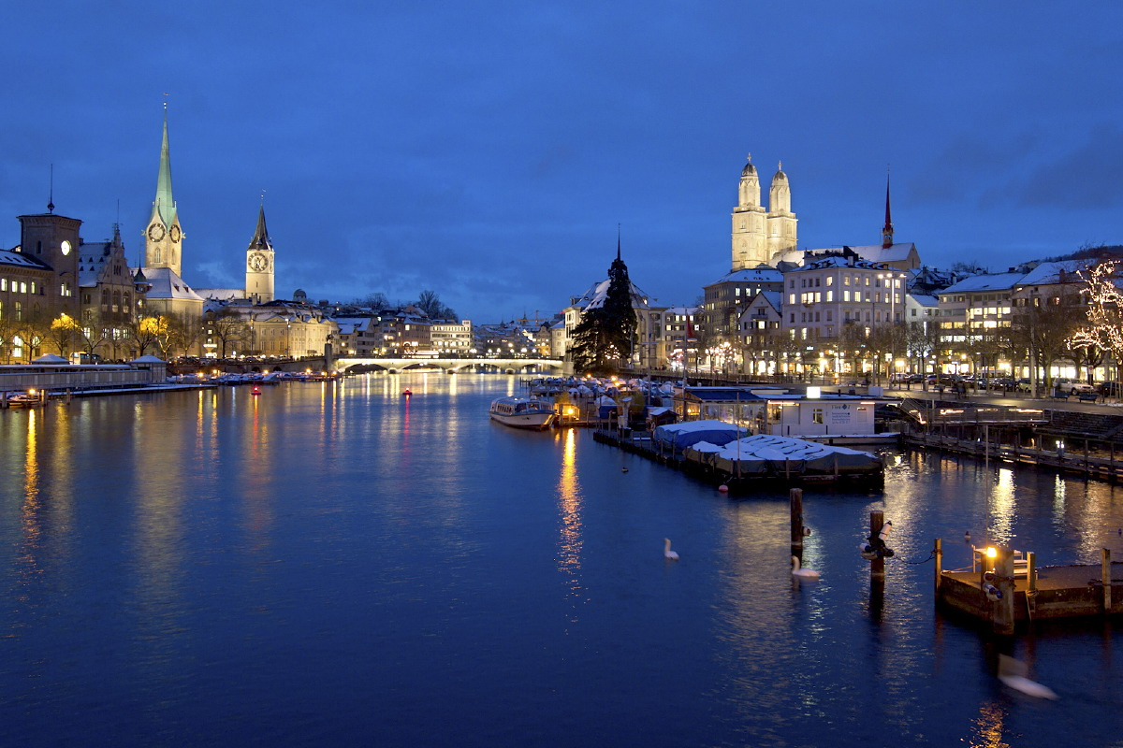
He heard of a school in Zurich in Switzerland, that did not necessiate a technical school diploma which he lacked. Finally, he entered the Mechanical Technical Division of Zurich Polytechnical School.
One day while eating in restaurant one waitress caught his eye. It was Anna Bertha. Bertha was six years elder to him. Soon, she is become his wife.
Notes:
Necesiate-wymagać lacked-brakowało

Slide 7
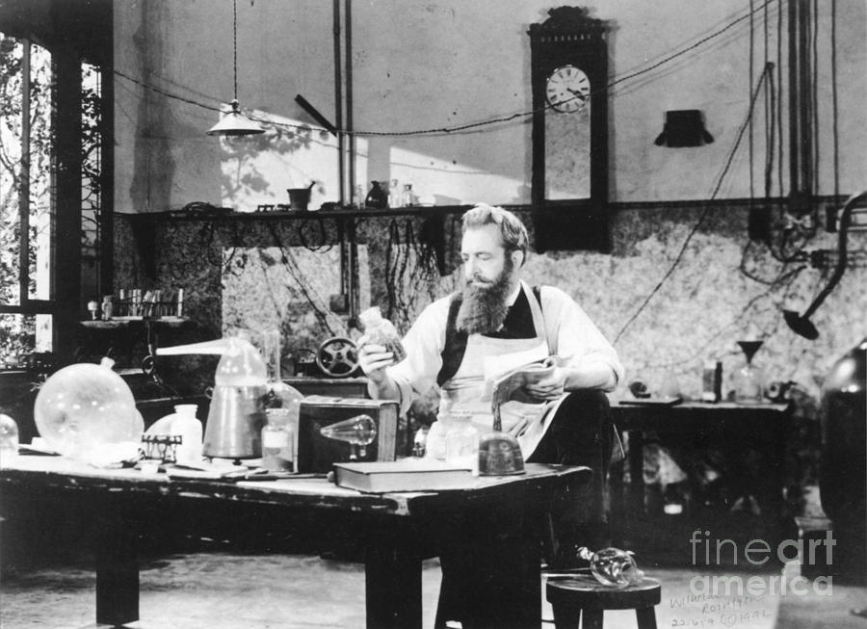
He met dr August Kundt. Roentgen took courses with him and he developed Roentgen’s potential as a theoretical scientist.

Slide 8
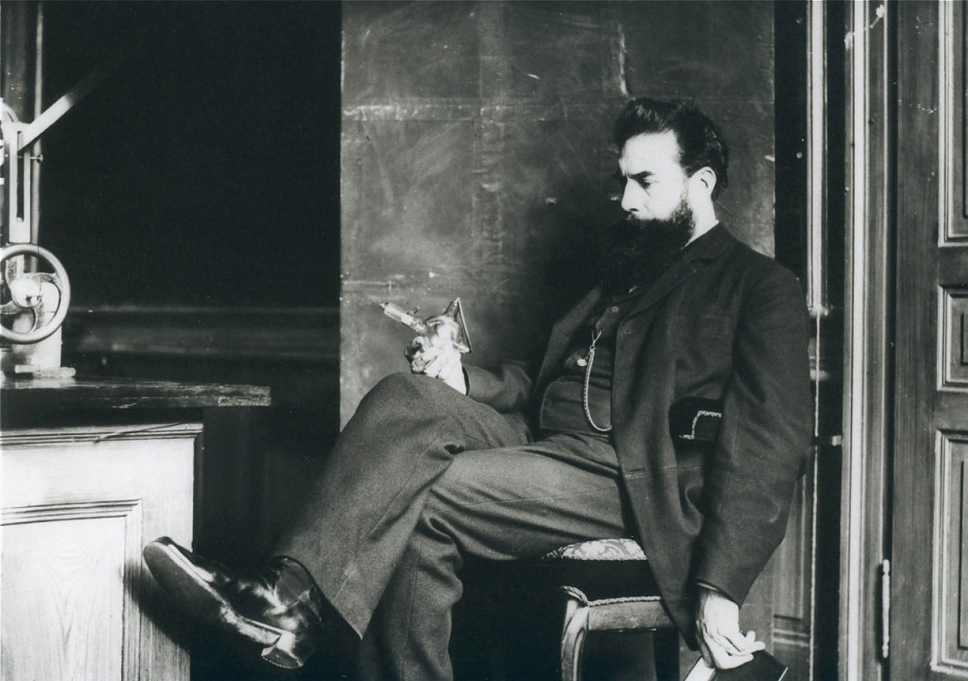
The golden period…
He returned to Wurzburg and was offered the position of profesor of Physics and director of the new Physical Institute at the University. He produced seventeen important papers-the most important of his life and he was elected as Rector.
Many scientists experimented with the properties of cathode rays and collecting results. Roentgen began with accumulating the best apparaturs.

Slide 9
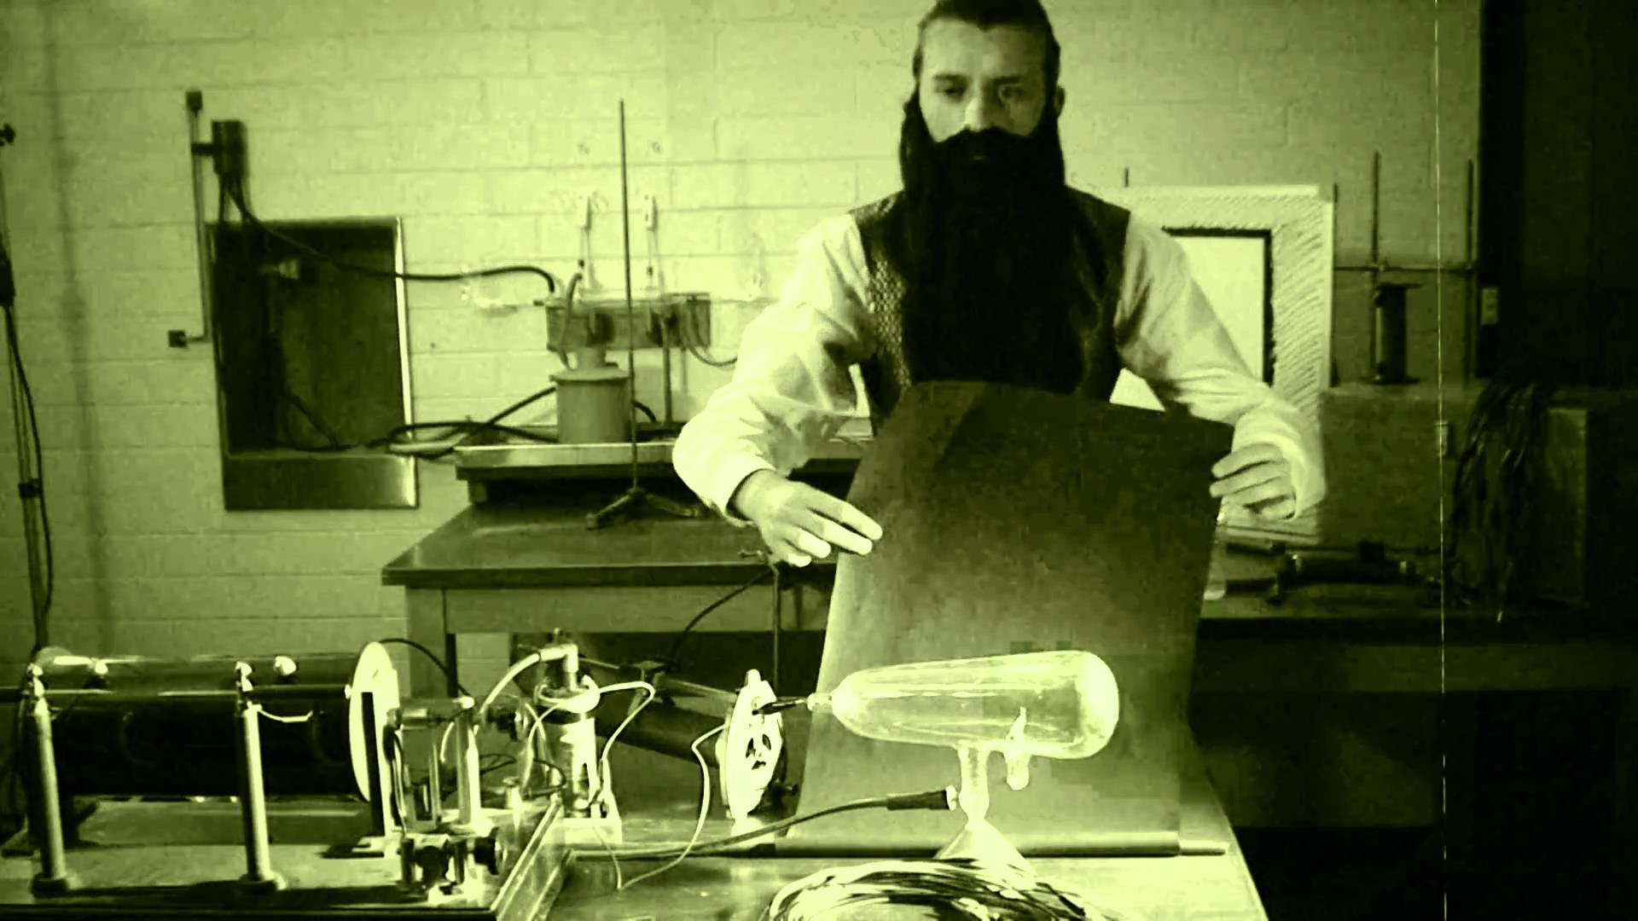
This bring us to the moment of Friday, 8 November 1895…
Roentgen was exploring the path of electrical rays passing from an induction coil through a partially evacuated glass tube. Although the tube was covered in black paper and the room was completely dark, he noticed that a screen covered in fluorescent material was illuminated by the rays. He later realised that a number of objects could be penetrated by these rays, and that the projected image of his own hand showed a contrast between the opaque bones and the translucent flesh. He later used a photographic plate instead of a screen, and an image was made. In this way an extraordinary discovery had been made: that the internal structures of the body could be made visible without the necessity of surgery.

Slide 10
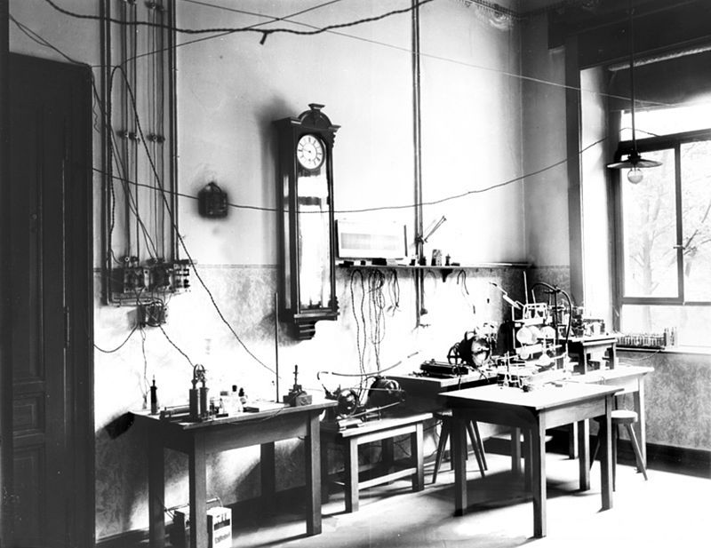
Röntgen speculated that a new kind of ray might be possible.
8 November was a Friday, so he took advantage of the weekend to repeat his experiments and make his first notes. In the following weeks he ate and slept in his laboratory as he investigated many properties of the new rays he temporarily termed "X-rays", using the mathematical designation ("X") for something unknown. The new rays brought fame his name and in many languages are reffered
as ,,Röntgen Rays”.
Röntgen Laboratory in Würzburg(1895–1900)

Slide 11
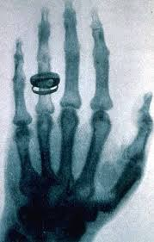
Nearly two weeks after his discovery, he made first picture using X-rays of his wife Anna Bertha's hand. When she saw her skeleton she said
,,I have seen my death!”.
It is an image of his wife's hand - you can see her wedding ring.

Slide 12
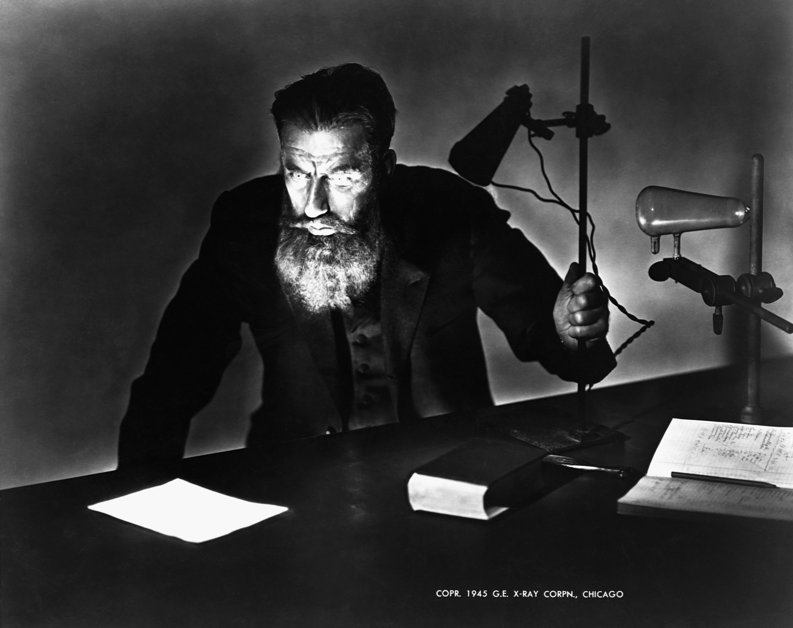
It was a mistake?
He determined to continue his experiments in secrecy, because he feared for his professional reputation if his observations were in error.
Röntgen's original paper ,,On A New Kind Of Rays“ was published on 28 December 1895. Röntgen was awarded an honorary Doctor of Medicine degree from the University of Würzburg after his discovery. He published a total of three papers on X-rays .
Today, Röntgen is considered the father of diagnostic radiology, the medical speciality which uses imaging to diagnose disease.

Slide 13
Notes:
Nie sądziłem, że zbadałem;)

Slide 14
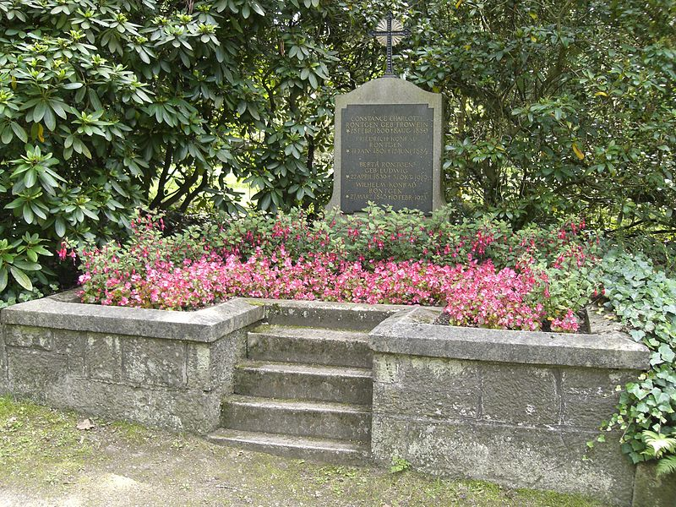
Honors and awards…
In 1901 Röntgen was awarded the first Nobel Prize in Physics. Röntgen donated the monetary reward from his Nobel Prize to his university.
He died on 10 February 1923.
This is grave of Wilhelm Röntgen.

Slide 15
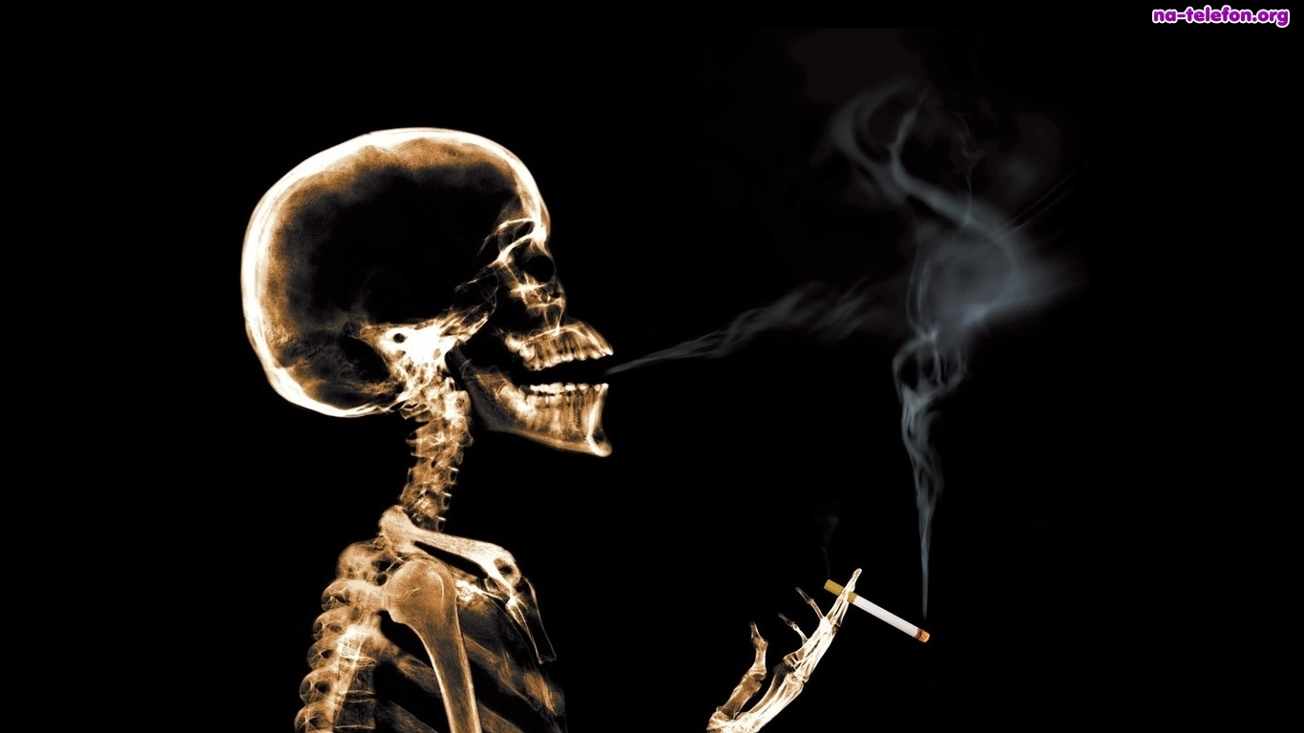
It was recognised that frequent exposure to
X-rays could be harmful, and today special measures are taken to protect the patient and doctors. By the early 1900s the damaging qualities
of X-rays were shown to be very powerful in fighting cancers and skin diseases.

Slide 16
Thank you for your atenttion
Aneta Dziura
Elektroradiology

