Slide 1

Uniwersytet Rzeszowski
Wydział Socjologiczno-Historyczny
Praca socjalna II, gr. IV
Monika Świder
A day in the life of
a care home (UK)
Rzeszów 2014/15

Slide 2
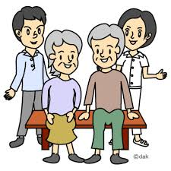


Issues for discussion:
Definition of a care home
Daily activities residents and care assistants
A short video about life in a care home

Slide 3
VOCABULARY
Care home- dom opieki
Late- stage dementia- późniejsze stadium demencji
Care assistant (carea)- opiekunka
Shift- zmiana (w pracy)
Ailments- dolegliwości
Pads- pampersy dla dorosłych
Feeding- karmienie
Hoist- dźwig, podnośnik
Zimmer frame/ walker- chodzik
Diabetic- osoba cierpiąca na cukrzycę

Slide 4

What the care home is?
This is a home for people who need continuous medical treatment or who are unable to look after themselves, especially people who are old or mentally ill.

Slide 5
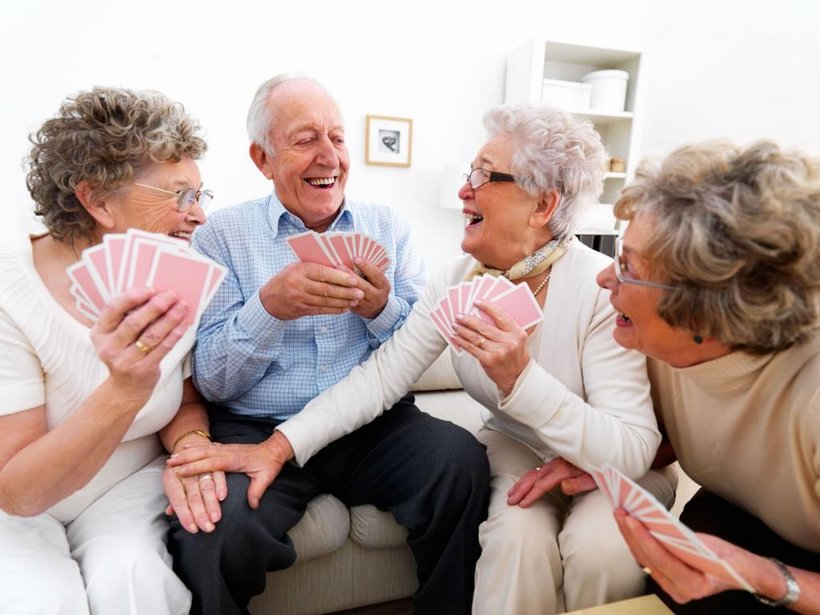
Daily activities in a care home

Slide 6
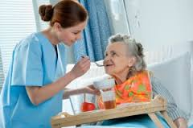
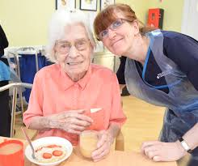

First thing in the morning
7.30 a. m. – START THE DAY
Joint meeting care assistants with the staff of the night shift
Serving breakfast
Assisting in feeding

Slide 7



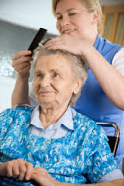
Mid morning
Assisting with changing night clothes, pads,
washing, dressing and getting ready for the day
Medications
Ralaxing
Care Assistants are cleaning the rooms,
changing bedclothes, serving tea and biscuits

Slide 8
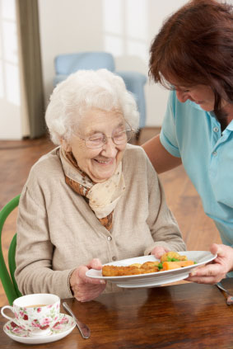

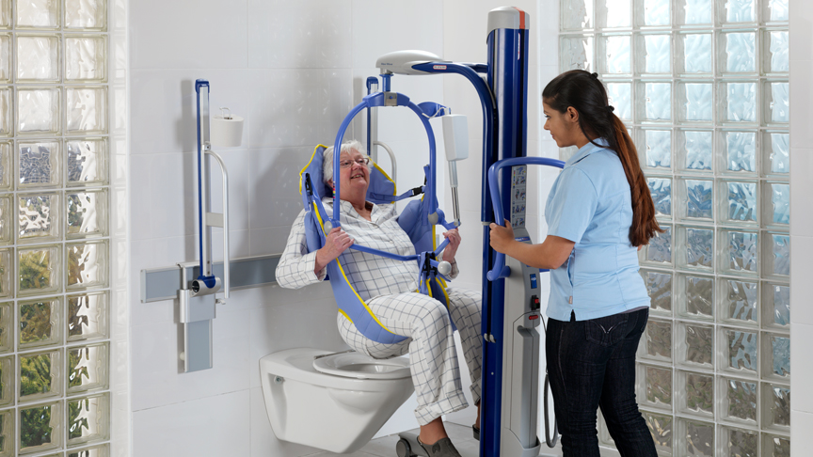
Lunch time
Assisting in toileting
1 p.m. – start the lunch
Every Friday- Fisch and Chips
Assisting in feeding

Slide 9
Afternoon
Residents:
Gymnastic
Music therapy
Art classes
Concerts
Care assistants:
doing the laudry
setting tables
changing bins
doing a menu

Slide 10
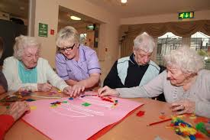
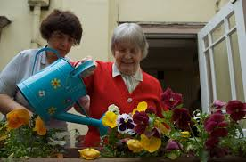
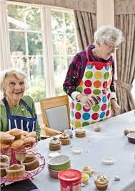
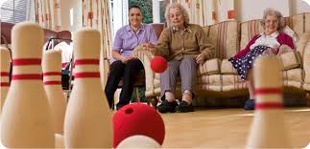

Slide 11
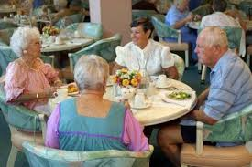
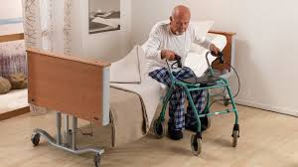
Supper
Assisting in toileting
6 p.m. – start the supper
Visits
Assisting with changing
clothes and going to beds

Slide 12

Care plan

Slide 13


What is more…
supervision- every month
own key worker
once in a week hairdresser
a few times in the year - PARTIES

Slide 14
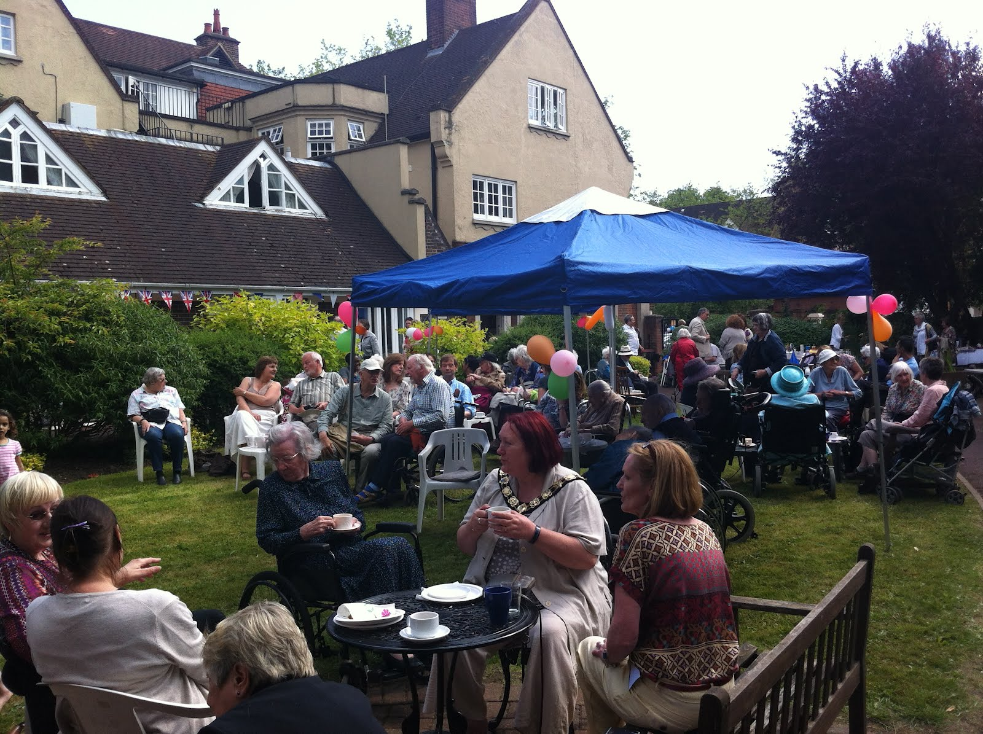
Garden party at Compton Lodge

Slide 15

A short film about life in a care home

Slide 16
Thank you very much! ☺☺☺

Slide 17
Bibliography
http://www.bbc.com/news/health-30919525
http://www.swiftaci.co.uk/apprentices/dayInTheLife
http://www.macmillandictionary.com/dictionary/british/care-home
https://www.youtube.com/watch?v=ZfSKGqaTEw8

