Slide 1
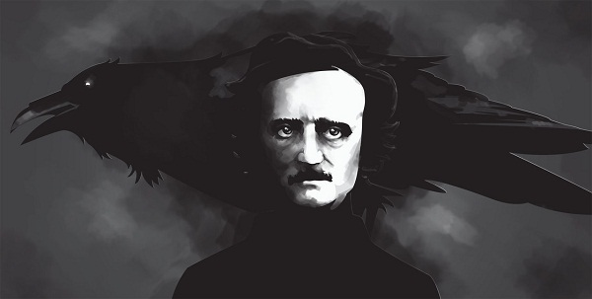
EDGAR ALLAN POE: MASTER OF MYSTERY

Slide 2
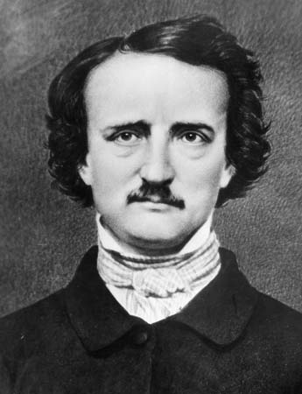
Edgar Allan Poe
American short-story writer, poet, critic, and editor
His tales of mystery and horror initiated the modern detective story
Born in Boston, Massachusetts
early orphaned
"Adopted" by the family of Scottish merchant - John Allan
strict education and discipline
gambling and financial problems
abandoned the study of ancient and modern languages on University of Virginia

Slide 3
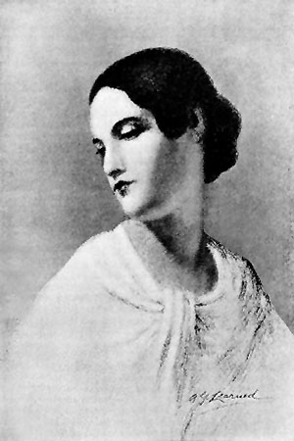
He started the military career in 1827, the same year he released his first book - a collection of poetry - Tamerlane and Other Poems
Poe married his younger cousin – Virginia
Dismiss from work and Virginia's weakening health, brought him to unstable state of mind and abusing alcohol
On October 3, 1849, Poe was found in Baltimore in great distress
He died four days later in hospital

Slide 4
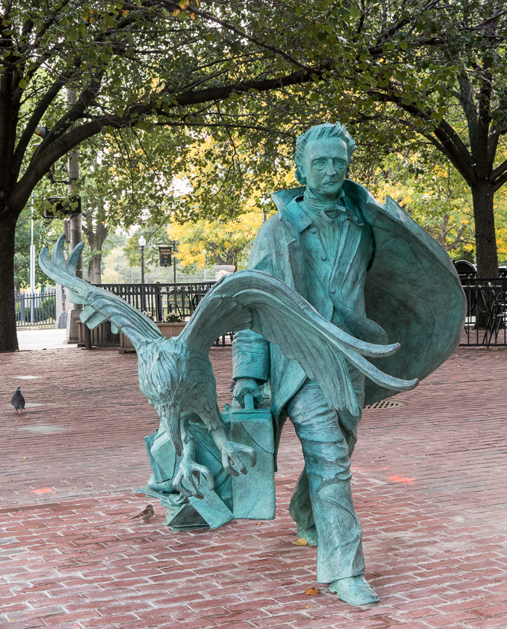
Mysterious death
congestion of the brain?
rabies?
alcoholism?
cholera?
suicide?
murder?
cooping (forced to vote)?

Slide 5
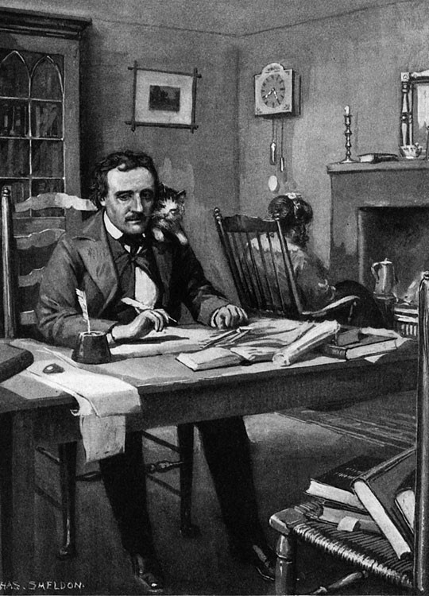
Style and themes
great role of Dark Romanticism
Poe's best known fiction works are Gothic
The terrible experiences of his early life lead him to believe that the world is covered by sin and insanity
weak mind, nightmares and abuse of alcohol lead to hallucinations - all of this has an influence of his works
Theme: death of a beautiful woman

Slide 6
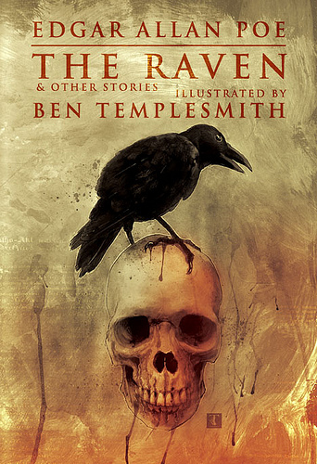
The Raven
Poem The Raven - brings him enormous fame and interest

Slide 7
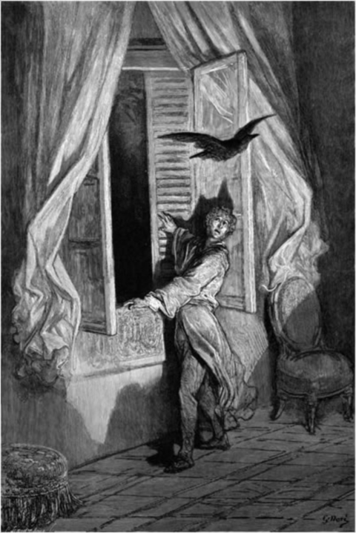
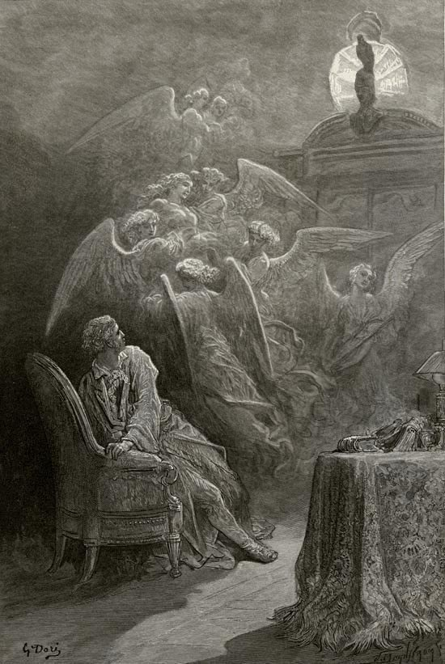

Slide 8
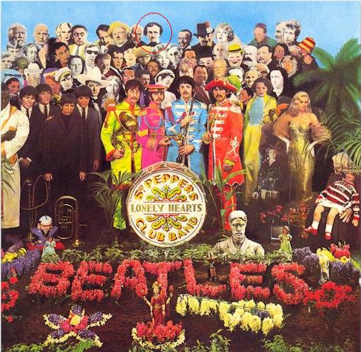
The Beatles - Sgt. Pepper's Lonely Hearts Club Band (Poe on the cover)

Slide 9
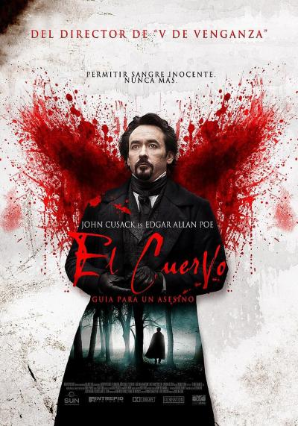
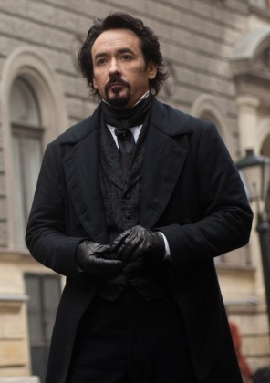
John Cusack as Edgar Allan Poe, "The Raven" (2012)

Slide 10
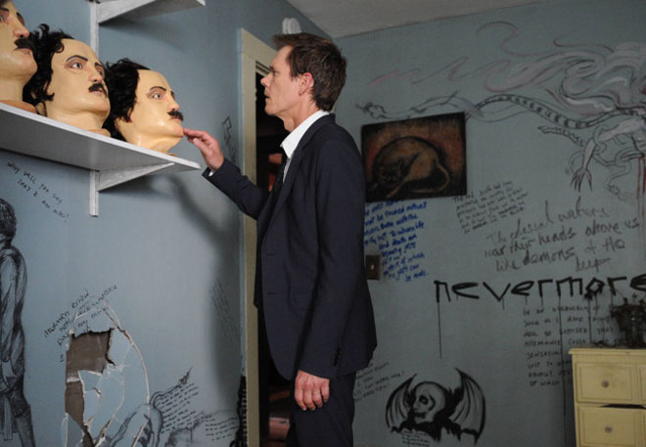
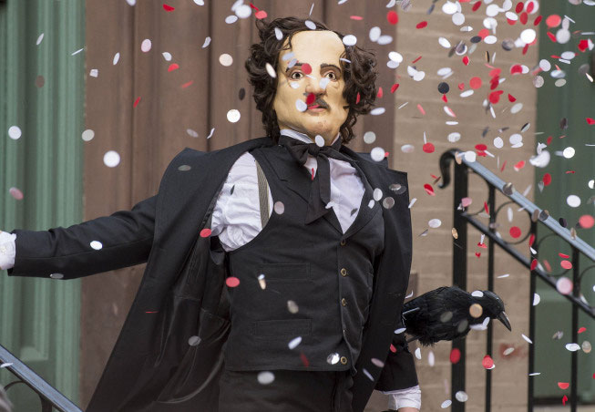
Kevin Bacon in TV series - "The Following"

Slide 11
www.poemuseum.org
Edgar Allan Poe Museum – Poe’s life, legacy and Works

